Slide 1
Student Advocacy & Accountability
Jonathan Sanders, Ph.D.
Tracy Blanchard, MHS-L.P.C.
Chelsie Bickel, M.Ed.

Slide 2
Code of Student Conduct
New Code of Student Conduct as of August 1st
Amnesty Policy
Updated Hazing and Coercive Behavior Policy
Student Organization Conduct
Know the Code Campaign!

Slide 3
SAA Caseload for 2017-2018 Total 2,238
Notes:
Total Cases (n=1,797)

Slide 4
Historical Graph

Slide 5
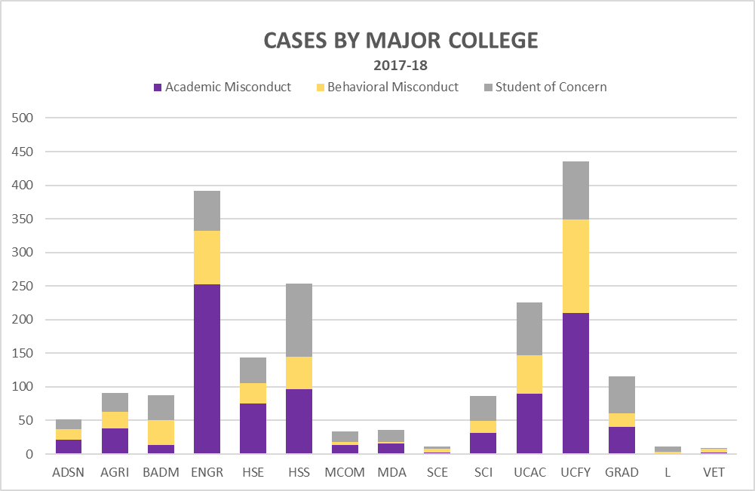
Cases by Major College

Slide 6
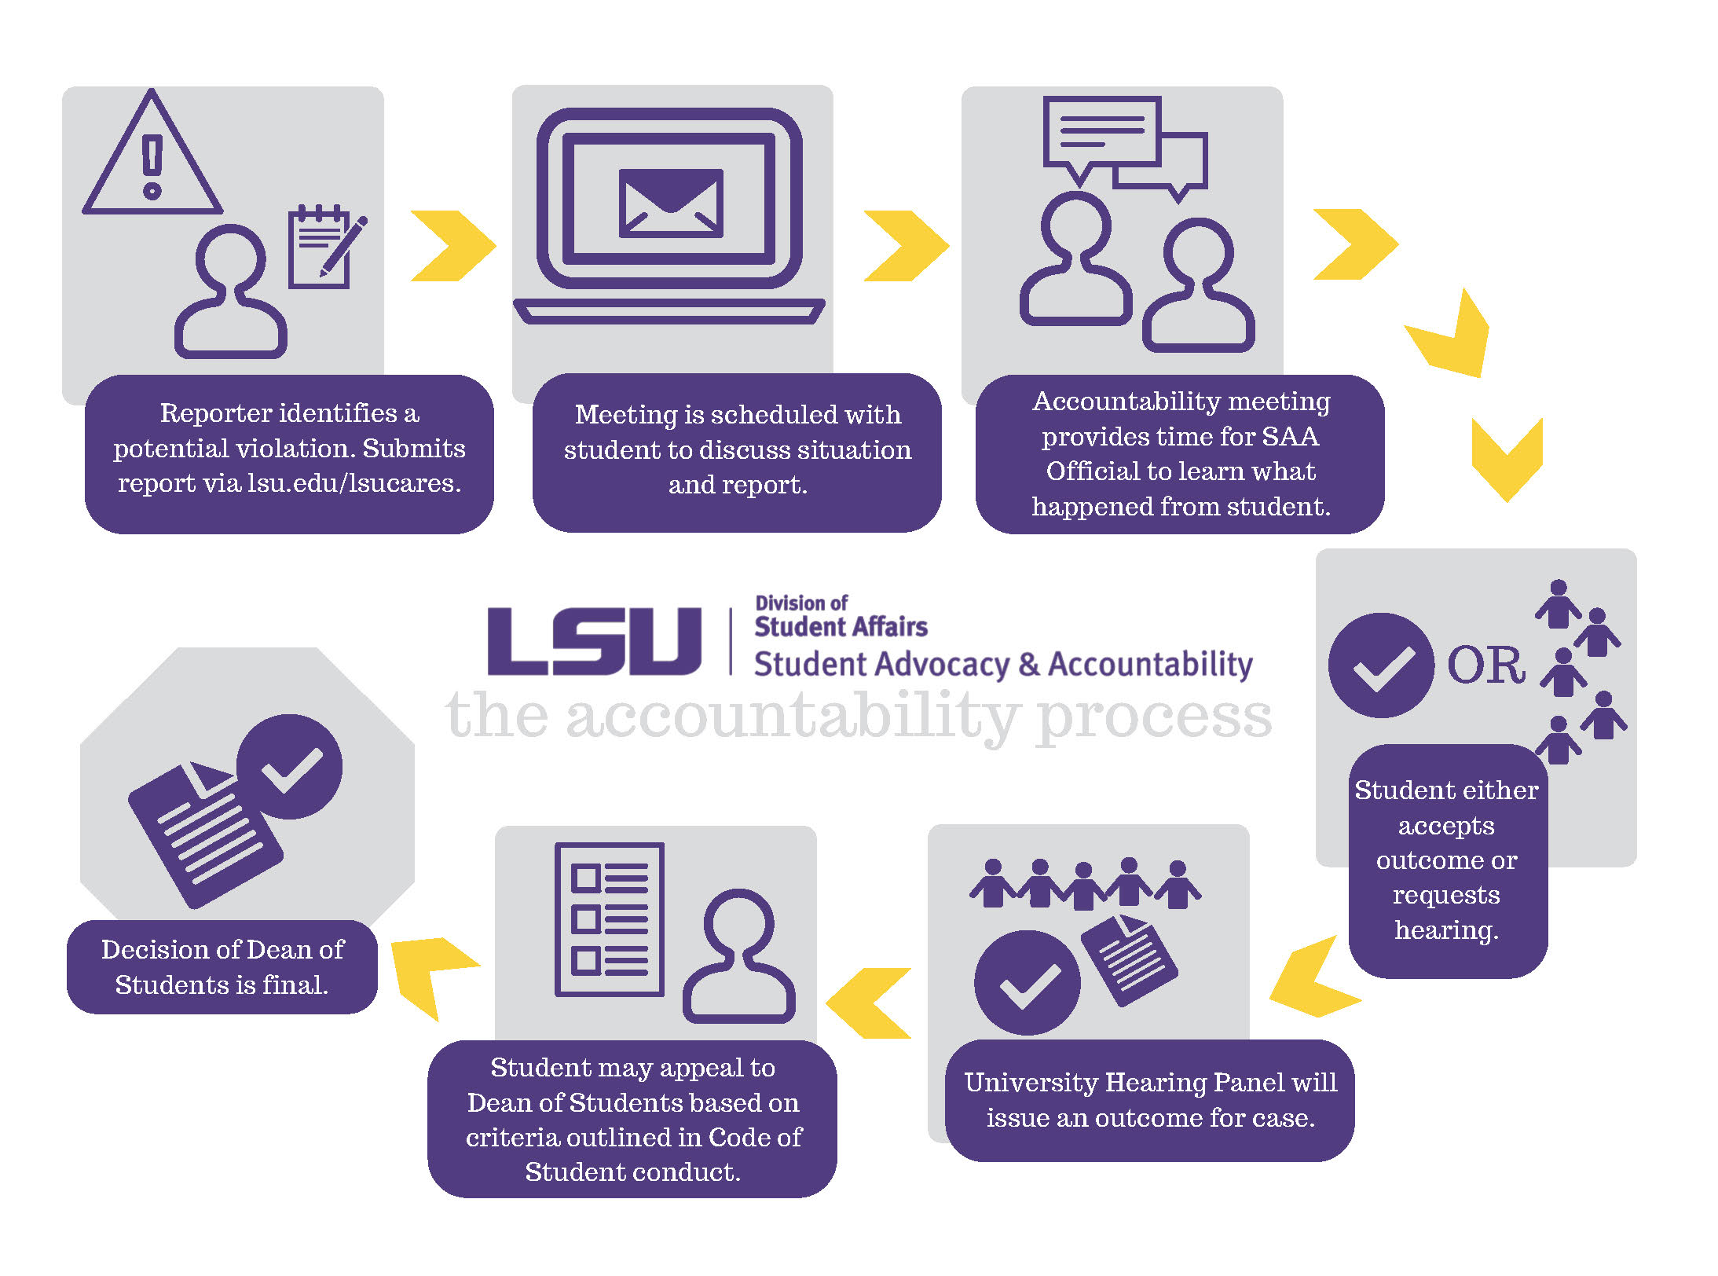
Accountability Process

Slide 7
Accountability Status

Slide 8
Top Academic Charges

Slide 9
Accountability Outcomes
Typical Outcomes for Undergraduate Students:
1st violation: Disciplinary Probation for a minimum of two semesters (including transcript notation);
Zero on the work in question;
Educational activity: Academic Misconduct Moodle module, Plagiarism Moodle module, Assignment resubmission for no credit, Letter of Apology, Ethics & Decision-Making class, etc.
Typical Outcomes for Graduate Students:
1st violation: Deferred Suspension for a minimum of two semesters (including transcript notation); Zero on the work in question and lower the overall grade by one letter OR Fail the course.
*Student records are kept for 7 Years, unless a student was suspended or expelled.

Slide 10
LSU Trends
GroupMe
Quizlet
Old-fashioned exam cheating
Paper mills/ Ghost Writing
Online tutoring or “chat” features
Plagiarism by word switching
Passing down material

Slide 11
Integrity Tool Kit

Slide 12
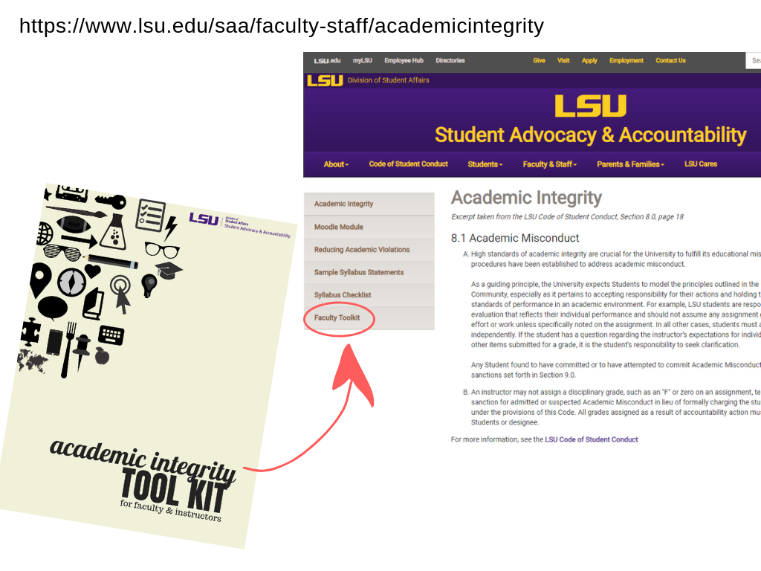
Where to find the tool kit

Slide 13
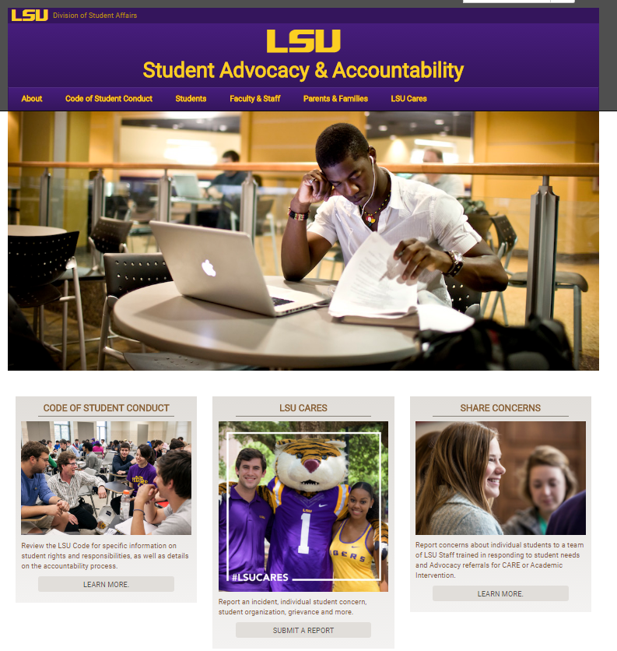
SAA Website
Resources

Slide 14
LSU Cares
LSU Cares is a university initiative dedicated to the well-being of students and promotion of a community that cares about each of its members.
LSU offers an online reporting system to help students, faculty, staff, families, and friends submit reports about:
LSU Code Of Student Conduct;
Sexual Misconduct And Hazing;
Bias Or Discrimination;
Complaints Or Grievances; And
Concerns About Students In Crisis Or Distress.

Slide 15
Common Situations for Student of Concern Reports:
Sexual trauma
Suicidal Risk
Food Insecurity
Homelessness
Pregnancy/Miscarriage
Medical/Psychiatric Illness
Relationship Breakup
Loss of Family Member
Natural Disaster
Emerging Mental Disorder
Disordered Eating
Domestic Violence
Health Insurance
Financial Stressors
Student Death
Identified Patterned Behaviors

Slide 16
Top Care Concerns

Slide 17
Red Folder

Slide 18
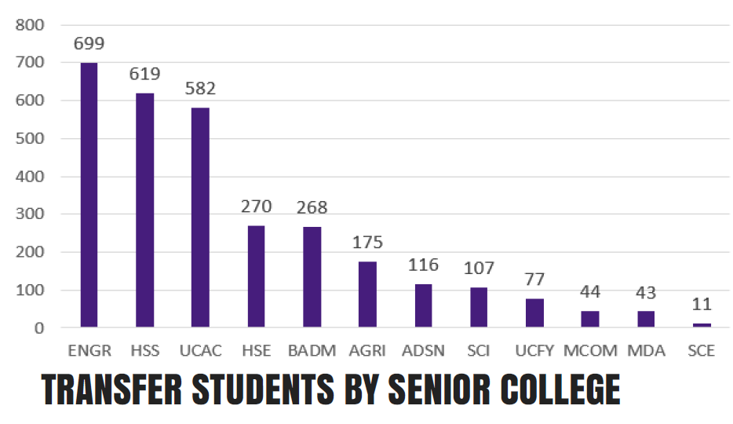
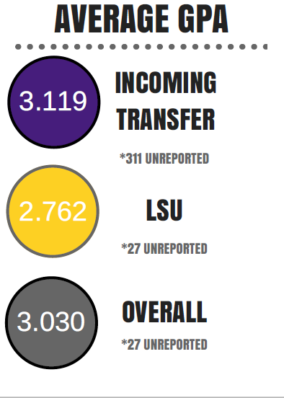
Transfer Student Programs

Slide 19
We Need You!
Faculty Involvement & Partnership
Making Reports- Eyes and ears of campus
University Hearing Panel- Need additional faculty panelist. Email Chelsie Bickel at cbickel1@lsu.edu
Accountability Advisors Program- Email Eddie St-Vil at estvil@lsu.edu
Committees/Think Tanks- Red Folder Feedback

Slide 20
We Are Here To Support You!
Student Advocacy & Accountability
Suite 340
LSU Student Union
225-578-4307
www.lsu.edu/saa

