Slide 1
Understanding Retirement

Slide 2
Agenda
Retirement – Belinda Doyle
Supplemental Retirement- Todd Langlois
Deferred Compensation - Connie Stevens
Dept. of Finance - Donald Chance

Slide 3
Are you ready for Retirement?
TRSL, ORP, and Social Security
Belinda Doyle

Slide 4
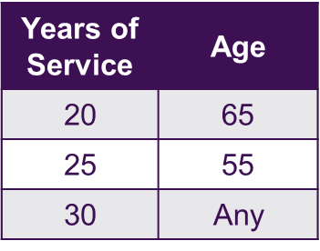
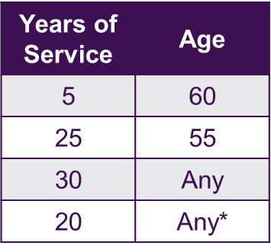
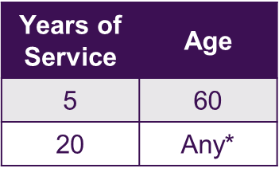
Retirement Eligibility (TRSL)
Before July 1, 1999
Between July 1, 1999 and Dec. 31, 2010
On, or after Jan. 1, 2011
*actuarially reduced benefit
*actuarially reduced benefit

Slide 5
Retirement Eligibility (ORP)

Slide 6
Your Retirement (TRSL)
Service – Stop working and start receiving your lifetime monthly retirement benefit.
DROP – Freeze your retirement benefit and continue working for up to 36 months, while building your retirement nest egg. You can retire at the end of your DROP participation, or continue working. (DROP funds available at retirement)
ILSB – Retiree and receive a lump-sum payment of up to 36 times your monthly maximum retirement benefit, but your lifetime monthly retirement benefit is actuarially reduced (Cost per $1,000).

Slide 7
Your Retirement (ORP)
Payment Options for ORP Balances:
A lifetime income
Trustee-to-trustee, single lump-sum cash rollover between qualified plans
IRA
Death benefits
At retirement, a one-time, lump-sum payment of up to 36 months of your annuity in addition to a lifetime annuity payment. If the up-front lump sum is chosen, lifetime benefits would be reduced accordingly.

Slide 8
Social Security Benefits
LA does not pay into Social Security. However, you may still be eligible for Social Security benefits through other employment or through your spouse’s employment.
The type of Social Security benefit you are eligible for determines which offset provision applies to you.
Your state pension is not reduced by your Social Security benefits.
Government Pension Offset (GPO) – reduces Social Security benefits by 2/3; law requires that spouse or widowers benefit is offset dollar for dollar by the amount of his/her own benefit.
Windfall Elimination Provision (WEP) – reduces your own Social Security benefit if you receive a pension; a modified formula is used to compute your Social Security benefit; your Social Security benefit is not eliminated

Slide 9
Questions to Ask Social Security
At what age can I receive my full Social Security benefit, and how much will it be?
What is the earliest age I can receive Social Security benefits, and will this amount be reduced?
Are there earnings limits if I collect Social Security while I am still working and paying into TRSL?
Do I qualify for an exception to GPO or WEP?
If GPO or WEP does apply to me, how much will my Social Security benefit be?
Call 1-800-772-1213 to schedule an appointment to visit your nearest Social Security Office located on Bankers Avenue

Slide 10
TRSL Participants (Retirement Eligible)
Workday Census
TRSL Census

Slide 11
Supplemental Retirement
What are your options?

Slide 12
403(b) Retirement
Assets $ 590 Million
Previous Average Fee = 0.93%
Previous Vendors:
Fidelity, MetLife, TIAA, Voya, VALIC

Slide 13
Challenges
Too many fund options
Many vendors
Understanding Fees (High/Low)
Difficult to make a selection

Slide 14
403(b) Plan Improvements
Improved, simplified investment lineup
Vendors reduced to Fidelity, TIAA, and VALIC
Increased education
Reduced fees

Slide 15
Savings Example
An employee contributes $500 per month for 30 years ($180,000 total)

Slide 16
LSU Supplemental Retirement
403(b) and 457(b) plans available
Paycheck Contributions
Before-tax
After-tax (Roth)
Start/change contributions at any time of the year online

Slide 17
LSU Supplemental Retirement
Contribution Limits for 2019
Under age 50: $19,000
50 and over: $25,000
Limits are independent of each other

Slide 18
LSU Supplemental Retirement Participation
403(b)
8% of eligible employees have a current paycheck contribution
Less than 500 employees under age 40 have a 403(b)

Slide 19
Retirement Survey – Personal Finances
Getting Help
Investing
54% I want to make my own decisions, but want someone to validate that decision
32% I want specific advice (I want to be told what to do)
15% I don’t need anyone’s help
53% Of employees are comfortable selecting investments that are right for them
53% Of employees have reviewed their investment portfolio within the last 12 months

Slide 20
Retirement Survey – Financial Support
Adult Children
Parents or In-Laws
42% of employees who have children over 21 provide financial support to their adult children
23% of employees are providing financial support for parents or in-laws

Slide 21
Retirement Survey – Financial Stress
Nearly half (47%) of employees report that they are stressed dealing with their financial situation, and 41% say their stress level related to financial situation has increased over the last 12 months.
Financial matters was the top choice for stress across all generations:
Millennials – 42%
Generation X – 46%
Baby Boomers – 28%

Slide 22
Retirement Survey – Retirement Confidence
47% of employees are confident they’ll be able to retire when they want
More than one in four (26%) of all employees has already withdrawn money held in retirement plans to pay for expenses other than retirement and 42% think its likely they’ll need to use money held in retirement plans for expenses other than retirement.

Slide 23
Retirement Survey – Retirement Savings
43% of Baby Boomers say they have $100,000 or less saved for retirement*
*Based on basic retirement planning guidelines, $100,000 of savings provides just $4,000 per year over 30 years of retirement

