Slide 1
Electronic Research Administration @ LSU
Stephen David Beck Office of Research & Economic Development
Robin Ethridge Information Technology Services

Slide 2
What is Electronic Research Administration?
“Electronic Research Administration (eRA) provides critical IT systems support to manage the receipt, processing, review, award, and monitoring of research and non-research grants at an institution or agency.”
National Institutes of Health (era.nih.gov)

Slide 3
eRA at LSU
Sponsored Programs System (SPS) has been used at LSU since 2003 to manage the Pre-Award process for developing, authoring and review of external grant applications. SPS was built for the campus mainframe and continuously developed to address the campus needs as they evolved.
InfoReady Review is a commercial product used to manage our internal grant applications, limited submission competitions and other approval workflows for the Office of Research & Economic Development

Slide 4
eRA at LSU
SPS only processes Pre-Award information and documentation. It does not handle:
Post-Award processing and reporting
Conflicts of Interest reporting and management
Research Compliance reviews and management

Slide 5
Why Replace SPS
SPS only runs on the campus mainframe
Mainframe will be decommissioned
There are now many vendors of eRA software
ITS prefers to work with vendor solutions

Slide 6
Need for a new eRA
Integrated services for grant preparation and approvals
Comprehensive on-demand reporting for Deans, Chairs, Faculty and Administration
Modernize internal review processes for research compliance
Shared resource for research for all LSU entities

Slide 7
Finding a new eRA for LSU
LSU
OSP
ORED
ITS
Faculty
AgCenter
PBRC
SPA
OSP
OSP
Fall 2016
Ad Hoc Committee
Members from LSU, Ag and PBRC
Notes:
In Fall 2016, an ad hoc committee was established to identify our eRA needs, and begin a procurement process for a new eRA platform.
Review Committee also included representation from college grants administrators and OSP/SPA staff.

Slide 8
Criteria for eRA
Intuitive User Interface
Easy to use
Enterprise Grade
SaaS
Multi-campus support
Extensive user base
Easy to configure
Easy to manage
Solid Performance
Continuous development
Established company
Best of class application

Slide 9
Finding a new eRA for LSU
Committee Established
Fall 2016
RFP
Summer 2017
Fall 2017
Procurement
Spring 2017
Vendor Presentations
Product Selection
Spring 2018
Summer 2018
Contract Negotiation
Implementation Begins
Fall 2018

Slide 10
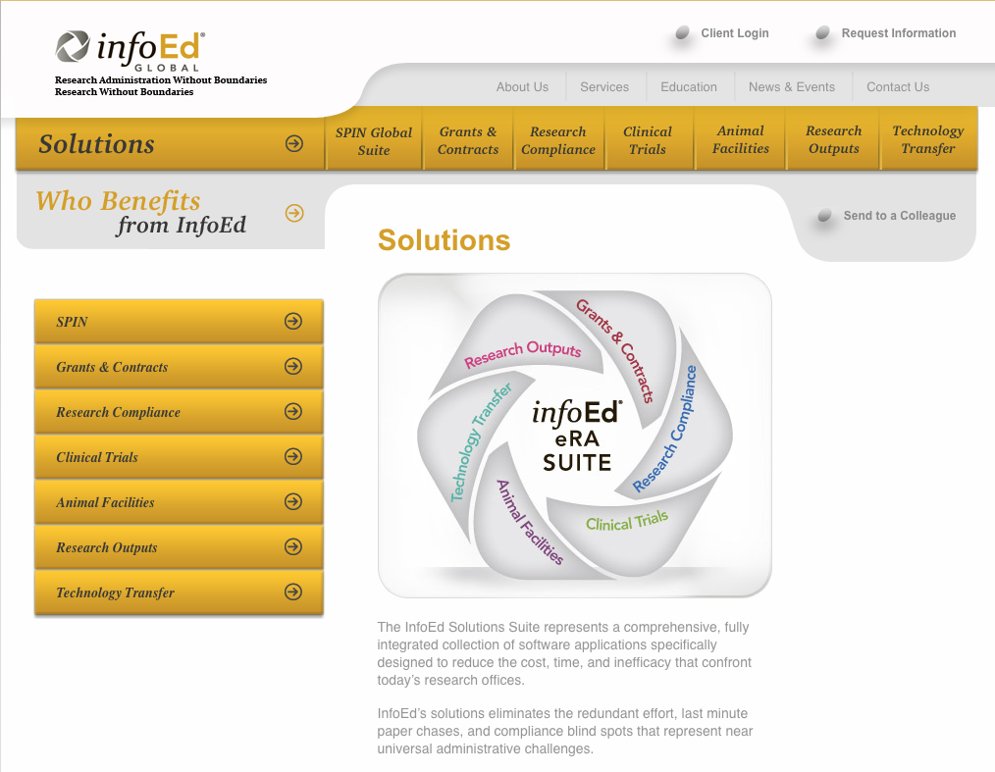
Introducing InfoEd Global

Slide 11
Introducing InfoEd Global
InfoEd Global focuses 100% of their business on research administration
25 years of providing eRA solutions
Clients include ~ 400 university, hospital, and government agencies world-wide
Best-of-class product
Makers of SPIN grants database

Slide 12
Who uses InfoEd Global?

Slide 13
Strengths of InfoEd Global
Software as a service (SaaS)
Fully integrated product
Integrations with
HR/Accounting (Workday)
Faculty 360 (Digital Measures)
Sponsor to sponsor submissions (S2S) for federal grants
Supports the whole grant life cycle
Provides comprehensive reporting

Slide 14
Benefits for Faculty
Faster proposal development
Automatic HR data
S2S for federal grant opportunities
Automatic Current & Pending
Automatic calculations of F&A, benefits, tuition remission
Advanced approvals and routing
Integrated Conflict of Interest Management
Financial Conflicts of Interest Declarations
PM-11 Management
Modern system for IRB/IACUC approvals
Integration with Faculty 360

Slide 15
Benefits for Academic Administrators
Advanced Approvals and Routing
Automated distribution of F&A and project credit
On-demand Reporting
Pre-built AND Custom Queries
Integration with Faculty Annual Reports

Slide 16
Benefits for Research Administration
Single location for tracking all details related to proposals
S2S submissions via Grants.gov
Award and award modification documents are stored in system
Reduction in duplicate data entry
Expanded reporting

Slide 17
Benefits for IT Administration
Enterprise solution for multiple campuses
Continuous updates to comply with agency and sponsor requirements maintained by vendor
Configuration (vs customization) allows non-technical administration
Easy-to-use interface and embedded help
Real-time, shareable self-service reporting within application interface
Role-based granular access control (record-, screen-, and field-level)

Slide 18
Benefits for IT Administration
Secure physical platform (regulatory and internal policy compliance)
User interface supports assistive software and usability standards
Single-sign-on with LSU credentialing methods
Built-in module integration
Utilizes generally accepted external interface methods
Complies with technical architectural direction
Easier integration with Workday and other vended solutions
Allows use of modern integration methods and tools

Slide 19
InfoEd is part of the TAIL Program
Transforming and Architecting the Information Landscape
A technology modernization initiative. Others include:
Student Information System Modernization Program (Geaux Forward)
Hybrid-Cloud Infrastructure Program
Includes projects intended to modernize enterprise information architecture, applications, and IT tools
Ratified by IT governance
Supported by central IT

Slide 20
eRA Project Modules
Human Subjects
Animal Subjects
Conflicts of Interest
Sponsored Programs

Slide 21
Implementation Process
Business Process Assessment & Mapping
On-site Prototype Demo & Training **
Process Revision & Iteration
Project Team Review
User Acceptance Testing & Training **
**
Involves both project team and end user constituents
Data Migration

Slide 22
Training and Support
Embedded User Help
Online Training
Workshops
Campus User Groups
Configurable/custom embedded user guides
Develop online training resources
Workshops for
Faculty, staff, graduate students
Colleges, Departments
Establish Campus User Groups
Administrators of Sponsored Programs
Faculty Researchers
eRA Ambassadors

Slide 23
Deployment Schedule
Process Begins
Aug 2018
March 2019
Conflict of Interest Module
Sponsored Programs Module
May 2019
Human Subjects Module
Nov 2019
May 2020
Animal Subjects Module
July 2019 (FY 2020)
Transition from SPS to InfoEd Global

Slide 24
Name The eRA Contest
We use several products to help support research, including InfoEd Global, InfoReady Review, and InfoReady Marketplace. We need a single name or acronym to encompass it all.
We need your help! Create the eRA brand!

Slide 25
Name The eRA Contest
Create the eRA’s brand identity! Now soliciting ideas. All submissions will be reviewed by the project team, and the winning name will be selected by the VPR.
Submit by December 1, 2018
www.lsu.edu/research/era

Slide 26
Contact
Stephen David Beck
Associate Vice President
Office of Research & Economic Development
sdbeck@lsu.edu
Robin Ethridge
Director, Business Intelligence & Legacy Support Information Technology Services
robyn@lsu.edu

