Slide 1
Louisiana Public Employees Deferred Compensation Plan
State of Louisiana Public Employees DCP

Slide 2
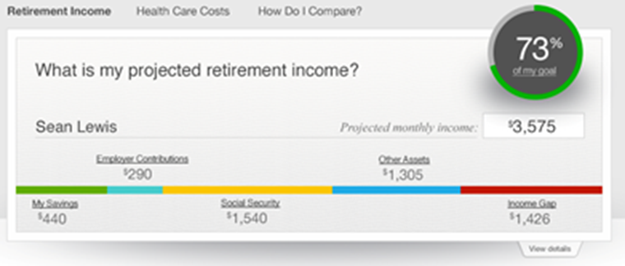
A Homepage that provides a clear view of projected income in retirement
Focused on income replacement
Suggested next step to increase savings
Proactive, personalized next step messaging
Investment guidance and advice with a link to managed account provider
Full integration of multiple retirement plans

Slide 3
Empower – income view - participant age 45

Slide 4
Enhanced “next step” multiple ways to increase contributions
Model scenarios using sliders
Save more
Maximize match
Take me to the IRS limit
Auto-Increase

Slide 5
Consistent experience across all interactions
Fully mobile enabled digital experience
E-Delivery of participant communications and notices

Slide 6
Employee communication trends
Preferred delivery method continues to be electronic
Email is #1.
If content is relevant, employees want more regular contact.
Messages to personal email are preferred.

Slide 7
Retirement education
Components
Group sessions
1x1 meetings
Digital presentations
Benefits fairs
Spanish presentations and representatives
Sample topics
Getting started
Financial wellness
Millennial seminar
Investing on your terms
An apple a day: healthcare
Women and investing

Slide 8
Reinventing Retirement Knowledge Is Retirement Power
Louisiana Deferred Compensation

Slide 9
What's keeping you from saving?
“I can't afford to contribute.”
“Retirement is too far off to worry about right now.”
“I'm already taking care of my retirement needs by participating in another savings plan (such as an IRA or bank savings account).”

Slide 10
Pay yourself first
The cost of waiting one year

Slide 11
Saving a little more can mean a lot
Increasing your contributions by just $25 a paycheck can make a big difference. This chart illustrates contribution amounts in $25 increments and how they accumulate over time.

Slide 12
Budgeting: Helping You Reach Your Goals, Helping You Achieve Your Dreams
Louisiana Deferred Compensation Plan

Slide 13
What is a budget?
It helps to ensure that the money spent doesn’t exceed money earned
Your budget is a plan
A savings plan
A retirement plan
An investment plan
A spending plan
It’s more than just “cutting up the pie”
Increase predictability
Maximize your financial worth
Manage surprises when they happen
Improve your standing with lenders

Slide 14
Evaluate your income
Wages/salary
Income from self-employment
Interest and dividends
Alimony or child support

Slide 15
Expenses
Fixed expenses are expenses set in stone
For example:
Taxes
Housing
Insurance
Automobiles
Child care
Variable expenses are expenses that change
For example:
Food
Clothing
Furniture, appliances
Gas, oil
Entertainment
Medical care

