Slide 1
Why Cost is so Important:
A Case Study of a Hypothetical LSU Employee
Donald Chance

Slide 2
Hypothetical LSU Employee – Case Study
Veronica Moeller is a 55-year old LSU employee. She is divorced and completely self-supporting.
She has a 403(b) account through LSU that has a balance of $300,000 (rounded). This is under the pre-September 2018 plan.
She is in the state pension system but figures that the income from her pension will be just enough to live. Her 403(b) is supposed to make the difference in getting by and living comfortably.
She hopes to retire in 10 years.

Slide 3
Hypothetical LSU Employee – Case Study
Veronica’ adult daughter, Leigh Ann, a recent LSU graduate with an MS in finance, decides to ask her about her retirement savings.
Leigh Ann: Mom, how much are you paying for your 403(b) account?
Veronica: I don’t really know, but I don’t think it’s very much. I never see any bills or anything.
Leigh Ann : Let me take a look at your statement.

Slide 4
Hypothetical LSU Employee – Case Study
After reviewing the statement, Leigh Ann estimates that Veronica is paying 0.2% for admin fees, and the weighted expense ratio of her mutual funds is 0.8% for a total of 1% (rounded).
Leigh Ann : Mom, you’re paying 1%.
Veronica: That’s not much. Last year I got a 1% raise, and I can’t even feel it.

Slide 5
Hypothetical LSU Employee – Case Study
Leigh Ann : Yeah, I’ve heard that story too. Remember my ex-boyfriend Jason? He told me he once went to Cancun with some friends. He was drinking a lot and in a generous mood, like buying drinks for everyone in the bar. Then he woke up the following day having maxed out his credit cards. He had no recollection, though he did have a headache.
Veronica: Well, I hope that friend wasn’t really you.

Slide 6
Hypothetical LSU Employee – Case Study
Leigh Ann : No, it wasn’t but it might as well have been you, mom. You’re spending three grand a year and you have no idea that you’re doing it. On top of that I’m pretty sure you don’t know what you’re getting for your money. What do you think you’re getting?
Veronica: Well, they have an 800 number I’ve called a few times, like right after the divorce. I get a statement every quarter, and my money has gone up. I’m shocked I have this much money. How can I complain?

Slide 7
Hypothetical LSU Employee – Case Study
Leigh Ann: And how much of that increase in your money has come from your additional contributions, the fact that the market has gone up, and backing that out, has there been any performance you can attribute to the manager of the mutual fund?
Veronica: I have no idea. I don’t even understand what you’re talking about. That’s why I pay them the money.
Leigh Ann : That’s what I thought, mom. I’m pretty sure they’ve never answered those questions for you. And to be honest, you really don’t have that much money.

Slide 8
Hypothetical LSU Employee – Case Study
Veronica: Well, thanks for cheering me up, young lady.
Leigh Ann: Don’t worry, mom. There’s plenty you can still do to cut your costs and get better control of your money.
Veronica: Do you think I need a financial advisor?
Leigh Ann: What, and give him another 1% of your money?
Veronica: What should I do?

Slide 9
Hypothetical LSU Employee – Case Study
Leigh Ann: For now, I’ll be your financial advisor. If you didn’t have me, however, I would advise you to invest in low cost index mutual funds. That’s what Warren Buffett says you should do. And I’m betting Jimmy Buffett would agree. I know how much you like him.
Veronica: Thanks, Leigh Ann. Tell you what, I’m taking you to Margaritaville in Biloxi, this weekend.

Slide 10
Why are People Fooled by Investment Management Costs?
The 1% illusion
To the average person, a number like 1% is insignificant.
So let’s say, every Sunday, you go to the convenience store and buy a newspaper for $2.00. The newspaper announces a 1% price increase. Your paper now costs $2.02. Outside of having to scrounge around for two pennies, you consider this insignificant.
Employees who get 1% raises feel insulted.

Slide 11
You can fool some of the people all of the time
In 1997, Mark Carhart (Southern Cal) published a study in The Journal of Finance that showed that the single most distinguishing factor in predicting mutual fund performance is the cost.
And even if an investor is aware of the cost, Brad Barber (UC Davis), Terrance Odean (UC Berkeley), and Lu Zhang (Michigan) in a study published in The Journal of Business in 2005 find that 84% of investors believe that the more expensive the fund, the better the performance. This is simply not true. In fact, it is the opposite.

Slide 12
Overwhelming Choices = Bad Choices
The industry presents so many investment opportunities, in fact too many, that even an experienced financial advisor, has a hard time making the optimal decision.
  There is a psychological theory that says that the more choices you give a person, the more likely he’ll make a choice he’ll regret. (Barry Schwartz, The Paradox of Choice: Why More is Less”, 2004 and Sheena Iyengar, The Art of Choosing, 2011).
  Unfortunately in the investment management industry, the customer is likely to make the wrong choice but be too unaware to regret it.

Slide 13


The Salad Bar Effect
Retail investment decisions are like a salad bar, except:
  A salad bar has full transparency
  Investment decisions have virtually no transparency
  Fortunately under the new LSU 403(b) plan, you have full transparency and a limited number of efficient, low-cost choices. Enjoy your salad.

Slide 14
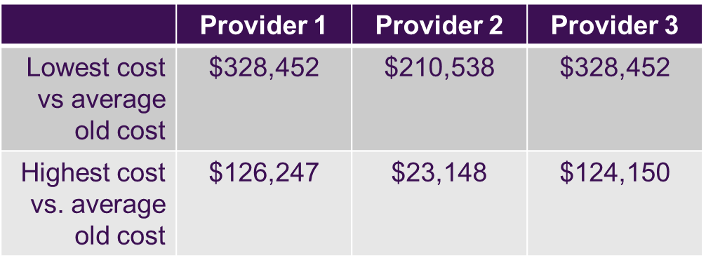
Potential Savings from New LSU Plan
Assume a $5,000 initial annual deposit, 2% increase in savings per year.
The additional money you would accumulate after 35 years, assuming same returns as S&P 500 over last 35 years:

Slide 15
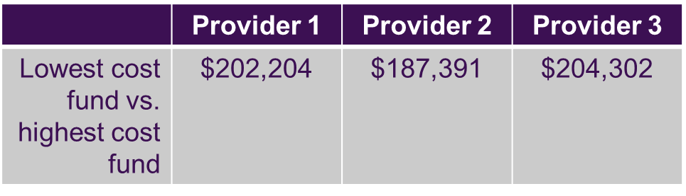
Potential Savings from New Plan
Lowest vs. highest cost savings by provider

Slide 16

Potential Savings From New Plan
Lowest cost fund of lowest cost provider vs. highest cost fund of highest cost provider

Slide 17
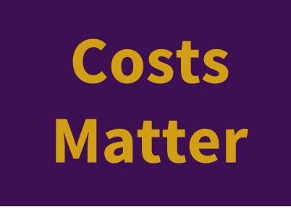
In Short

