Slide 1
COIA
www.thecoia.org
Joan M. King
Professor
Vice Chair of COIA
LSU A&M Faculty Senate COIA Representative

Slide 2
History of COIA
History of COIA
began in March 2003
created by faculty senates of Bowl Championship
series conference schools
for purposes of pushing reform in athletics
due to statements by Knight Commission and AAUP
due to data from studies on relevant issues
due to BCS-conference presidents efforts at reform

Slide 3
Historic Goals of COIA
Historic Goals of COIA
have broad faculty voice in reforms of athletics
provide ideas to lasting reform
work with other groups to ensure that athletics
enhances the academic mission
result in reform of athletics by the NCAA

Slide 4
Historic COIA Reform Categories
Historic COIA Reform Categories
Academics
eligibility, admission and academic standards
Student welfare
scholarships, advising, other support, equity, athletics scheduling, practice time limits, engagement on campus
Finances and scale
arms race issues, revenue vs non revenue sports, financial planning, monitoring and reporting, equity between conferences, anti-trust laws, solvency

Slide 5
Historic COIA Reform Categories cont.
Historic COIA Reform Categories
Commercialization
dependency on corporate and media funds conflicting with academic missions or values, corporate sponsorship, dependent on revenue streams outside of institutional control
Governance
shared governance between faculty, presidents, athletics admins and supervisors/trustees of above related issues

Slide 6
Current Mission and Vision of COIA
Current Mission and Vision of COIA
Mission
to promote academic excellence, integrity and
student well-being in intercollegiate athletics
Vision
faculty mobilizing faculty to enhance the student
athlete experience

Slide 7
Current Core Beliefs of COIA
Current Core Beliefs of COIA
students athletes are students first
academic integrity
scholarship and critical inquiry
diversity and inclusiveness
financial responsibility and sustainability of
intercollegiate athletics
transparency and open dialog
protection of student health and safety

Slide 8
Membership
Membership
currently 57 university faculty senate members
from 10 NCAA FBS conference schools
recently invited all Division IA basketball schools

Slide 9
COIA Recommended Best Practices
COIA Recommended Best Practices
Maintaining lines of communication btw athletics dept. and faculty
Faculty oversight/advisory committee
Visits by athletic director or designee to faculty senate meetings
Encourage meetings or joint committee btw FAR and faculty senate
Foster discussion on topics such as travel schedules, online courses,
cluster courses
Clarify how FAR interacts with committees

Slide 10
COIA recommended Best Practices cont.
COIA Recommended Best Practices
Foster atmosphere of shared experiences and value for academia
announce student’s major when student introduced
have faculty appreciation at athletic events
have faculty member serve as honorary coach
have faculty shadow a student athlete to see what life is like
tag academic departments on athletics social media
encourage general sharing meetings

Slide 11
COIA Best Practices part 3
COIA Recommended Best Practices
Foster atmosphere of shared governance and transparency
include faculty governance on selection of FAR
have athletics oversight/advisory committee
share athletics information with faculty governance: budget,
GSR, NCAA performance
work together to understand which classes student athletes
are drawn to, review practice hour restrictions and times
include faculty senate involvement on athletic surveys,
planning committees, oversight, Title IX plans

Slide 12
Current Issues for Athletics and Student Athletes
Current Issues for Athletics and Student Athletes
Pay for Play
COIA against extra compensation
will erode amateurism
would cause unfair advantages for some schools
lead to improper recruiting and transfer inducement
students burdened with choices related to financial gain
vs. academic achievement

Slide 13
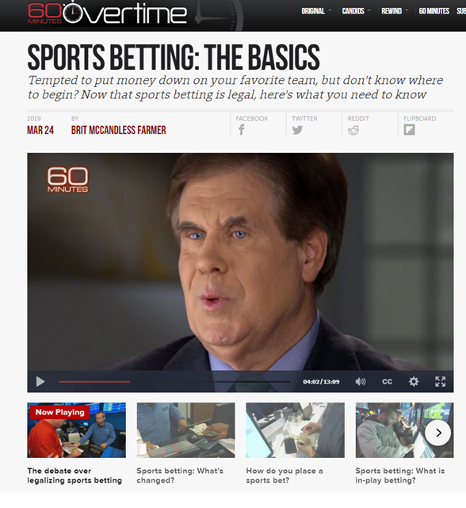
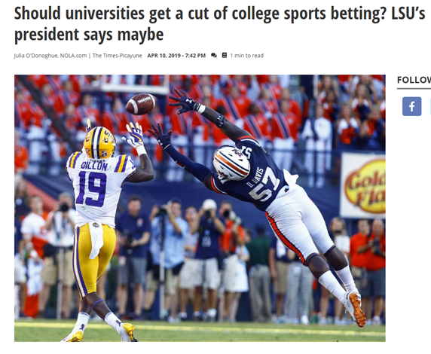
Gambling on College Sports
Gambling on College Sports
https://www.cbsnews.com/news/sports-betting-the-basics-60-minutes/
https://www.nola.com/news/politics/elections/article_3d511745-a768-534b-8fcf-0ecafa580c3d.html

Slide 14
Questions?
Questions?

