Slide 1


Incorporating Broader Impacts
Dr. Zakiya Wilson-Kennedy
Assistant Dean, Diversity And Inclusion, College of Science
Associate Professor of Research, Department of Chemistry
Dr. Kris Mecholsky
Scientific Writer, Research Advancement, Office of Research and Economic Development
Date: March 21, 2019
Time: 2:00 PM - 3:30 PM
Location: Himes (Robert L.) Hall - Room 129

Slide 2
What are broader impacts?
Groups of 3-4
Using large format memo pad
  Provide a working definition of broader impacts and
  provide some examples of broader impacts.
5-7 Minutes
Summary
Reporting
Common Themes

Slide 3
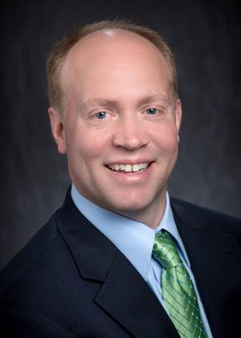
Greg Trahan
Director, Economic Development
Office of Research and Economic Development

Slide 4
Semantic (Possibly Pedantic): Words Matter
CLARITY FROM NOISE
A Proposal = A Sales Pitch
Asking someone with $ and options to give it to you, enthusiastically
Impact vs. Value
Impact is passive and subjective. Value is active and objective
Your Role As A Researcher: A Driver of “Broad Impact”
Your Job As A Proposer: “Specific Value”…and for whom!

Slide 5


Value vs. Impact, Illustrated
A SALES PITCH, BUT FOR WHOM?
OUTCOME 1
IDEA CONCEPT PROPOSAL
STAKEHOLDER 1
PROJECT
“CUSTOMER”
STAKEHOLDERS
“CUSTOMER”
REVIEWERS
OUTCOME 2
IMPACT!
STAKEHOLDER 2
ACTION
IMPACT!

Slide 6
So What Should You Write For?
ANSWER: THE THINGS YOU CAN CONTROL
THE THINGS IN YOUR CONTROL
NO CONTROL...
OUTCOME 1
PROJECT
IDEA CONCEPT PROPOSAL
STAKEHOLDER 1
“CUSTOMER”
WHY, AND FOR WHOM
“HOW”
THE PLAN
OUTCOME 2
STAKEHOLDER 2
ACTION
BUT YOU CAN INFLUENCE!

Slide 7
Revisiting “Broader Impacts”
AIM TO CREATE VALUE, AND WRITE TO SUGGEST IMPACT
A Proposal = A Sales Pitch = A Value Proposition
1. Relative: why would stakeholder care about pain/gain? Vs. doing nothing?
2. Prioritize: Get stakeholders to care - they drive impact
3. Testable: Can you determine if the concept moves the needle?
4. Measurable: How will you determine that?

Slide 8
Revisiting “Broader Impacts”
A SUGGESTED FORMAT: IDENTIFY STAKEHOLDERS + FRAME “BROADER IMPACTS”
A Proposal = A Sales Pitch = A Value Proposition
Our idea (research offering / effort)
helps (a defined stakeholder)
who wants to (complete some task / objective)
by (reducing / avoiding a stakeholder pain)
and (increasing / enabling a stakeholder gain)
THIS IS A BROADER IMPACT

Slide 9

National Science Foundation
Criteria for Merit Review
Intellectual Merit: The Intellectual Merit criterion encompasses the potential to advance knowledge; and
Broader Impacts: The Broader Impacts criterion encompasses the potential to benefit society and contribute to the achievement of specific, desired societal outcomes.

Slide 10
Why Broader Impacts?
Since the beginning of NSF, more excellent projects than there are funds.
Non-technical considerations come into play when there are many projects of quasi-equal scientific merit.
Research and education supported by tax dollars!
Clear criteria are important.
BI must be discussed and evaluated at each stage:
  Proposal Reviews
  Panel Summary Review analysis
  Annual report & final report

Slide 11
How Does This Work?
Since 1998, more strict accountability for BI at every stage of the merit review process.
BI must be discussed and evaluated at each stage:
  Proposal
  Reviews
  Panel Summary
  Review analysis
  Annual report & final report
Assess BI treatment at each stage.
Suzi Iacono, Head of the Office of Integrative Activities, NSF
BI IMPACTS SUMMIT, April 26, 2018

Slide 12
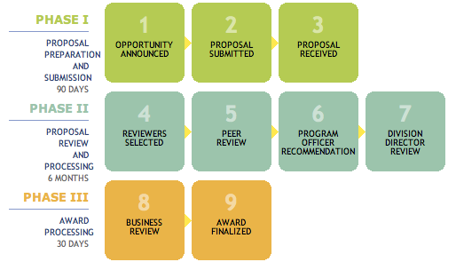
Merit Review Process

Slide 13
Merit Review Process
BI
BI
BI
BI

Slide 14
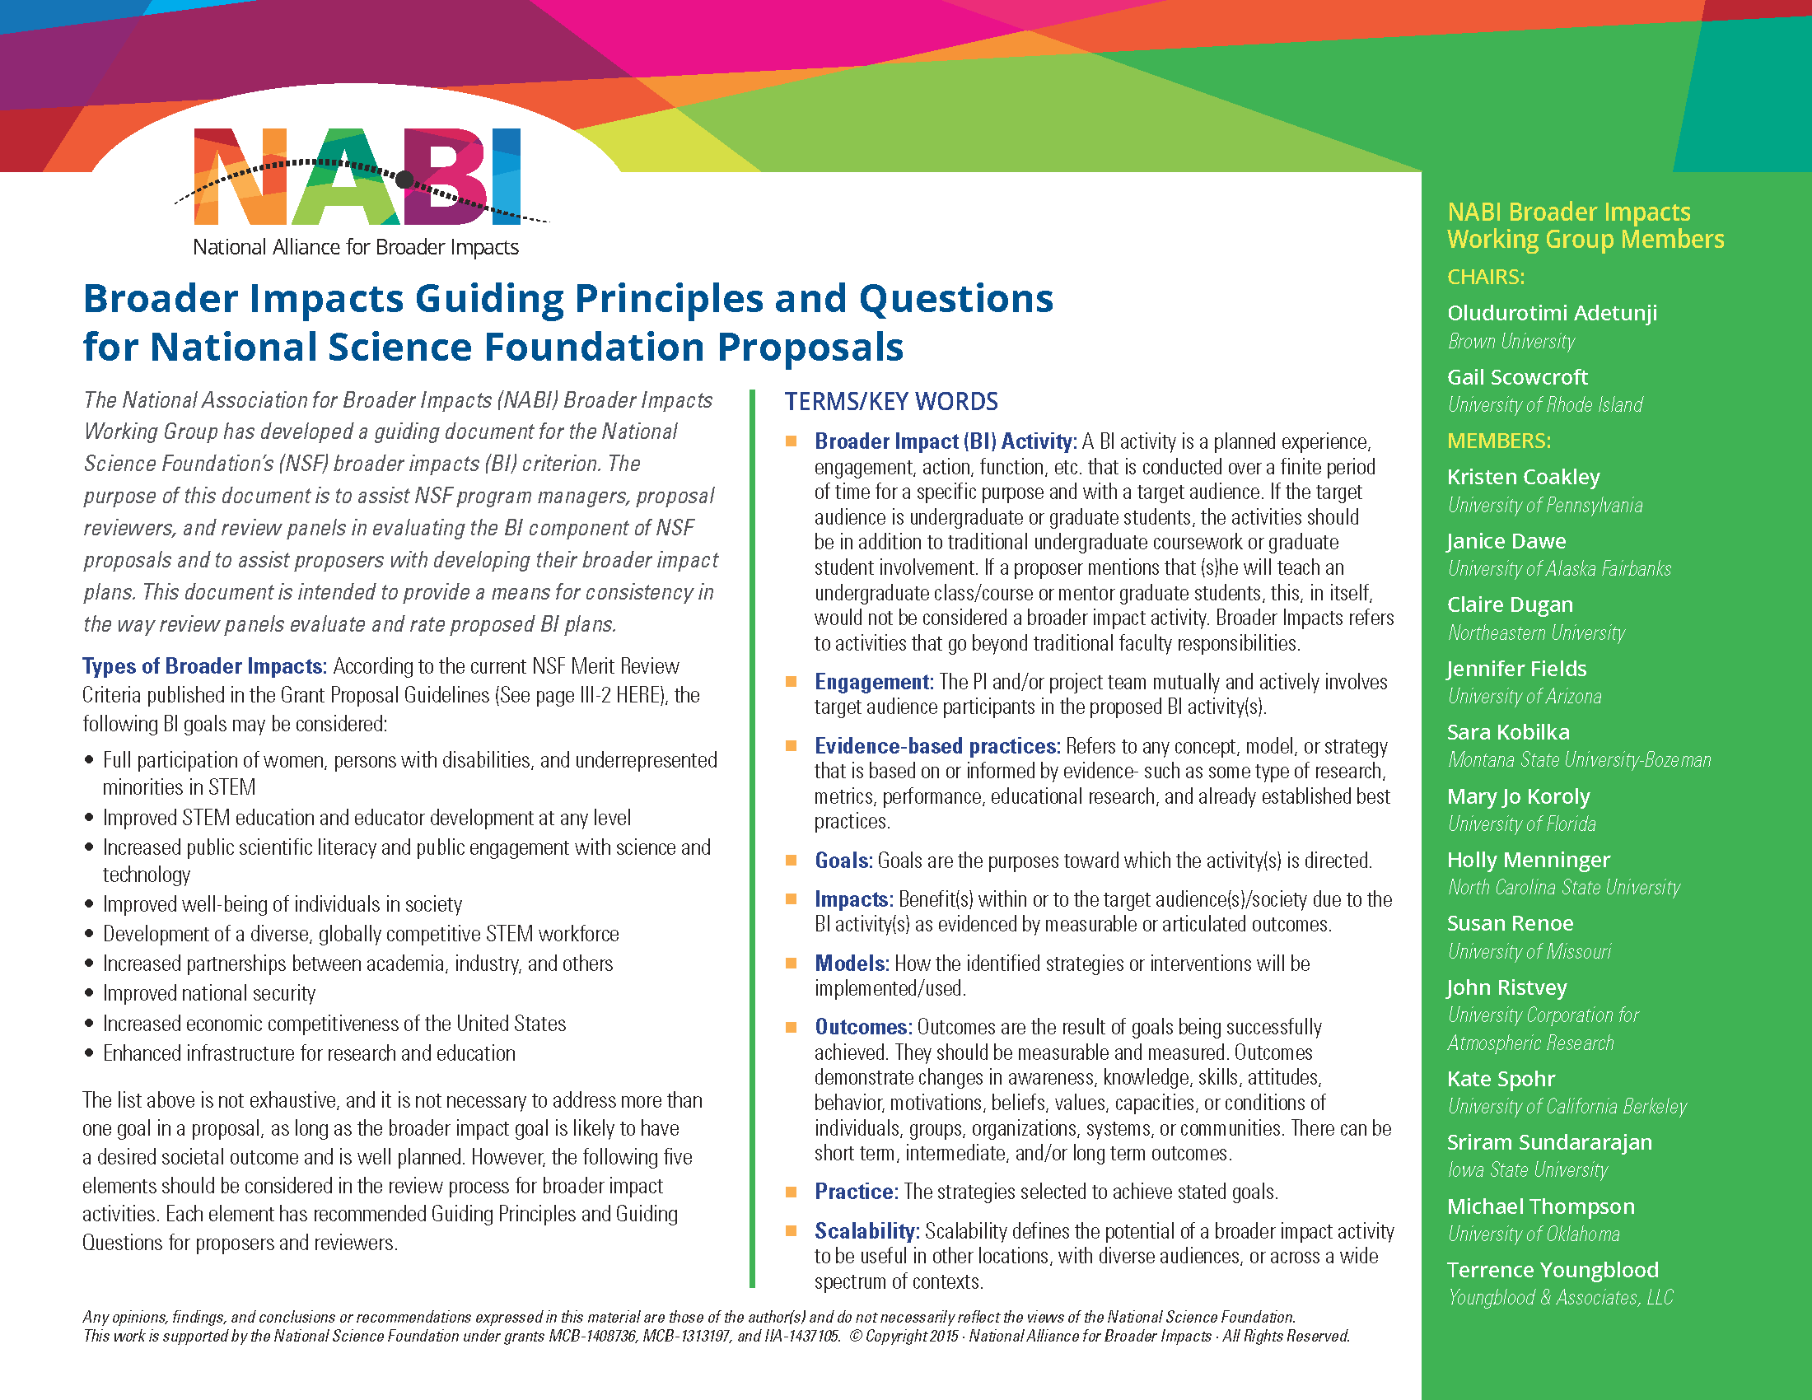

Slide 15
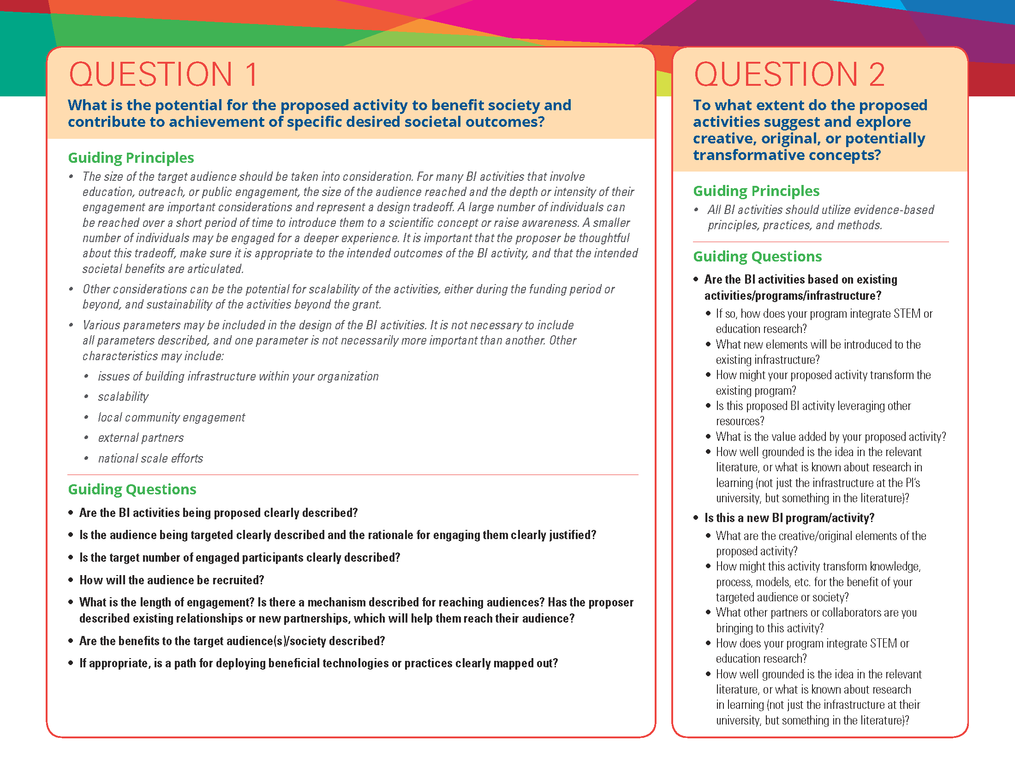

Slide 16
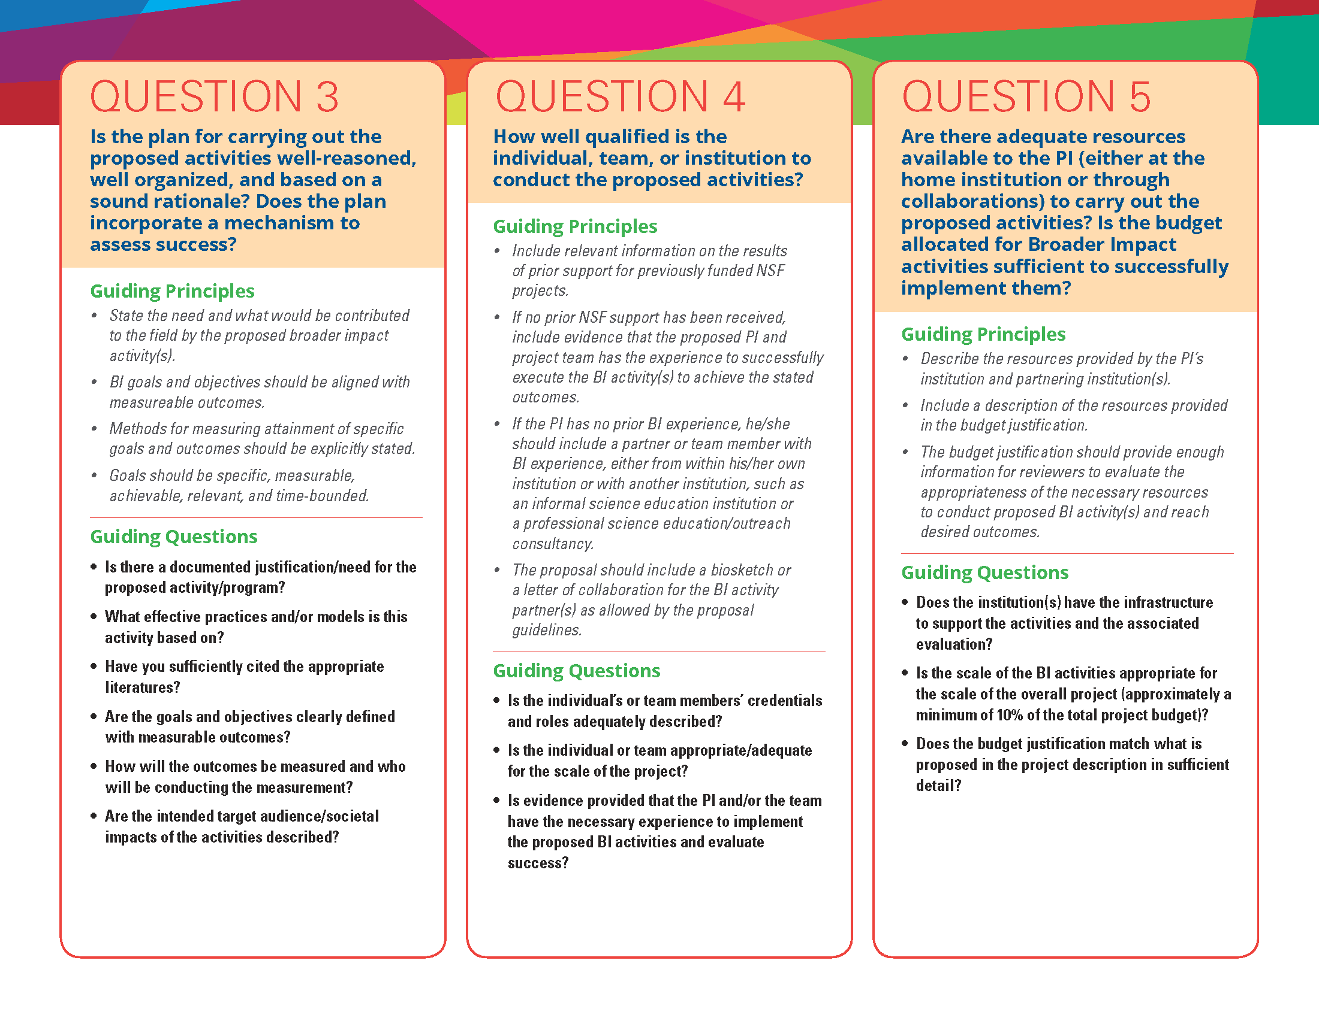

Slide 17
CASE STUDIES
Sarah Ferstel, Program Manager, LSU Discover
Dr. Sophie Warny, Associate Professor – Geology and Geophysics
Dr. Pallavi Dani, Associate Professor - Mathematics
Dr. Juana Moreno, Associate Professor - Physics

Slide 18
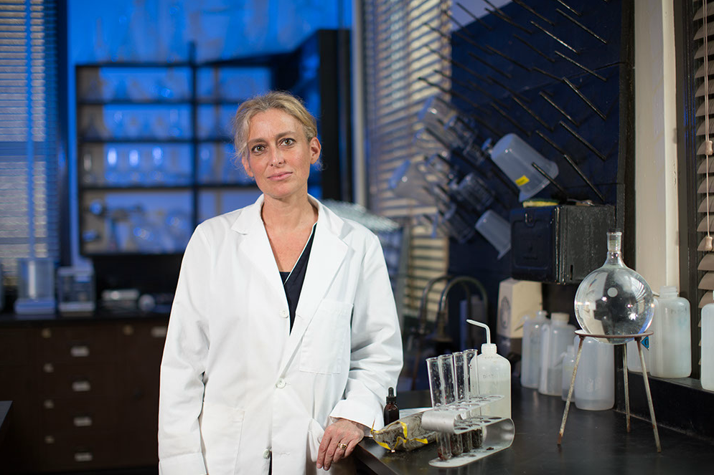
Dr. Sophie Warny
AASP Chair, Associate Professor of Palynology
Curator, Museum of Natural Science

Slide 19
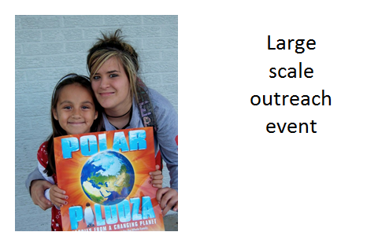
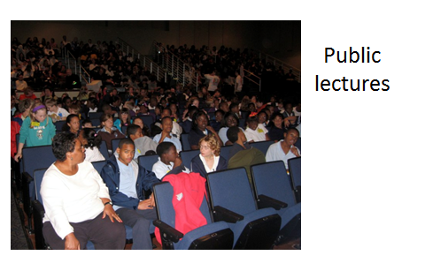
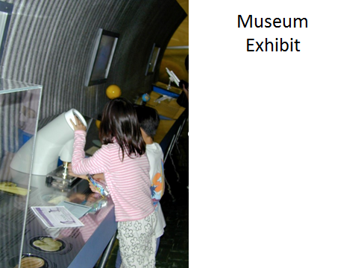

Slide 20
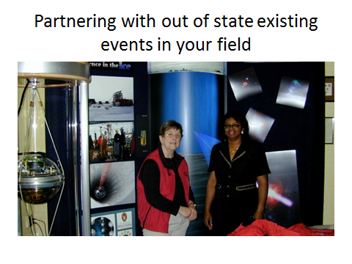
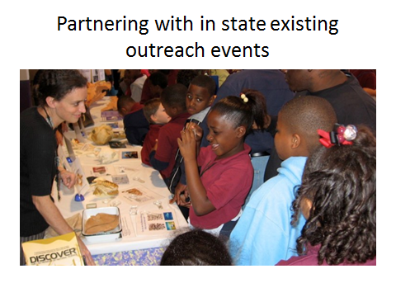

Slide 21
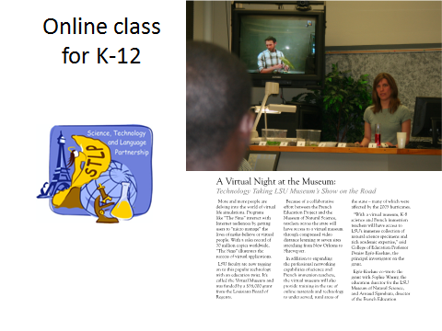

Slide 22
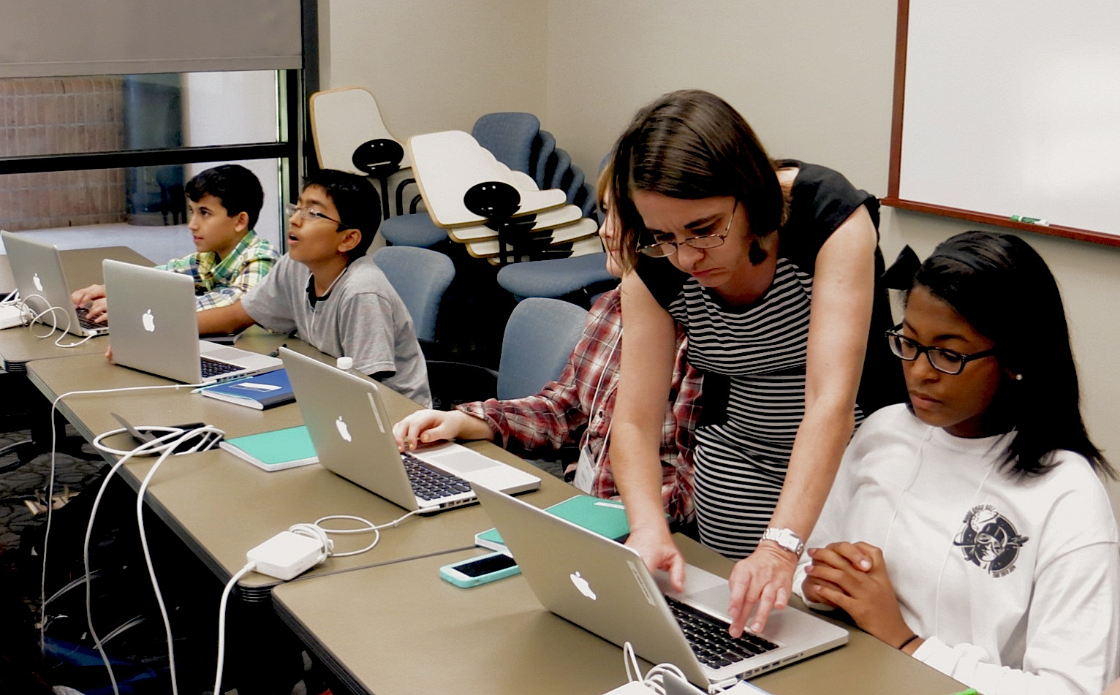
Dr. Juana Moreno
Associate Professor of Physics

Slide 23
Broader impacts in research proposals:
Possible projects:
Develop a new course (and/or specific training to complement courses) and make the materials public.
Workshops for middle and/or high school teachers. Develop curriculum for middle and/or high school . Get “champion” teachers to help.
Outreach to middle and/or high schools.
Outreach to Community Colleges.
Support REU students and/or RET teachers during summer to do reach in your lab and/or develop curriculum for their classes.
Partner with a museum to develop an activity, exhibit, workshop.
Develop open-source code and distribute it with documentation.
Integration in proposal:
Integrate the broader impacts within the rest of the proposal.
Justify the need for the broader impact.
Get informed about similar initiatives on-campus and at other institutions. Put your initiative within a context.
Get letters from partners: superintendent of school district, museum staff, colleagues supporting your project, etc.
Include funds to cover the costs.

Slide 24
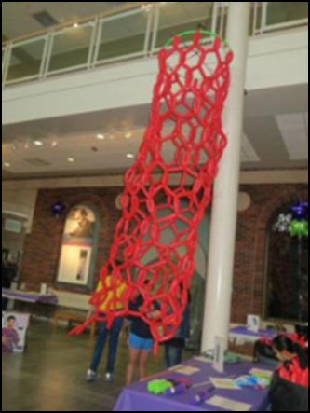
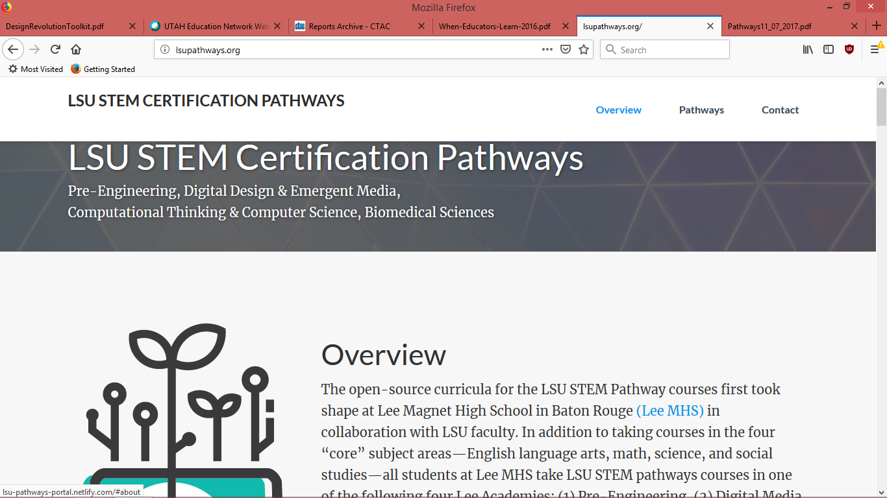
Grades 6-12 Students and Teachers
High-school STEM Certification Pathways
RET opportunities for teachers
Summer camps:
  Teach Math to your Computer
  Computer Simulations
Two-year College Students & Instructors
Short courses and REU/RET participation
Engaging the Public
Nanodays in Baton Rouge
Since 2011
Over 1,000 visitors every year

Slide 25
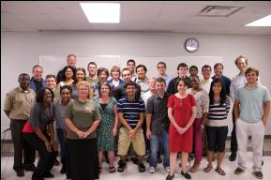
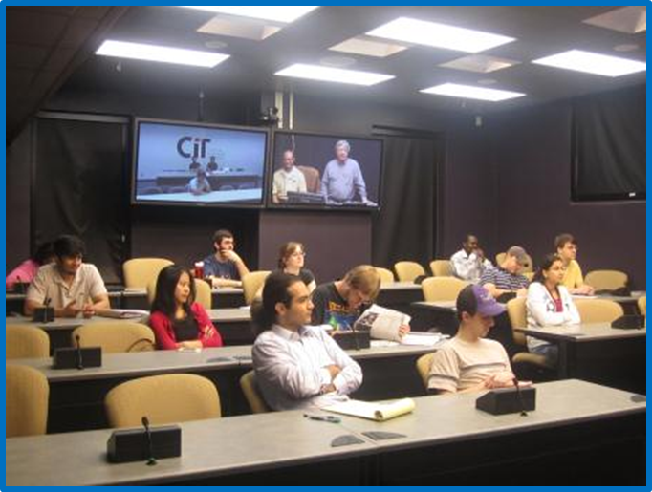
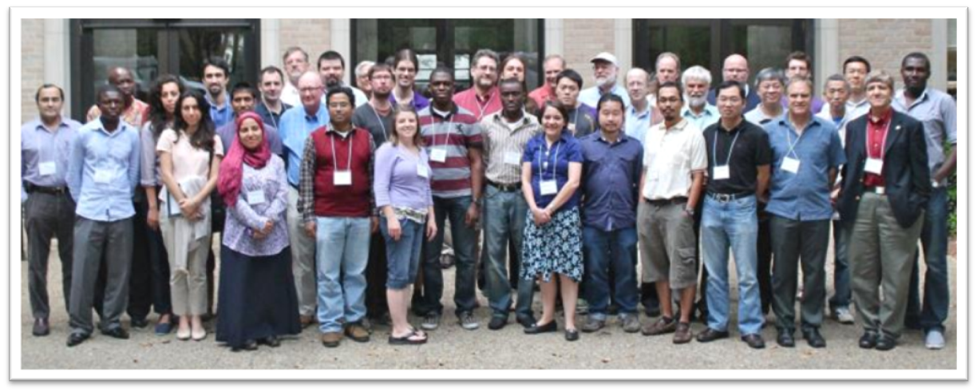
Research Experiences for Undergraduates
Since summer 2010
Graduate Students
40 semester-long courses offered using videoconference
Effective Teaching Workshop for graduate students/postdocs
Topical Research Workshops
LA-SiGMA Data Semantics Workshop, LSU, June 7-8, 2013
(37 participants, 8 speakers)
Notes:
25

Slide 26
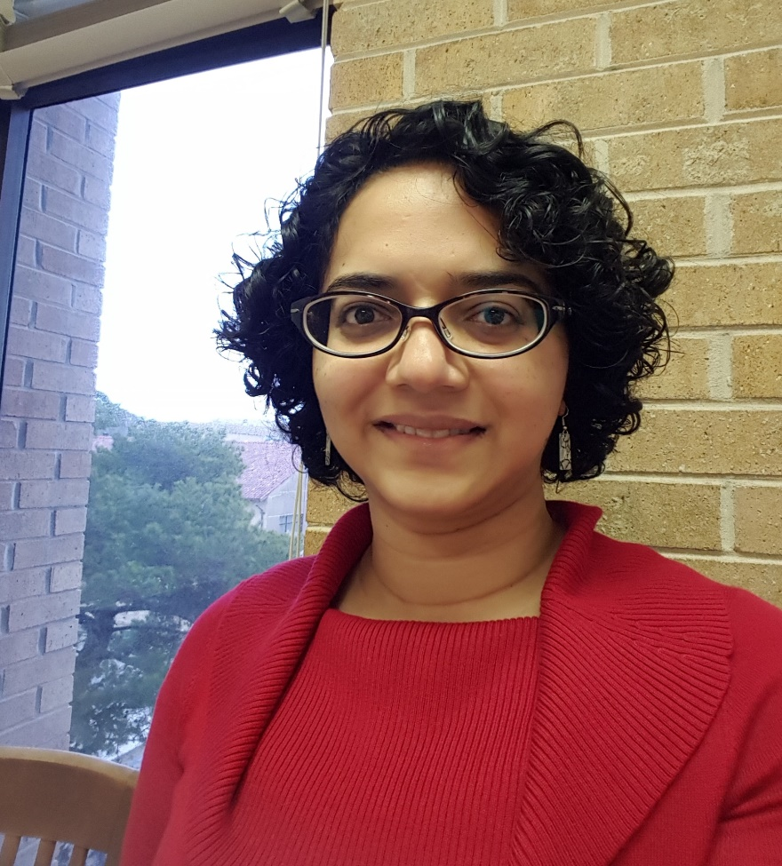
Dr. Pallavi Dani
Associate Professor of Mathematics

Slide 27
Mathematical training at different levels
Mini courses at summer schools for graduate students at institutes and other institutions
Reading courses and seminars for graduate students (beyond standard teaching duties)
Popular math talks/activities for
    a broad audience of scientists
    undergraduates
    high school students and middle school students
Video interview with SciState aimed at high school teachers.
Survey article in my field of specialization

Slide 28
Promoting diversity in mathematics and academia.
LSU College of Science diversity committee
Awards Committee of the AWM (Association for Women in Math, a national organization)
Faculty advisor of the LSU student chapter of the AWM
Panelist on various panels on women in math at conferences

Slide 29
Service to the profession
Organizing workshops and meetings (particularly those that are aimed at providing opportunities for young researchers)
Steering committee for the Spring Topology and Dynamics Conference (a large multi-section annual conference)
Selection committee for the American Mathematical Society’s Simons Travel Grant (A grant for researchers within five years of their PhD)

Slide 30
CASE STUDIES
Dr. Sophie Warny, Associate Professor – Geology and Geophysics
Dr. Pallavi Dani, Associate Professor - Mathematics
Dr. Juana Moreno, Associate Professor - Physics

Slide 31
Example Criteria for Prioritizing BI Activity
Your level of interest in the idea (you may be doing this for a few years)
How much the idea aligns with mutual goals between you and priority partners
How much the idea aligns with priorities of your department and/or the College
The level of effort the idea will require to execute
Ability of the idea to further your brand/reputation in your field
Strength of the idea’s connection to your research
How measurable or significant of an impact the idea could produce
How unique or creative the idea is
How sustainable the idea is
https://broaderimpacts.psu.edu/planning-your-broader-impacts-activities/

Slide 32
Human Capital | Cultural Capital
Technological Capital | Benefits to Society
Groups of Three (3-4)
Discuss a potential BI idea or project
How does it align with NSF PAPPG and NABI Guidelines
  What is the potential for the proposed activity to benefit society and contribute to achievement of specific desired societal outcomes?
  To what extent do the proposed activities suggest and explore creative, original, or potentially transformative concepts?
  Is the plan for carrying out the proposed activities well-reasoned, well organized, and based on a sound rationale? Does the plan incorporate a mechanism to assess success?
  How well qualified is the individual, team, or institution to conduct the proposed activities?
  Are there adequate resources available to the PI (either at the home institution or through collaborations) to carry out the proposed activities? Is the budget allocated for Broader Impact activities sufficient to successfully implement them?

Slide 33
What do Funding Agencies Require?
NSF broader impacts requirements for all proposals per Grant Proposal Guide
Summary page – separate text box
Separate section in Project Description narrative with a “Broader Impacts” heading
Prior NSF support subheading requirements for Intellectual Merit and Broader Impacts
Biosketch – Synergistic Activities (PAPPG NSF19001 – after 1/28/19)
  five distinct examples that demonstrate the broader impact of the individual’s professional and scholarly activities that focuses on the integration and transfer of knowledge as well as its creation
Notes:
broader impacts is not part of mission for all agencies

Slide 34
Broader Impacts in Your Proposal
What to cover in this section of the proposal
Impact on society (who and what)
  Economic development
  Technology transfer
  Academic-industry collaborations
BI activity (see NABI document, etc.)
  Evidence or literature base for your BI activity
  Outreach, undergraduate or graduate education, public engagement
  Expertise to lead the BI activity and Collaborators (when needed)
  Evaluation plans, appropriate personnel/collaborations, budget
Dissemination plans: research and BI activity
Personnel involved: research and BI activity
Notes:
Groups such as LSAMP often do not know they “promised” to do something until after proposal funded.
No budget can mean no real commitment
Not wise to create on own instead of leverage: wastes resources and shows you do not know the landscape
Must be tailored…not just “We will work with LSAMP to recruit a broader pool of qualified students.” How will you work with them? Booth at their regional conference?

Slide 35
Broader Impacts in Your Proposal
Mistakes grant proposers make
Programs/collaborators included in proposal without their knowledge
No budget for BI efforts/initiatives
Reinventing wheel instead of leveraging expertise
Not using evidence-base for proposed BI activity
Unclear intentions around advancing knowledge with BI efforts/initiatives
Too general to be meaningful
No evaluation plan/strategic for BI efforts/initiatives
Notes:
Groups such as LSAMP often do not know they “promised” to do something until after proposal funded.
No budget can mean no real commitment
Not wise to create on own instead of leverage: wastes resources and shows you do not know the landscape
Must be tailored…not just “We will work with LSAMP to recruit a broader pool of qualified students.” How will you work with them? Booth at their regional conference?

Slide 36
Empirical Study of BI Reviews:
Differences Between Awards – Declines by Directorate
Award Decline
Award Decline
Award Decline
Award Decline
Award Decline
Award Decline
Award Decline
Suzi Iacono, Head of the Office of Integrative Activities, NSF
BI IMPACTS SUMMIT, April 26, 2018

Slide 37
Knowledge Base is Emerging
Schienke, E.W., Tuana, N., Brown, D.A., Davis, K.J., Keller, K., & Shortle, J.S. (2009). The role of the National Science Foundation Broader Impacts Criterion in enhancing research ethics pedagogy. Social Epistemology (317-336).
Rothenberg, M. (2010). Making judgments about grant proposals: A brief history of the Merit Review Criteria at the National Science Foundation. Technology Innovations 12 (189 – 195).
2013: National Alliance for Broader Impacts (NABI) formed: a community of practice that fosters the development of sustainable and scalable institutional capacity and engagement in broader impacts activity.
Watts, S.M., George, M., & Levey, D.J. (2015). Achieving broader impacts in the National Science Foundation Division of Environmental Biology. BioScience, 65(4), 397-407.
NABI (2018). The Current State of Broader Impacts: Advancing Science and Benefiting Society.
Ongoing: Analyses of institutional data in NSF’s Office of Integrative Activities.
Notes:
An almost 2 year process
Directorate-wide discussions
Internal staff
External ACs
NSF Leadership Workshop in September 2015
Report to OMB in December 2015 + July 2016
Agency-wide strategic review in January – March 2016
Report to OMB due June 2017
Consensus hypotheses
Hypothesis 1: The application of BI has changed over time; we should expect it to continue to evolve.
Hypothesis 2: The so-called “confusion” might be variation in BI due to different award sizes, disciplines and solicitation language; inconsistent instructions from NSF; and/or some other reasons.
Hypothesis 3: There are some common practices in panels, e.g., tie-breaking.

Slide 38
Resources
(examples and not exhaustive)
Perspectives on Broader Impacts https://www.nsf.gov/od/oia/publications/Broader_Impacts.pdf
Merit Review Broader Impacts Criterion: Representative Activities https://www.nsf.gov/pubs/2002/nsf022/bicexamples.pdf
National Alliance for Broader Impacts (NABI) https://broaderimpacts.net/
Center for the Advancement of Informal Science Education http://informalscience.org/
STEM Learning and Research Center http://stelar.edc.org/
Association of American Colleges and University (AAC&U) STEM Higher Education https://www.aacu.org/resources/stem-higher-education

Slide 39
Resources
(examples and not exhaustive)
Undergraduate Research
  LSU Discover, ORED Office of Undergraduate Research, Office of Strategic Initiatives
K-12 Teaching and Outreach
  Cain Center for STEM Literacy; LSU Museum of Natural Science; Chem Demo Program; LSU Science Office of Diversity and Inclusion; LIGO Outreach Center
Industry and Corporate Partnerships
  ORED Director for Economic Development
University Teaching
  Teaching and Learning Collaborative; Center for Academic Success; Women’s Center; Office of Multicultural Affairs; LSU Online
Project Evaluation
  Faculty in School of Education, ELRC and Higher Ed; Sociology; Psychology; Communications; other external consultants

Slide 40


Panel
  Greg Trahan
  Sarah Ferstel
Office of Research and Economic Development (ORED)
Dr. Kris Mecholsky

