Slide 1
Office of Civil Rights &
Title IX
Response to the Husch Blackwell Report
Jane Cassidy, PhD
Interim Vice President

Slide 2
Office Operations
Accomplishments
  Interim Vice President hired
  Reporting lines changed
  Four positions advertised
  Director of Lighthouse full time
  Office moved to 118 Himes Hall
  Recommendation #1 in progress
  Recommendation #2 in progress
  Recommendation #3 completed
  Recommendation #4 completed
Notes:
Top four recommendations here, because noting else is possible without personnel.

Slide 3
Title IX Organization Chart
March 16, 2021

Slide 4
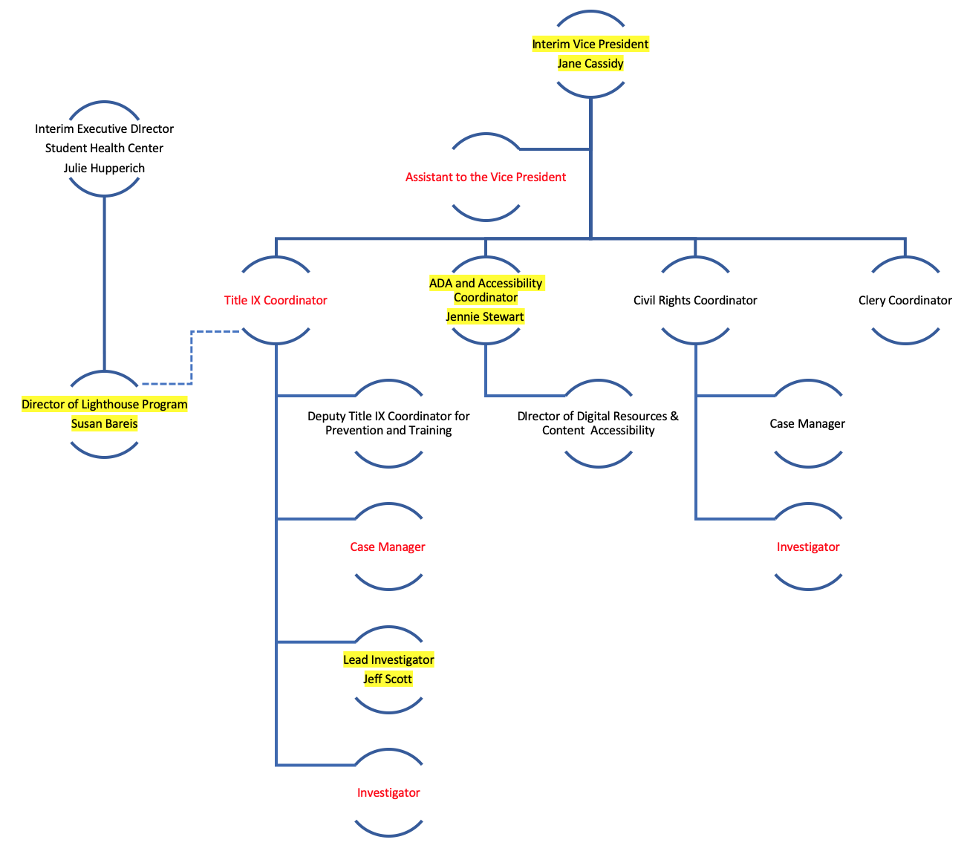
Proposed Office of Civil Rights &
Title IX
Organization Chart
April 10, 2021

Slide 5
Projected Timeline:
Operations
Hire dates for Assistant to the Vice President, Case Manager, and Investigators: May 20
Hire date for Title IX Coordinator: July 15
Hire date for Vice President: January 1, 2022

Slide 6
Process
Accomplishments
  Timeline established for discrimination cases
  Process for complaint if process not handled promptly
  Restorative justice process currently in use
Recommendation #13 in progress
Recommendation #14 in progress
Recommendation #15 in progress
Notes:
Some of these are done, just not memorialized in policy yet

Slide 7
Title IX Process and Timeline
Notes:
5 days + 44 days + 35 days = 84 days

Slide 8
Projected Timeline:
Process
Formalize alternative resolution processes: August 15
New Civil Rights and Title IX policy that will describe reporting process, define mandatory reporters, and provide sanctions for employees who fail to report: July 15
Presumptively Appropriate Sanctions for students found responsible for sexual misconduct: July 15

Slide 9
Training and Education
Accomplishments
  All Athletics appointees required to make reports of sexual discrimination of students directly to the Title IX Coordinator
  Contract established between Athletics and STAR for education, training, and policy development
  Contract established between LSU and STAR for education, training, and review of current online training modules
  STAR has provided a first educational session on sexual misconduct to members of the LSU football team
  Bystander Intervention program implemented by Athletics
Recommendation #7 in progress
Recommendation #10 in progress
Recommendation #12 in progress
Notes:
LSU ATHLETICS COUNCIL ON SEXUAL AND DOMESTIC VIOLENCE
Student Athletic Advisory Council AND Black Student Athletic Association committed to a bystander intervention program in order to advocate for survivors
New HR positions focused on increasing awareness of sexual and domestic violence
Comprehensive education program for student athletes, coaches, and all Athletics employees that includes a contract with STAR and A Call to Men
Developing policies that will show commitment to anti-harassment and code of conduct expectations
Of course, mandatory reporting to the Title IX Office

Slide 10
Projected Timeline:
Training and Education
Annual mandatory training for employees, graduate assistants, and student workers reviewed by STAR, recommendations included in revisions, and implemented: August 15
MyStudentBody training for new students reviewed by STAR, recommendations included in revision, and implemented: August 15
Training for Title IX personnel: First week in June
Notes:
Comprehensive health education program

Slide 11
Record Keeping and Reporting
Accomplishments
  MOU with LSU PD signed
  Assessments of Title IX training sessions implemented
Recommendation #5 in progress
Recommendation #6 in progress
Recommendation #9 completed
Recommendation #17 in progress

Slide 12
Projected Timeline:
Record keeping and reporting
Format of quarterly reports being determined, and reports will be provided to the president every year on or before March 31, June 30, September 30, and December 30
Format for annual reporting for campus being determined, and report will be published on September 1, 2021 and then annually on or before March 1
Training in Maxient for all Title IX and Civil Rights employees and collaborators scheduled for May 24, 2021
Assessment of Title IX responsiveness and satisfaction by all who use our services will go into effect June 1, 2021

Slide 13
Communication and Accountability
Accomplishments
  Easy to use and easy to locate website for reporting created www.lsu.edu/support
  Tracker has been developed and is being used/updated for all action items in the Husch Blackwell report; includes action item, responsible person/office, deadline, and updates on progress
  Clarity is being communicated to the campus community that all sexual misconduct by or toward students must be reported to the Title IX coordinator
Recommendation #8 in progress
Recommendation #11 in progress
Recommendation #16 in progress
Recommendation #18 ongoing
Notes:
Tracker includes 18 recommendations with 47 action items

Slide 14
Projected Timeline:
Communication & Accountability
New Civil Rights and Title IX policy that will describe reporting process, define mandatory reporters, and sanctions for employees who fail to report: July 15
Navigate platform (EAB) used by students to schedule appointments on campus to include appointments with Office of Civil Rights & Title IX: May 15
New App specifically for Civil Rights & Title IX developed by Communications & University Relations for campus community: July 1
Tracker made available upon launch of new Title IX website: May 1
New website for the Office of Civil Rights & Title IX: April 19 lsu.edu/civil-rights
Notes:
47 action items

