Slide 1
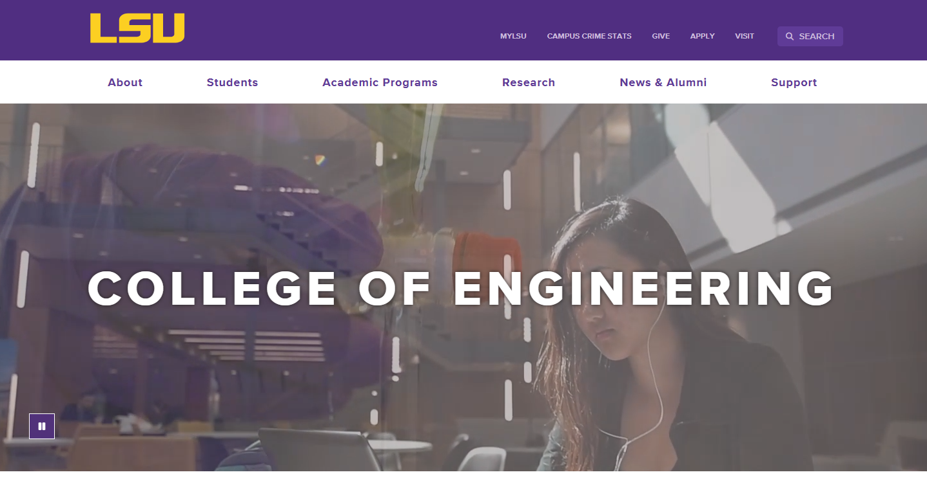
LSU COLLEGE OF ENGINEERING
Division Website
Focus Group – Faculty
Eddie Manes
Digital Communications Manager
Casey Muller
Creative Strategist
Libby Haydel
Communications Manager

Slide 2
Evaluate Sites for
Usability
Functionality
Identify missing information

Slide 3
CMS Overview -
Modern Campus
Accessibility Compliance
Mobile-friendly
University brand consistency
Variety of user experience

Slide 4


Website Comparison
https://www.lsu.edu/_fierce-draft/eng/cse/index.php
https://www.ou.edu/coe/cs

Slide 5
Introduction to
College Site
-White Nav Bar
www.lsu.edu/eng

Slide 6
Introduction to
Division Site (NEW)
-Purple Nav Bar
-CSE wiki
https://www.lsu.edu/_fierce-draft/eng/cse/index.php

Slide 7
Introduction to
Legacy Sites (CURRENT)
-Purple Nav Bar
-older sites, still relevant
information
https://www.lsu.edu/eng/cse

Slide 8
Basic Tasks
Division Site
https://www.lsu.edu/_fierce-draft/eng/cse/index.php
https://www.ou.edu/coe/cs
Laptop (75%) vs. Mobile (25%)

Slide 9
CHOOSE FIVE, PERFORM ON BOTH SITES,
TAKE NOTES
Find the mission statement or an overview of the department.
Identify the contact information for the department office.
Locate the faculty directory and find a specific professor’s profile.
Search for recent department news or announcements.
Locate information on student advising services.
Search for student organizations affiliated with the department.
FEEL FREE TO ASK QUESTIONS AND SPEAK OUT OPINIONS FOR US TO TAKE NOTES ALSO.

Slide 10
Lunch and Discussion

Slide 11
Tailored Tasks
Division Site
https://www.ou.edu/coe/cs

Slide 12
TAILORED TASKS – Faculty and Prospective Faculty
CHOOSE FIVE, PERFORM ON BOTH SITES, TAKE NOTES
Identify key department initiatives and major research priorities.
Find information about faculty benefits, professional development, or programs for new professors.
Find details on faculty-led student organizations or outreach programs.
Check where to submit requests for website updates or content changes.
Check how to contact an advisor or program coordinator.
Identify potential collaborators for a research proposal.
Learn about the department's size, ranking, and initiatives
Determine how research-active a specific faculty member is and whether their interests match yours.
Find the department’s research centers and labs and locate the faculty affiliated with them as well as details on available research funding opportunities at LSU.
Find recent publications or conference presentations by department faculty.
Locate information on research funding and grant opportunities.
Look up the department’s undergraduate and graduate programs to understand what courses you may be expected to teach.
Locate past or current course syllabi for classes related to your expertise and expectations (e.g., typical course load for faculty).
Check how to contact an advisor or program coordinator.
Find details about graduate student organizations or networking opportunities.

Slide 13
TAILORED TASKS
CHOOSE FIVE, PERFORM ON BOTH SITES, TAKE NOTES
Locate guidelines for hiring graduate or research assistants.
Identify department meeting schedules or faculty governance policies.
Locate department policies on lab space allocation.
Locate information about interdisciplinary collaboration opportunities.
Identify student advising resources available for faculty use.
Search for department policies regarding grant proposal submissions.
Locate past or current course syllabi for classes related to your expertise and expectations (e.g., typical course load for faculty).

Slide 14
Basic Task Creation
Division Site
5 minutes

Slide 15
Task Seeking
Division Site
10 minutes

Slide 16
Basic Task Creation
College Site
5 minutes

Slide 17
Task Seeking
College Site
10 minutes

Slide 18
Closing and
Next Steps

Slide 19
Thank you!

