Slide 1


Advances in Shrimp Gear Technology
2011 Technical Assistance
For Louisiana Shrimp Fishermen
LSU AgCenter
LSU Sea Grant Program
Prepared and presented by
Gary L. Graham

Slide 2
Shrimp Gear and Equipment Has Evolved over the Decades
Post WWII − operators installed military-surplus, diesel engines.
In the 50s − industry began using double rigs.
In the 60s − cotton webbing was replaced by nylon.
In the 70s − offshore trawlers converted to quad rigs.
In the 70s & 80s − many vessels added propeller nozzles.
Skimmer Trawls Became Popular in Louisiana
In 89 & 90 − nets made from high-tensile-strength, small-diameter fibers demonstrated fuel savings over nylon-based webbing.
In the 90s − some operators switched to more modern propellers.
In ‘05 – Sea Grant & Western Seafood began evaluating cambered doors.

Slide 3
Vessel and Gear Chances Mostly Directed Toward Higher Shrimp Catches
Often because of change, the fisherman had the choice of towing more webbing or dragging faster.
In some cases such as propeller nozzles, high tech smaller diameter netting, etc. vessel might drag at same speed and maintain same catch but experience fuel savings.

Slide 4
Long Run Outlook for Fuel
From 2010 to 2035, diesel forecasts suggest prices will increase by about 15¢ per gallon each year.
The current fuel prices greatly exceed these predictions.
About every seven years, the forecasted price will increase by roughly $1.00 per gallon.
This forecast only reflects trend … supply interruptions, additional regulations further limiting sulfur, etc. can dramatically influence actual prices. Today’s fuel prices substantiate this.
Energy price changes will affect the cost of virtually all activities.

Slide 5
Predicted Increase of
Fuel Prices from 2010

Slide 6
New Sea Grant Gear Study
Focused upon saving fuel
Importantly, catch rates maintained and not diminished

Slide 7
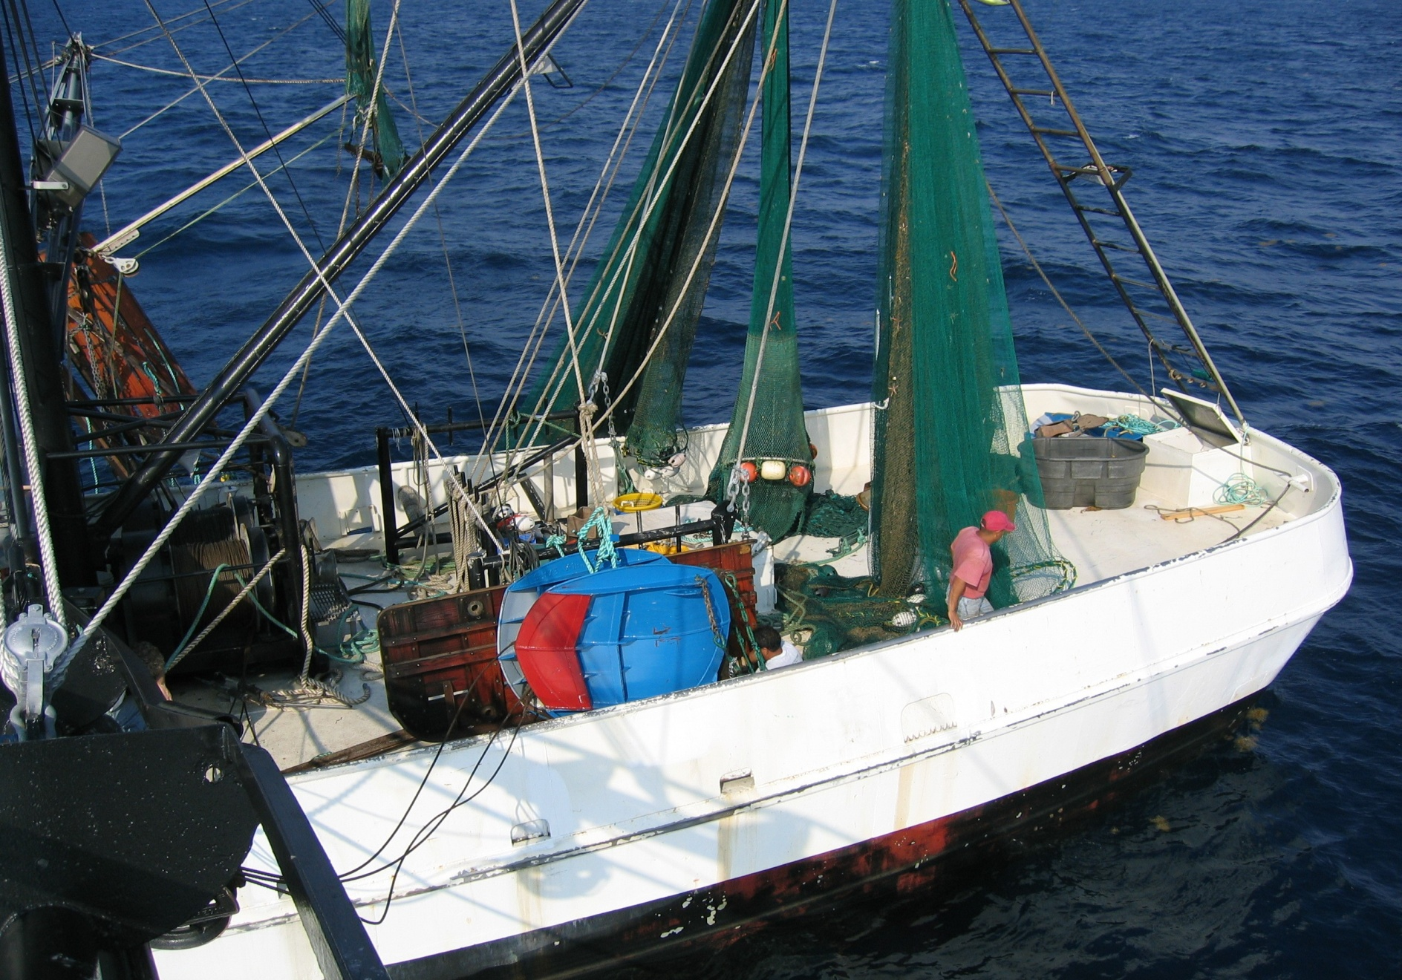
New Doors 50% Smaller than Traditional Wooden Ones

Slide 8
Cambered, Vented Doors
Doors are designed like a horizontal airplane wing
Do not spread with large angle of attack like traditional doors
Vents and curvature of the doors force them to open.
Think of air over an airplane wing. Doors work much the same but with water.

Slide 9
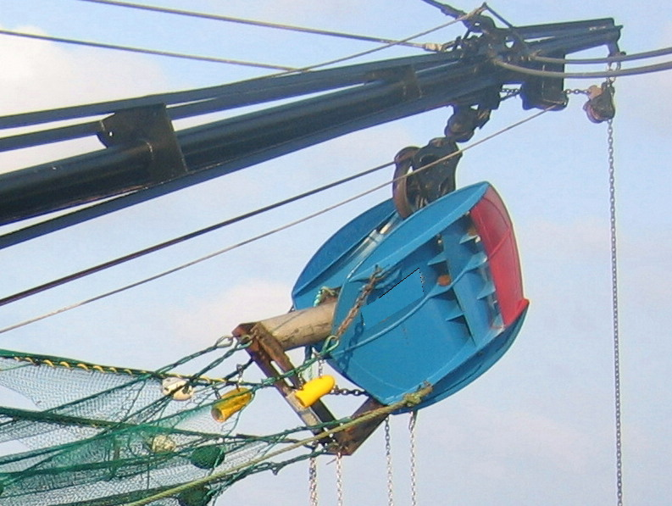
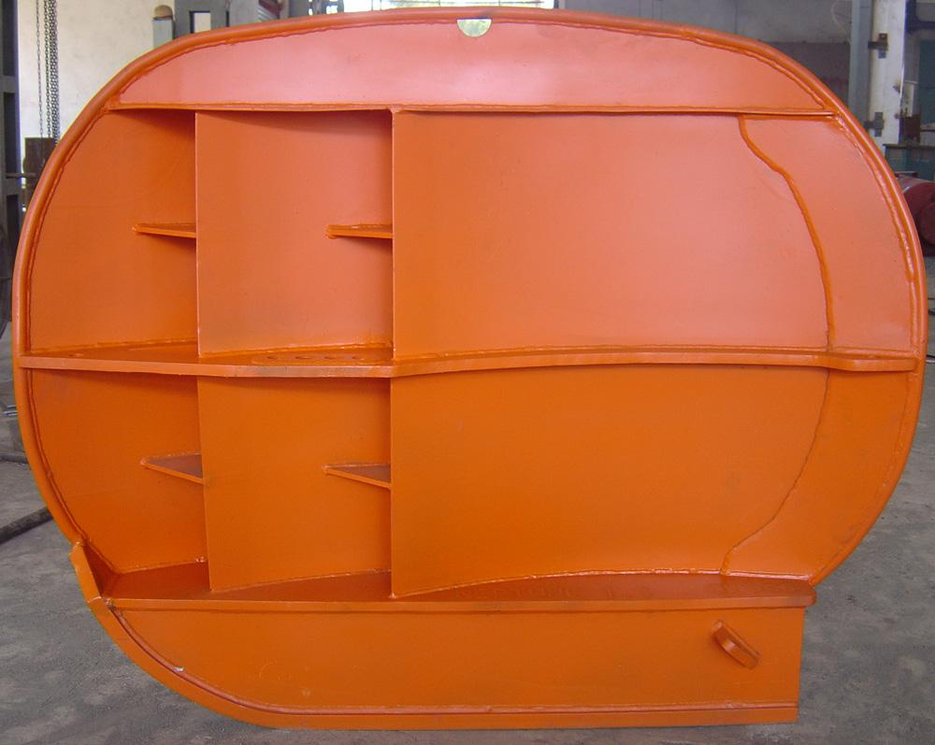
Gear Modifications from Sea Trials
Original experimental doors with curved shoes (oval doors)
Curved “shoes” were replaced with flat ones to lower the lead line and tickler chain attachment points.
“After-market”, Flat Shoe
“Curved” Shoe

Slide 10
Many bugs had to be worked out
Bottom of oval door needed to be modified
Learned how to tune the doors -door bridle placement different and rear attachment for trawl not the same.
Trial and error for choosing right door size
Quad rig sled needed to be modified

Slide 11
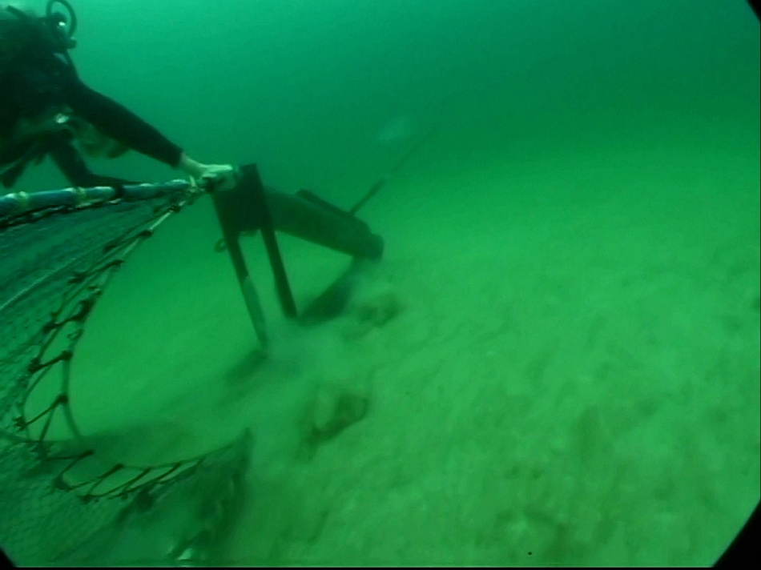
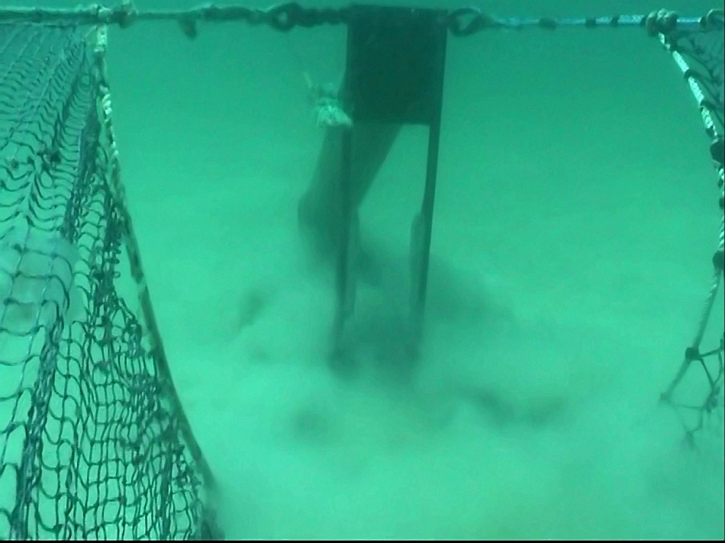
Two Views of the Buoyancy-tank Sled in a Double-rigged Trawl System

Slide 12
Current Dummy Door
Have since learned that floatation is not that necessary.
Many dummy doors used in conjunction with the new cambered doors are constructed with wide shoes.
This allows the sled to ski and not sink before the cambered doors

Slide 13
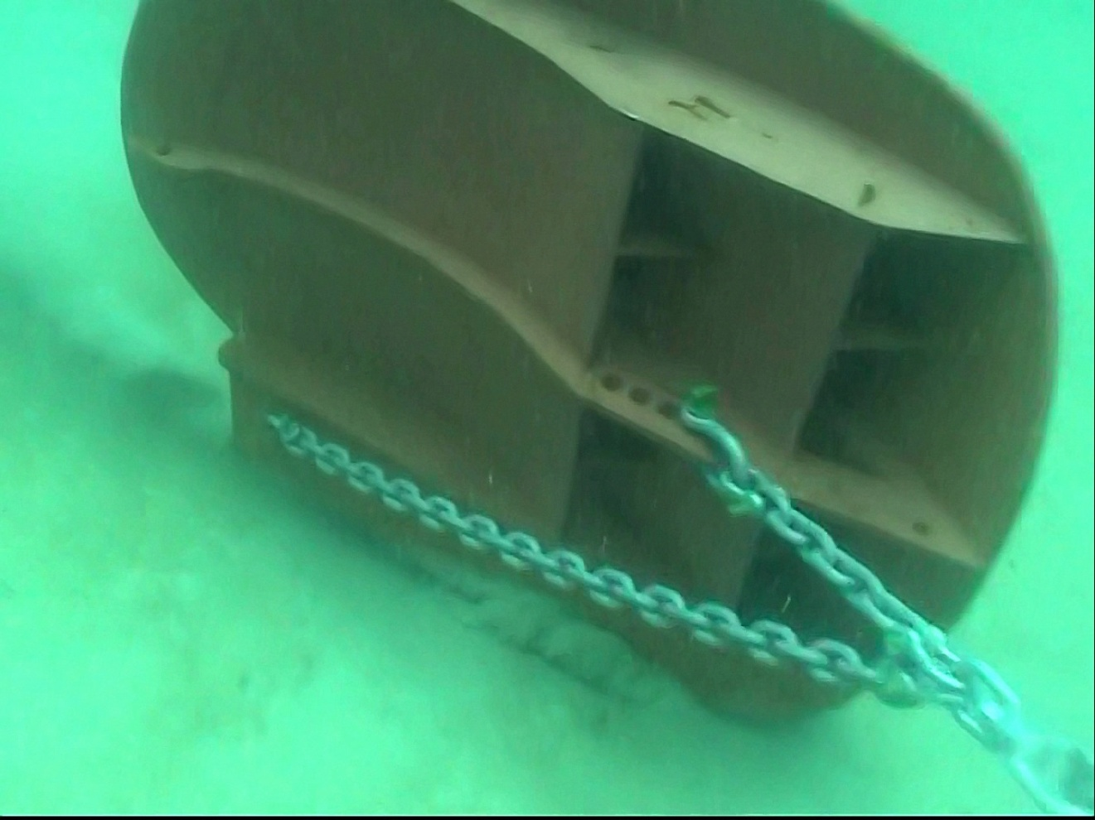
Modified Door Bridle Array

Slide 14
Door Chain Bridle
Like many European and Northern Doors, the towing cable originally attached to one point on the door called a brail which has several holes for selection of tow point.
Although doors spread by using this, an additional door chain was added to the back bottom.
This greatly enhanced stability and solved many problems.

Slide 15
First Formal Production Tests
2 % increase in shrimp production from the cambered doors
The numbers were not statistically significantly
Safe to say no shrimp loss from new gear

Slide 16
Grants Received to Rig Out Vessels throughout the Gulf
Intensive Technical Assistance
  Tim Adams – Bon Secour
  David Chauvin – Chauvin
  Juan Gaona – Brownsville
  Bobby Pendarvis – Irvington
  Tom Williams – Tarpon Springs
– Louis Stevenson – Texas City
Texas Energy Conservation Office
  Delbert Bull, Jr. – Sabine Pass
  Charles Burnell – Brownsville
  Manuel Calderón – Freeport
  Frank Lasseigne – Brownsville
  Ralph Rawlings – Matagorda
  Marcelino Ochoa – Brownsville

Slide 17
Equipment Provided for Each Vessel
Fuel Flow Meter
Sapphire Netting
Cambered trawl door array with modified sleds

Slide 18
Fuel Flow Meter
Meter had to be matched to the engine brand and horsepower
Measured gallons per hour fuel consumption
Very basic design
Worked well in most cases

Slide 19
Sapphire Webbing
Important to note that this was genuine Sapphire (Garware Walls) and not imposture
There has been “knockoff” netting sold in Louisiana as Sapphire which is not the same
Sapphire material was braided and not twisted
Early reports of twisted Sapphire indicated that it did not hold up
Sea Grant studies have shown that active vessels have received 3 or more years use with braided
The netting is not dipped.
It is a high density polyethylene material-HDPI

Slide 20
Why Sapphire Netting??
Chosen because of durability and costs
Certain webbing is on the market which has more strength with smaller diameter twine, hence potential energy savings, but more costly
Other high tech webbing tested by Sea Grant, such as Dynema or Spectra, had undergone significant price increases because of demand for product in Middle East conflicts (bullet protection.

Slide 21
Why Sapphire Webbing??
In 1990, Sea Grant did extensive work with SPECTRA netting. Excellent results were achieved and because of this, many boats converted to it.
The original cost was $28/pound and because of the later military demand, it went up to over $60/pound at the time of the door project
Sapphire cost $8.50/pound at the time of the project (price has risen slightly since)
Keep in mind that these webbing types weigh less than nylon (get more per pound!)

Slide 22
Twine Size Advantages
The early Spectra evaluations involved #11 Spectra which replaced a #18 nylon
This reduced twine area of the entire trawl by about 23.5%
The Sapphire used in the new study had a diameter of about 2.1mm which is about equivalent to a #15 twine.
Still we had a surprising fuel saving from Sapphire.
The weave of the webbing may be an important contribution to fuel savings.

Slide 23
Fuel Savings from Sapphire
Boats reported a reduction of fuel usage by .5 to 1.5 gallons per hour

Slide 24
Experimental Design on Each Boat
Each cooperator was asked to monitor fuel use and engine RPM across steps one, two, and four of a four-step procedure.
  Step 1 – Baseline (current complement of nets and doors).
  Step 2 – Sapphire® nets spread with traditional doors.
  Step 3 – Side-by-side prod. equivalency (traditional vs. cambered).
  Step 4 – Sapphire® nets spread with cambered doors.
Approach
  Cooperators pre-selected a knot speed and attempted to hold it (±) for all tows across steps 1, 2, & 4 of the four-step protocol.
  Each half hour the cooperator measured and recorded:
    Time of day
    Actual knot speed
    RPM
    Fuel consumption (from the indicating fuel-flow meter)
    “Current” sea conditions (With, Against, Across, Slack)
  Eight 3½ hr. tows are required for steps 1,2, & 4.
  15 good tows per side are required for the prod. equivalency step.

Slide 25
On Board Technical Assistance was Provided
Step 3 was associated with towing the cambered doors and traditional doors simultaneously
Often during this step it was the first time the boat actually fished the new doors
An experienced person was sometimes provided to assist the captain in tuning and setting the doors
This often made the difference whether the gear was fished successfully.
The doors are not that difficult to use but can be intimidating

Slide 26
East Coast Efforts
One smaller boat has been utilizing the doors for several years in South Carolina
Another vessel just started pulling the gear last year in North Carolina

Slide 27
East Coast Effort
South Carolina vessel fishes beach exclusively
Very hard turns are made during tows and the doors maintain their spread

Slide 28
Fuel Savings Impressive
Majority of boats had fuel savings of over 20% utilizing a combination of the Sapphire netting and cambered doors
Some vessels had fuel savings of 28% and one large fleet owner thinks his records indicate a savings of around 30%.
One boat had a fuel savings of only 10%. It towed slower than many of the other boats in the study.

Slide 29
Some Examples of Fuel Savings
Results from offshore cooperators indicate the new trawl gear generates immediate, significant fuel savings.
  S&S Sales (fleet): 375 hp. pulling 4 – 42 ft. nets reduced fuel use by 28 to 39%.
  Western Seafood (fleet): 500 hp. pulling 4 – 47½ ft. nets reduced fuel use by 28 to 33%.
  F/V Mariah Jade: Two-300 hp. pulling 4 – 32 ft. nets reduced fuel use by 27%.
  F/V Master Brandon: 500 hp. pulling 4 – 50 ft. 2-seam nets reduced fuel use by 20% inshore & 24% offshore

Slide 30
Reductions in rpm
Boats utilizing the new doors reduced engine rpm while maintaining the same speed through the water
Trawlers towing at 1525-1550 rpm before installing the doors reduced engine speed to 1400-1425 rpm with the new gear. Speed over ground or through the water was maintained.

Slide 31
Reductions in rpm
Fuel flow rates and RPM on engines in the 500 horsepower range were noted
For every 50 RPM reduction fuel usage dropped by 1.5-2.0 gallons
Besides saving fuel, the lower engine speed (RPMs) adds to the life of the engine. Longer times between oil changes and overhauls!

Slide 32
Single Trawl Array
The cambered doors have also been towed successfully on single trawls. Most of these are bibbed (Mongoose) type trawls used on white shrimp

Slide 33
Areas Tested
The doors have been fished on both sides of the Gulf
Muddy offshore substrate
Hard Florida bottom
On the beach and offshore

Slide 34
What About Smaller Boats?
Little work has been done inshore
Greg Falkner in Louisiana did some early work and showed positive results
Doors are on the market for smaller trawls
At this point no funding source for testing has been available

Slide 35
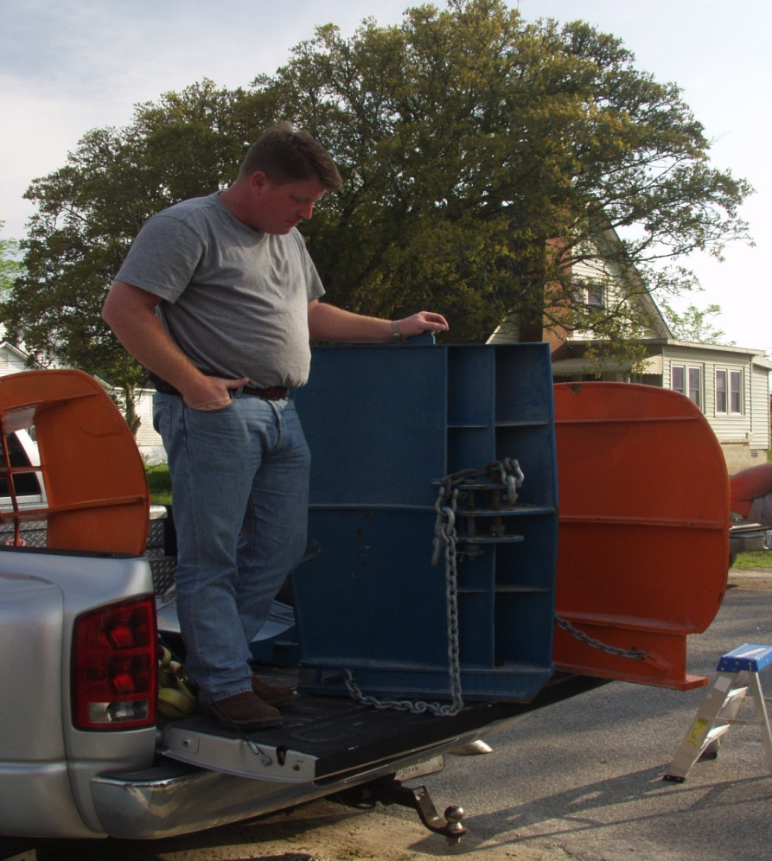
Potential Door for Smaller Nets
High Aspect
Very Short
Used Worldwide
Need to be evaluated

Slide 36
A Limited Propeller Study Was Conducted by Sea Grant
Cooperating vessel tested the difference in fuel efficiency between a traditional Kaplan propeller and the Rice Skewed Wheel.
There are more improved propellers on the market since the Skewed Wheel
Industry requested an evaluation

Slide 37
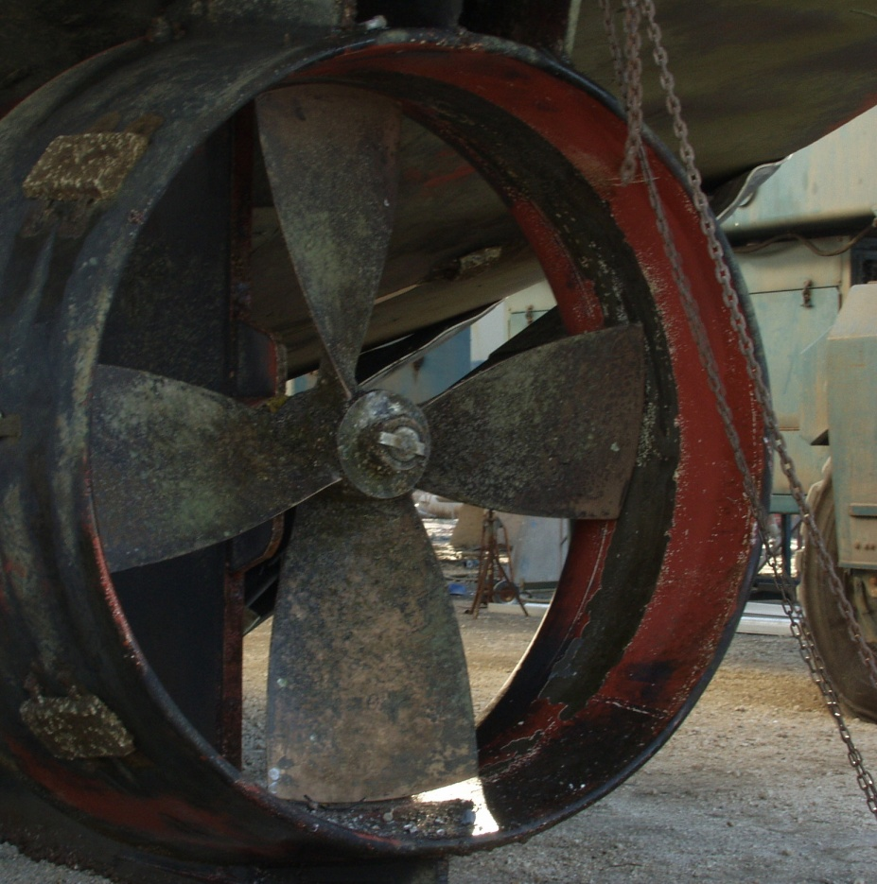
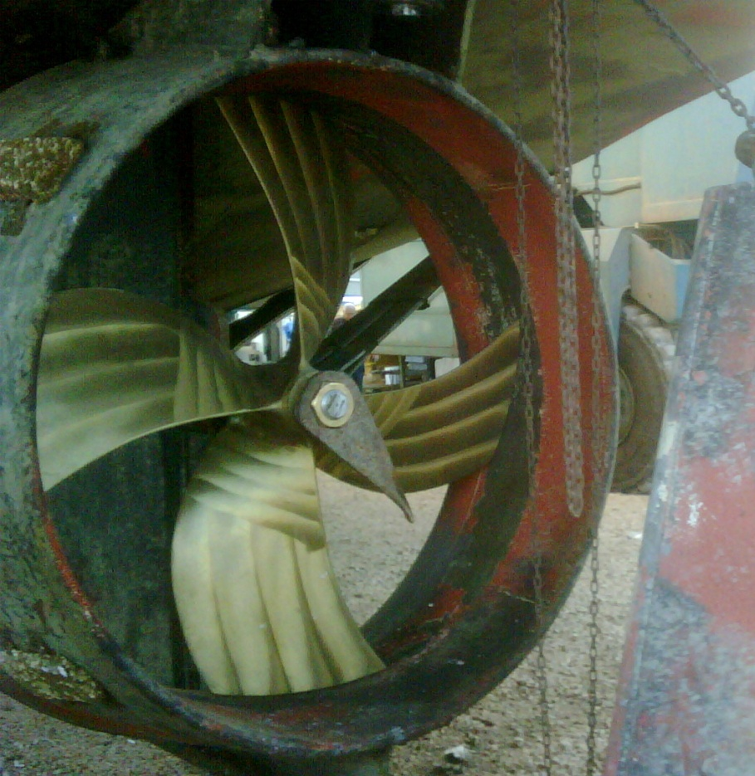
Comparing Efficiency of “Nozzled” Kaplan and Skewed Propellers

Slide 38
The Skewed Propeller
… is not the newest technology; the Rice Speed Wheel has been used since the skewed propeller was designed.
Some vessel owners have switched to the skewed propeller, but no empirical, comparative performance data were ever collected from fishermen.
At industry’s suggestion, RPM and fuel consumption was compared between Kaplan-style and skewed propellers.
  Kaplan-style performance data collected in early fall.
  Skewed performance data collected in winter when seas are stronger/heavier, and currents are faster.
  Thus reported differences of 0.9 GPH savings (6.1%) with the skewed wheel are conservative!

Slide 39
Skewed Wheel Results
  Kaplan-style performance data collected in early fall.
  Skewed performance data collected in winter when seas are stronger/heavier, and currents are faster.
  Thus reported differences of 0.9 GPH savings (6.1%) with the skewed wheel are conservative!

Slide 40
Important
The following data and calculations are from Professor Mike Haby with Texas A&M Sea Grant
These numbers were derived from a fleet of Gulf trawlers from which he has excellent economic data
The numbers would probably not apply to an inshore Louisiana vessel.

Slide 41
Gallons of Fuel Used Before Costs Of New Doors and Webbing Are Recouped at Various Diesel Prices and Fuel Reduction Rates
$/gal | 20% reduction | 24% reduction | 28% reduction
$2.00 | 26,500 | 22,083 | 18.979
$2.20 | 24,091 | 20,076 | 17,208
$2.40 | 22,083 | 18,403 | 15,774
$2.60 | 20,385 | 16,987 | 14,560
$2.80 | 18,929 | 15,774 | 13,520
$3.00 | 17,667 | 14,722 | 12,619
$3.20 | 16,563 | 13,802 | 11,830
$3.40 | 15,588 | 12,990 | 11,134
$3.60 | 14,722 | 12,269 | 10,516
$3.80 | 13,947 | 11,623 | 9,962
$4.00 | 13,250 | 11,042 | 9,464

Slide 42
At $3.00 diesel cost, the following amount of gallons need to be utilized in order to recoup cost of the new gear in Haby’s Gulf Study
20% Fuel Reduction 17,667 gallons
24% Fuel Reduction 14, 722 gallons
28% Fuel Reduction 12,619 gallons

Slide 43
Data From a Smaller Vessel
The South Carolina vessel documented a 10.5-11 gph burn rate
Utilizing just the cambered doors, the fuel burn rate was reduced to 9.0-9.5 gph
This is a fuel reduction rate of around 15-19%

Slide 44
Data From a Smaller Vessel
It is obvious that payback for the doors would take longer when only about 2 gallons per hour is being saved on the smaller vessel.
Note that fuel savings on many of the larger Gulf boats was around 5-6 gallons per hour.

Slide 45
Some Additional Expectations to be Derived from Utilizing the Gear
Cambered doors & small-diameter HDPE webbing can drive production costs out of the shrimp-trawling enterprise.
  Fewer RPM are required to reach towing speed so GPH ↓.
  Fewer RPM reduces engine-service hours per hr. operated.
  Reduced fuel use extends time between overhauls.
  The new trawl doors are longer lasting:
    Wooden doors last 12 to 18 months
    Cambered steel doors last 7 to 8 years
  HDPE webbing is also longer lasting:
    Nylon nets last 1 to 2 years
    Sapphire® nets last 3 to 4+ years
    HDPE nets do not require dipping; a huge savings!!
A skewed propeller can further reduce fuel consumption.

Slide 46
Vessels Converting to Doors
Brownsville has over 100 vessels utilizing the doors
Very successful in Western Seafood Fleet in Freeport
Palacios has none
Boats with the doors are scattered throughout the Gulf
Some people can and want to make them work

Slide 47
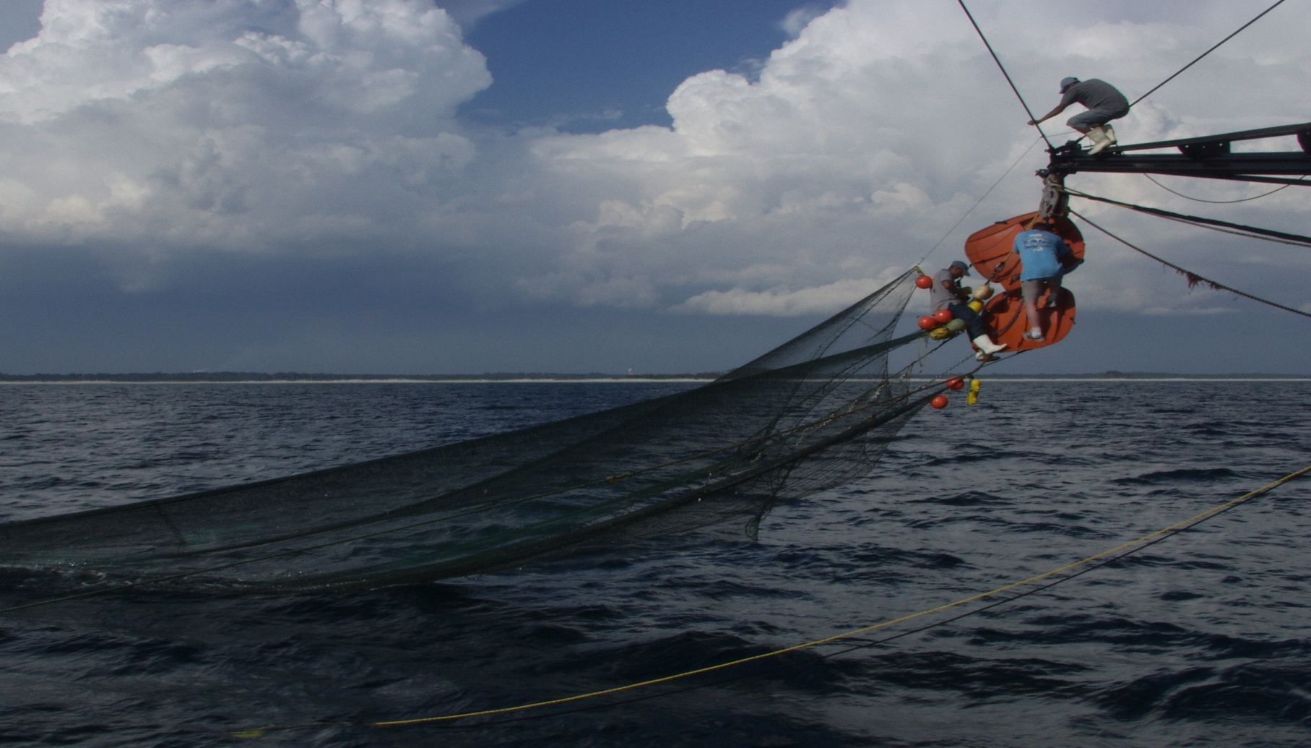
Net monitoring equipment being adjusted on the trawls
Questions? Comments?

