Slide 1
WCMS Online Accessibility
Online Accessibility in Omni Update and WordPress

Slide 2
Accessibility in Omni and Wordpress
LSU Standards

Slide 3
Accessibility in Omni and Wordpress
Design for clarity and simplicity
Can people readily answer the question “Where am I and what can I do here?
Design for comprehension
Design for readability
Consistent formatting, organization

Slide 4
Page Properties & Parameters
Page Title, Description

Slide 5
Page Properties & Parameters
Page Title
Shown as title in tab
Shown in search engine results
Used for browser bookmarks
Read by screen readers
Important for orientation
Important for SEO
Needs to adequately and briefly describe the page
Meaningful titles

Slide 6
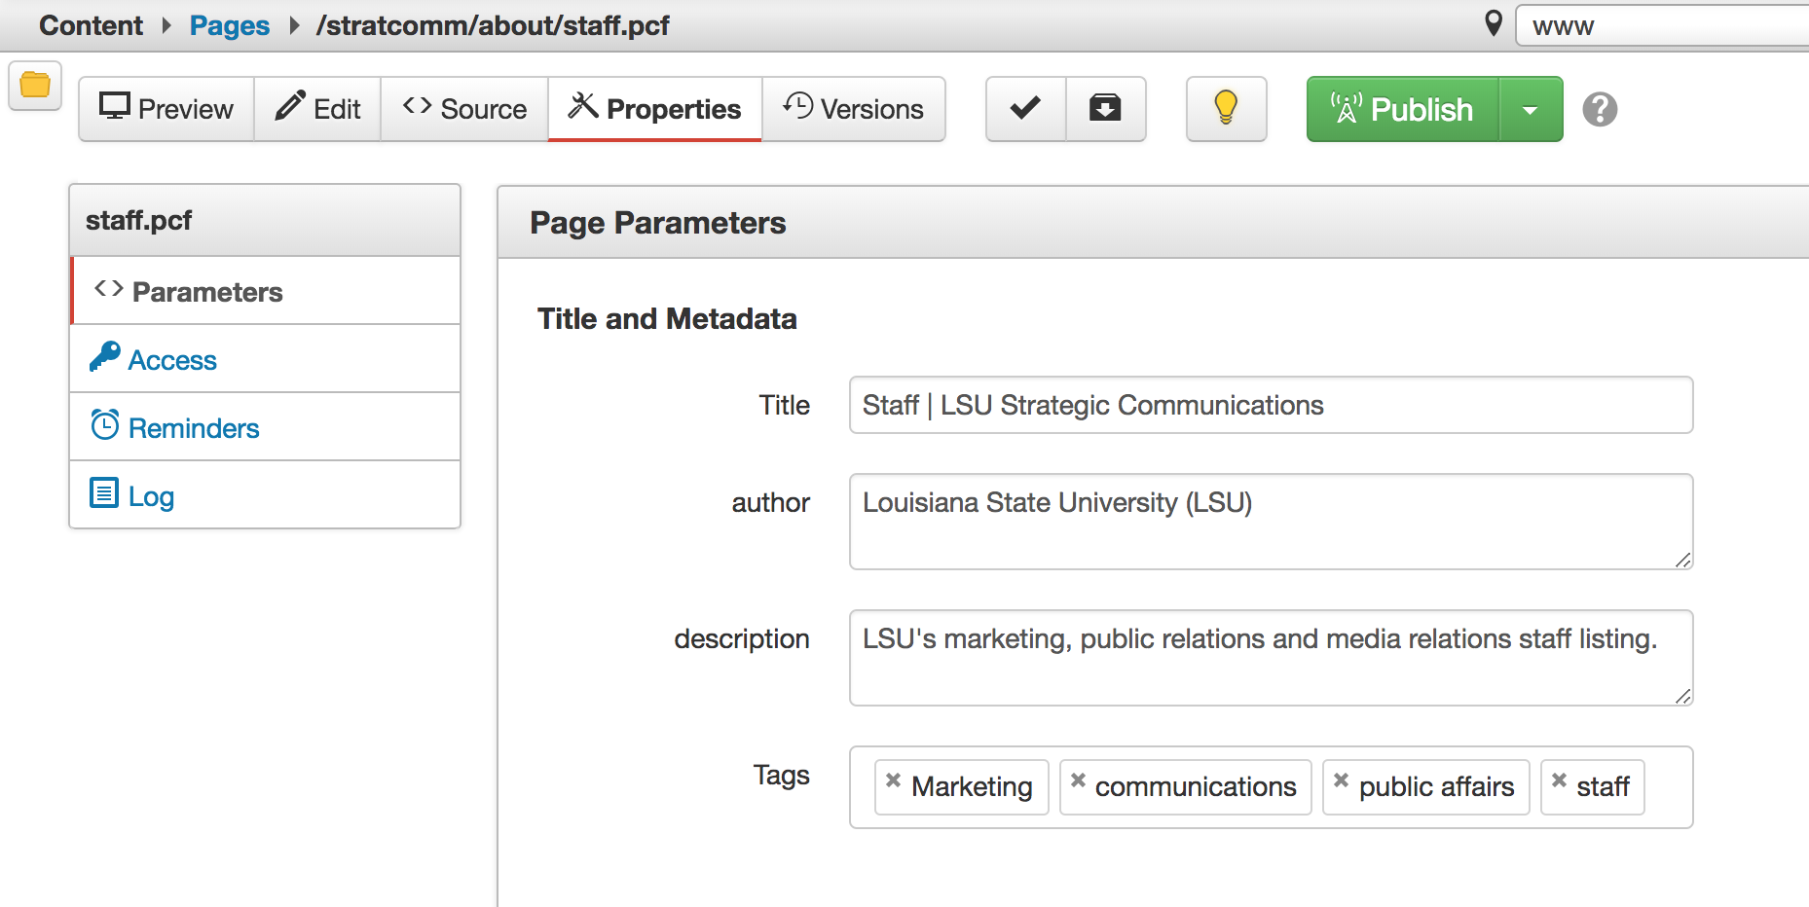
Page Properties & Parameters

Slide 7
Semantic Headings

Slide 8
Semantic Headings
Purpose
Provides structure to a page
Enables users to navigate a page quickly
Additional styles should not be applied to semantic headings
Never use bold, italicize, underline, etc. to define sections on your site instead of headings
Notes:
Headings with an equal or higher rank start a new section, headings with a lower rank start new subsections that are part of the higher ranked section

Slide 9
Semantic Headings
H1 – Main topic of the page
All content pages must have one, and only one, H1
Omni - If a page contains a banner with caption, that counts as the h1
H2 - Used to identify major sections of the page
H3 - Subheads within a major section of content
H4, H5, H6 - these will rarely be used; remember levels should never be skipped

Slide 10
Semantic Headings
Nest headings by their rank
Do not skip headings
Do not use headings to create large spacing

Slide 11
Semantic Headings
Compliant
Non Compliant
h1
h2
h2
h3
h2
h3
h3
h4
h4
h2
h1
h3
h3
h4
h4
h2
h4

Slide 12
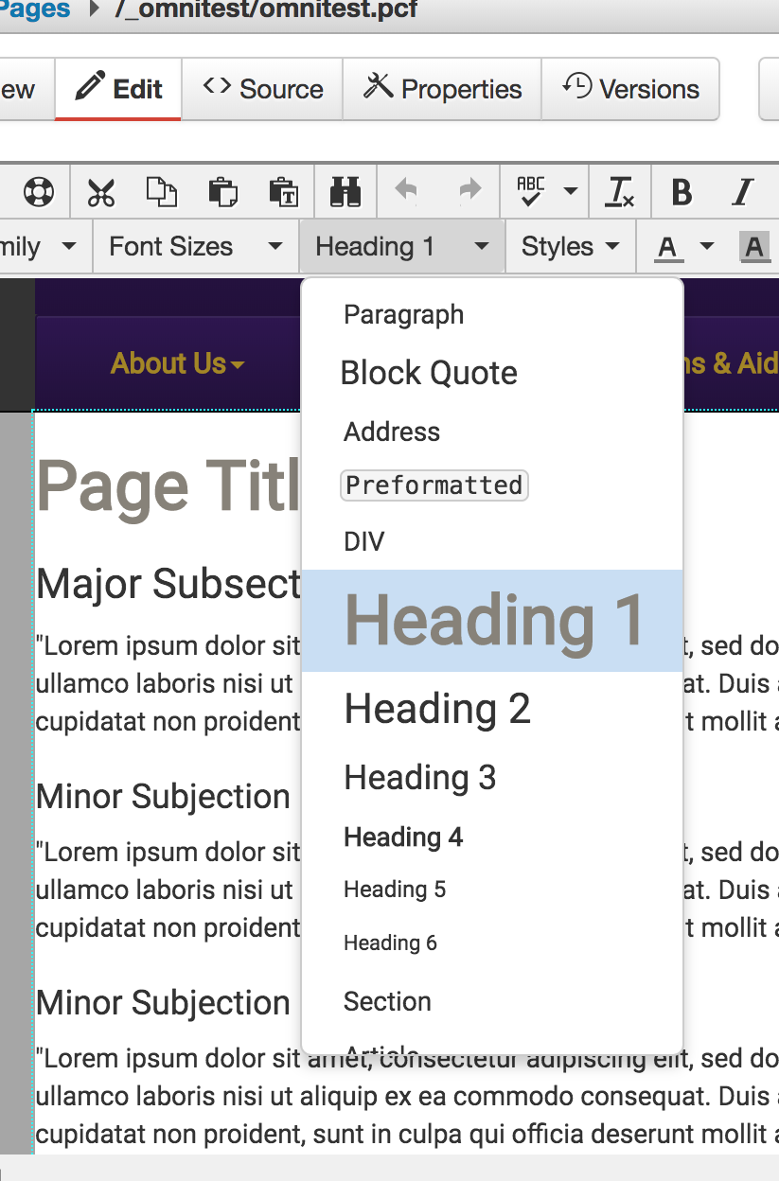
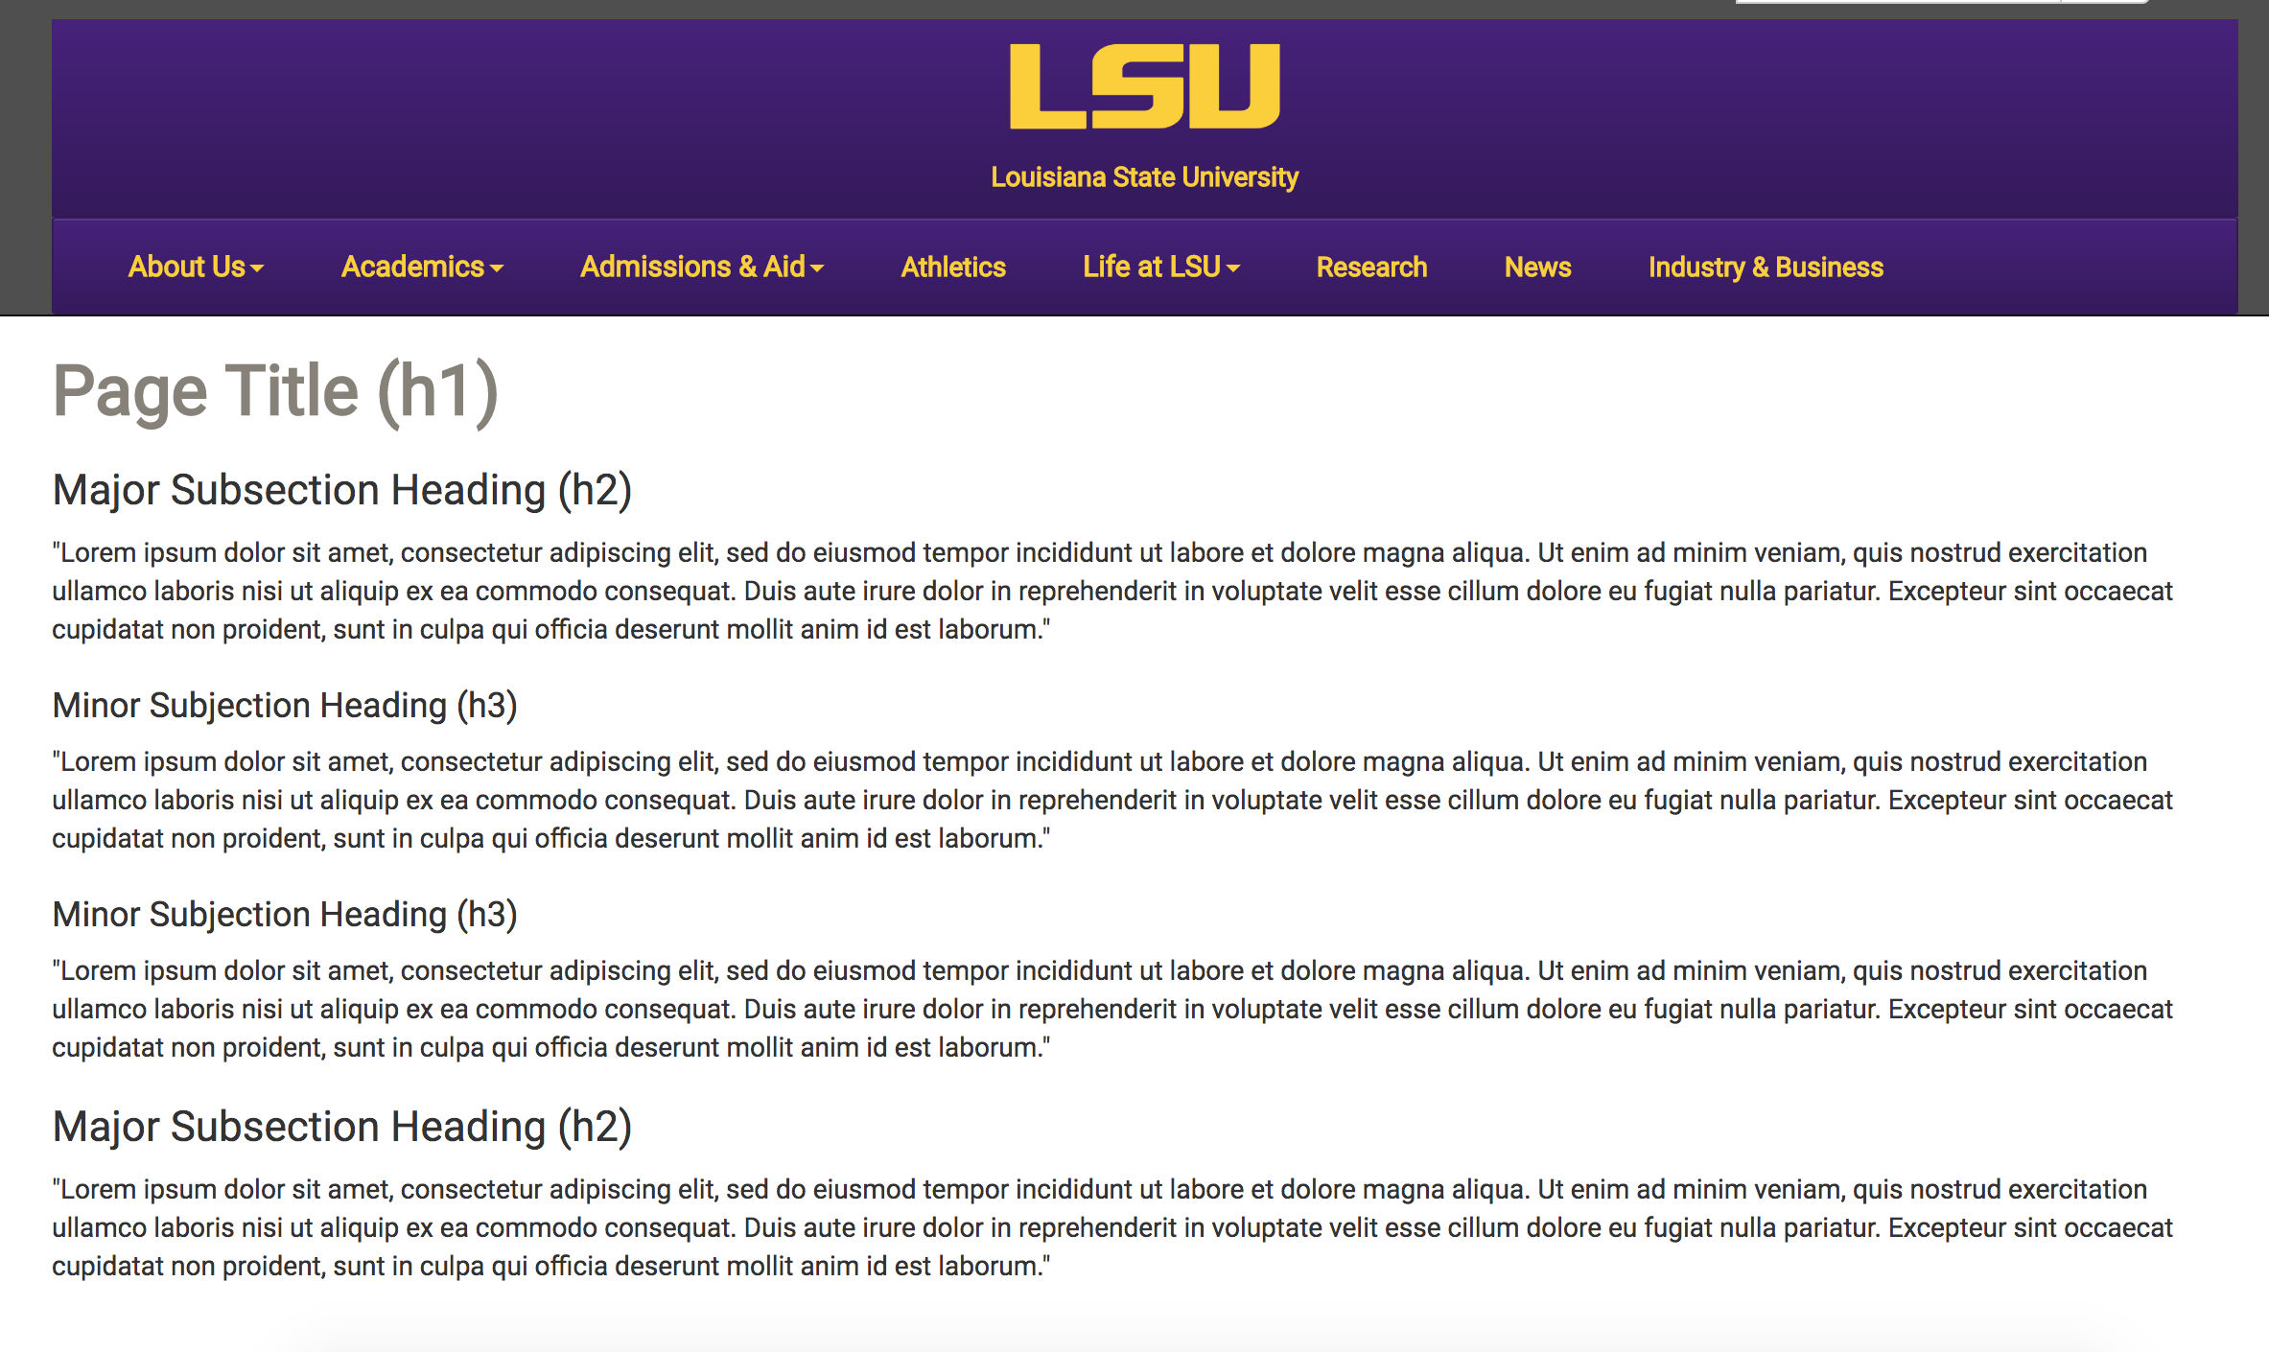
Semantic Headings

Slide 13
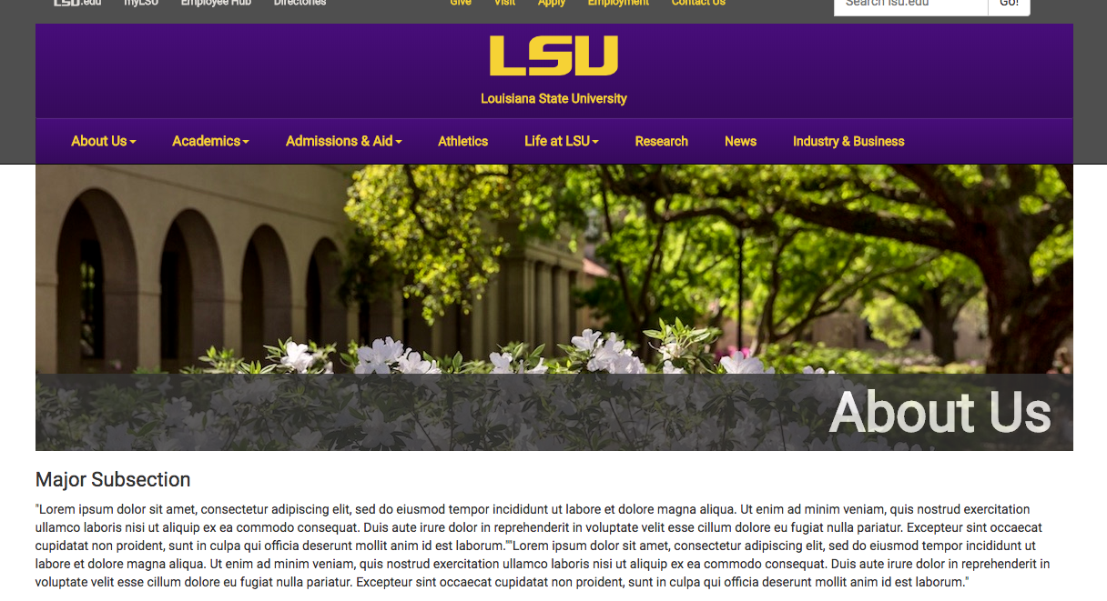
Semantic Headings

Slide 14
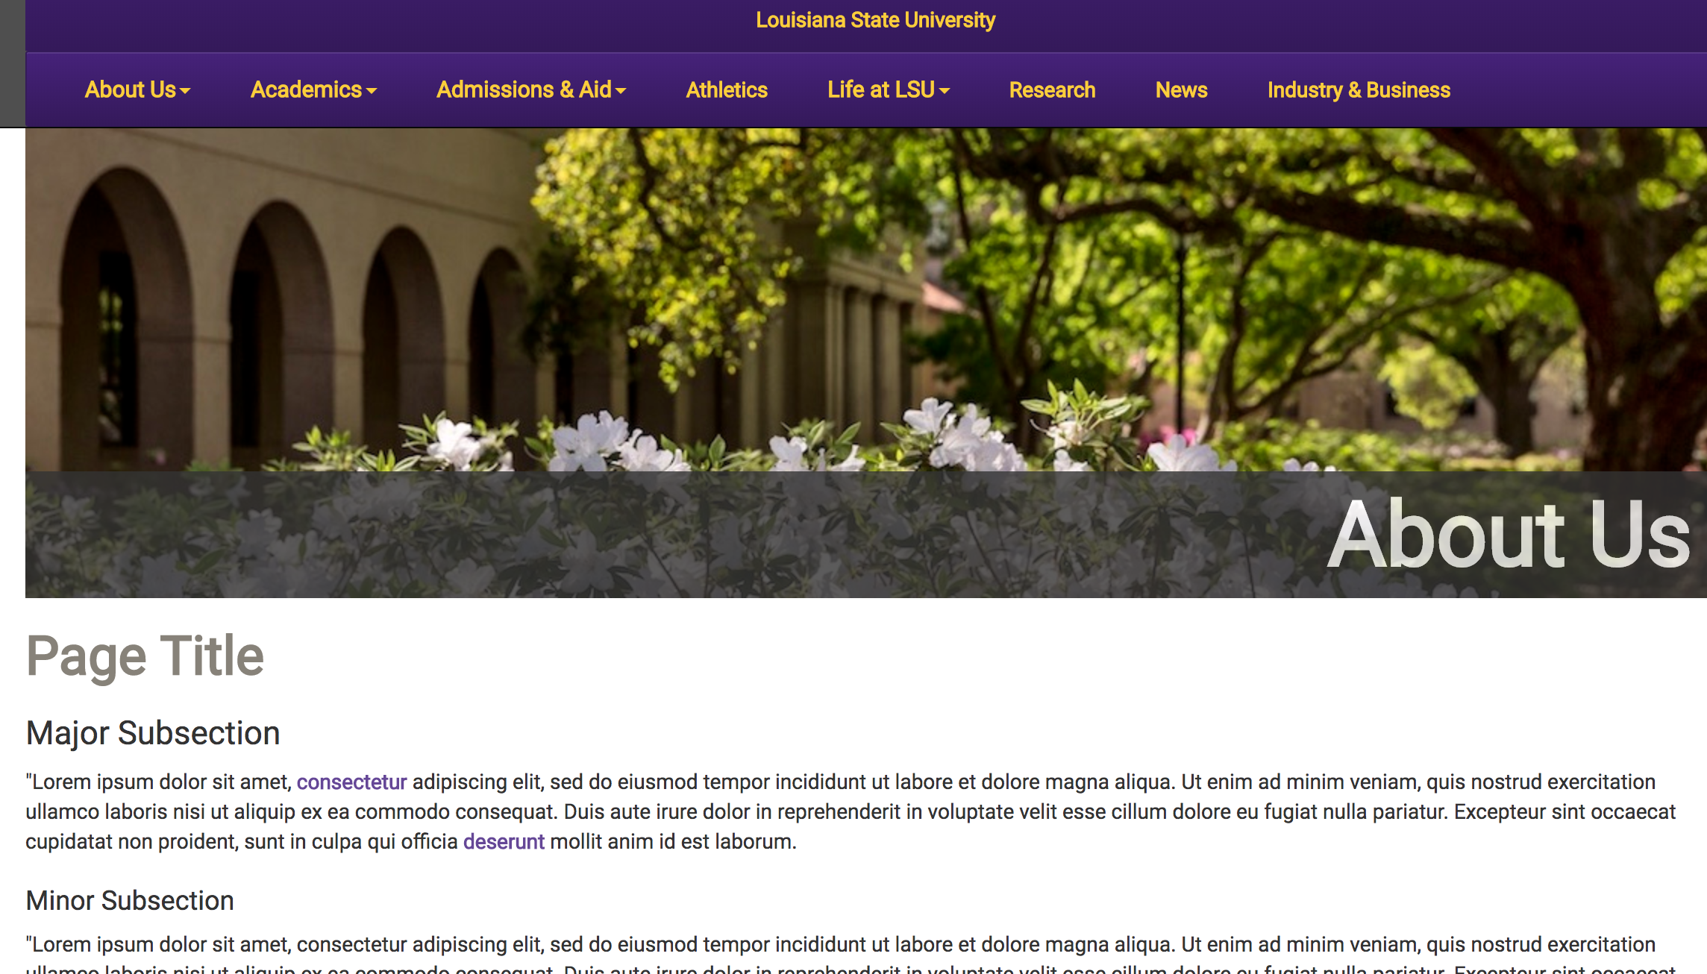
Semantic Headings
Non compliant

Slide 15
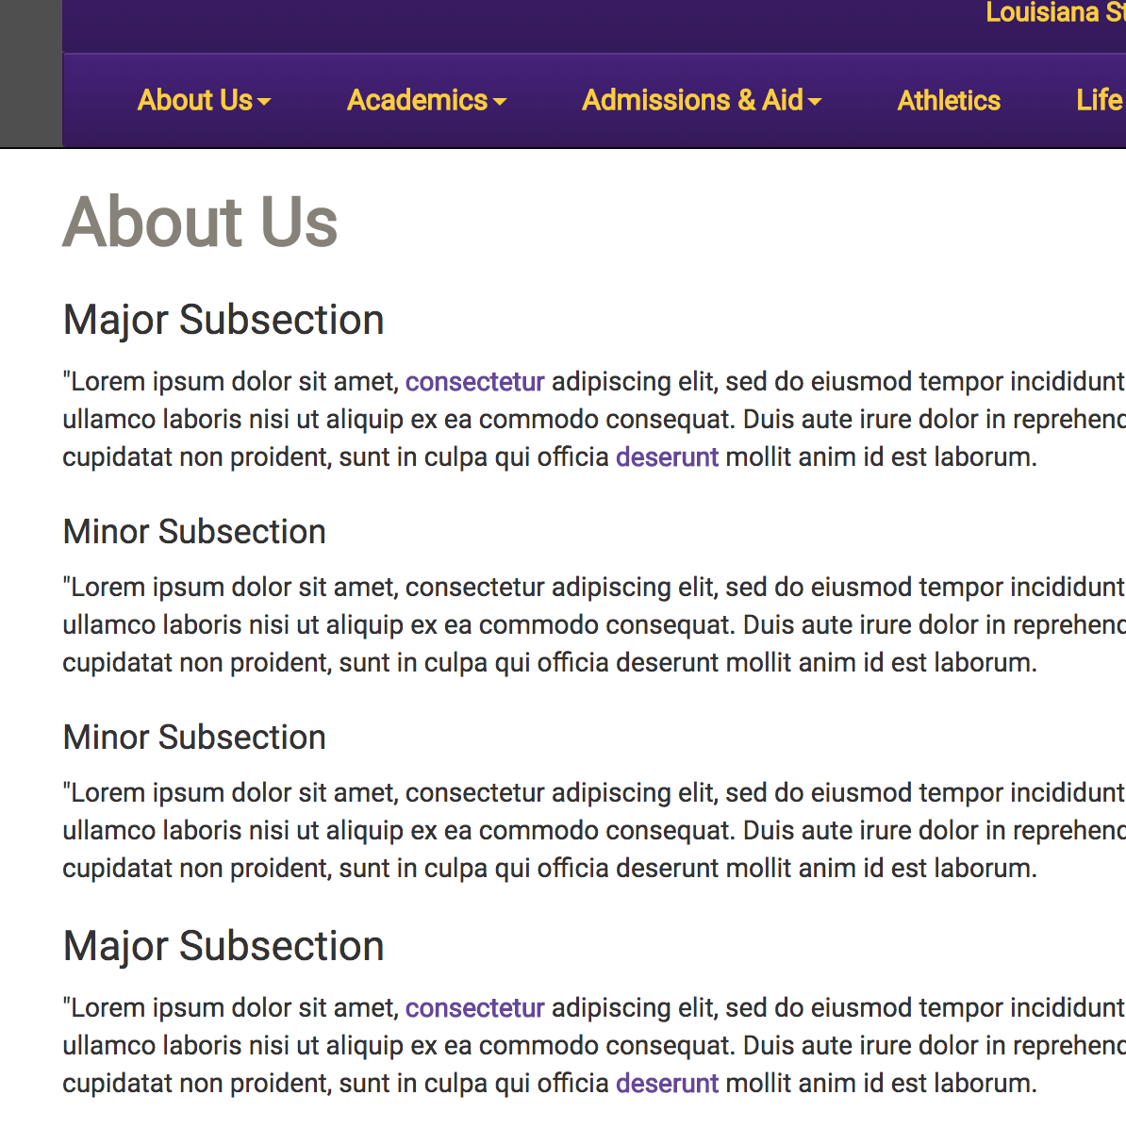
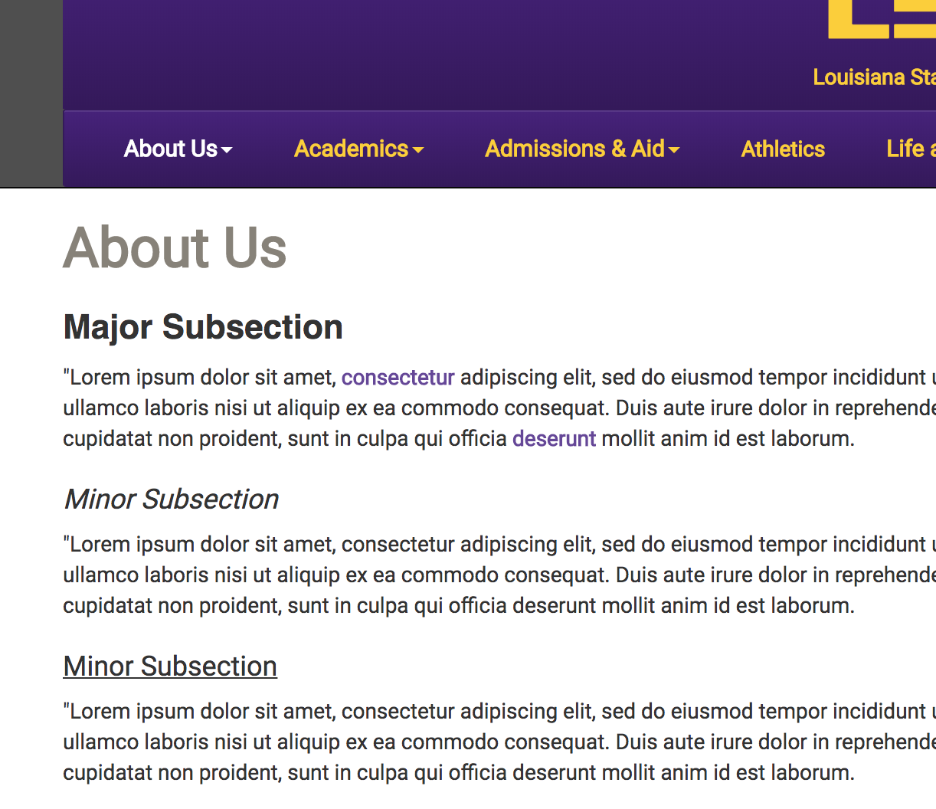
Semantic Headings
Compliant
Non Compliant

Slide 16
Semantic Headings
Compliant
Non Compliant

Slide 17
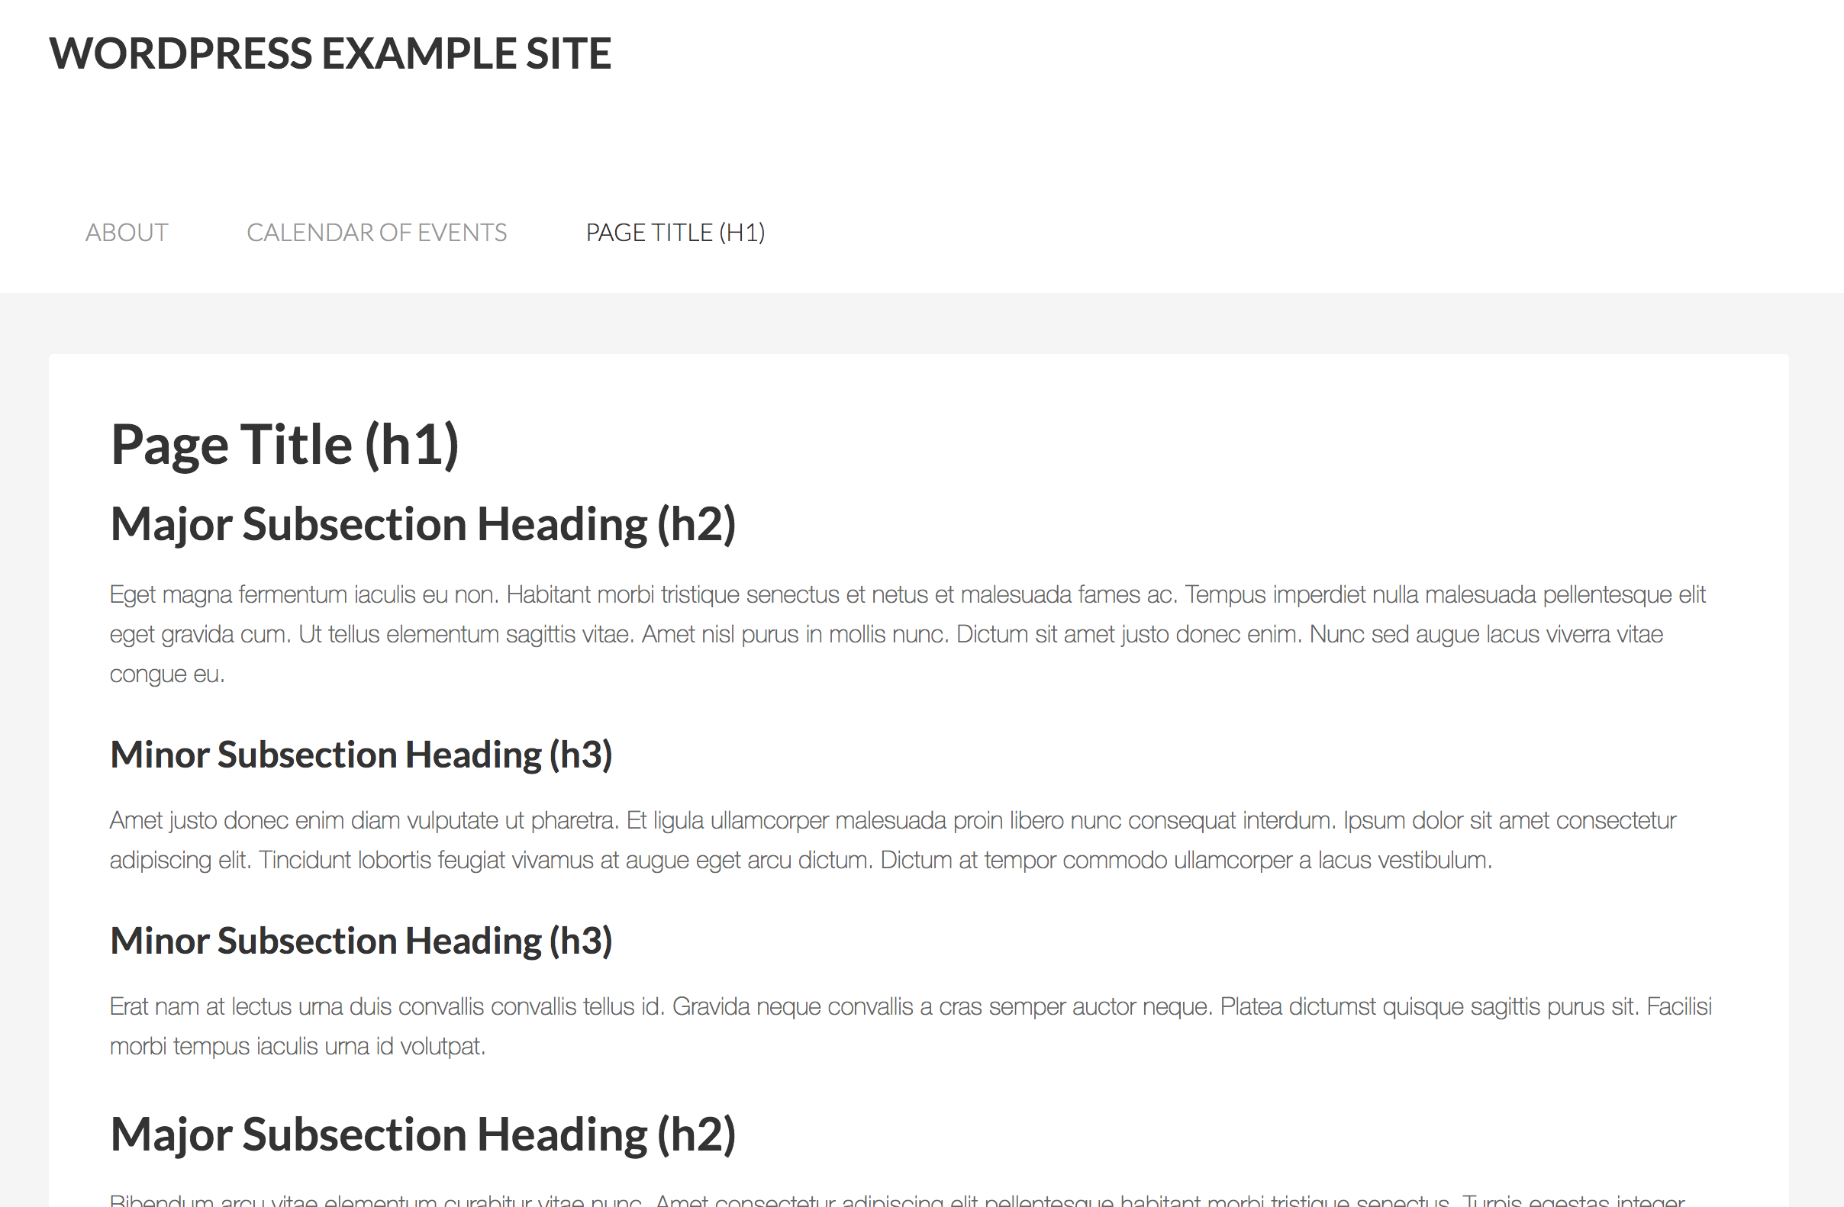
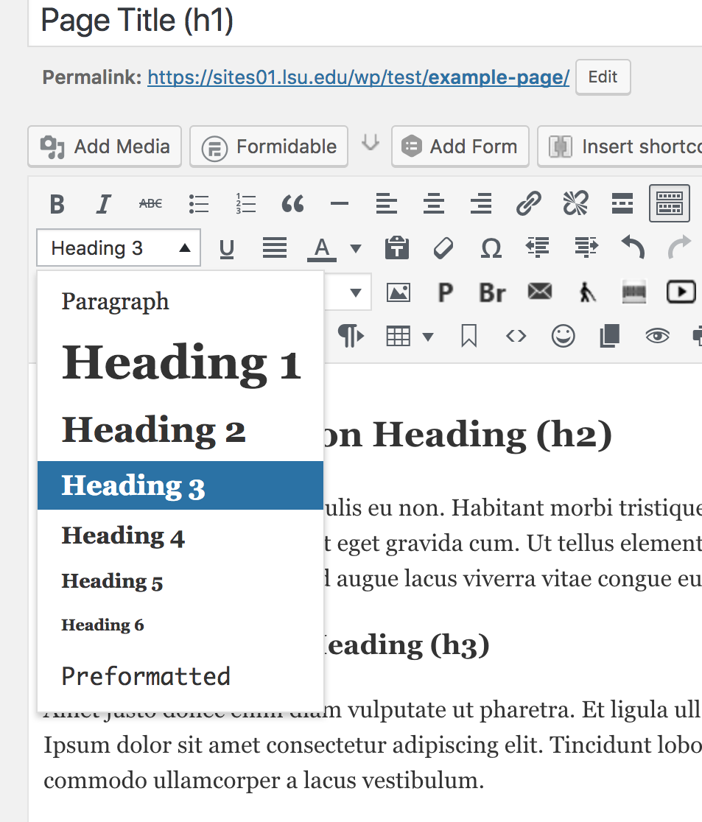
Semantic Headings

Slide 18
Text Formatting

Slide 19
Text Formatting
Only use all uppercase words when typing an acronym. Some screen readers will read “MUST REGISTER” as “M.U.S.T. R.E.G.I.S.T.E.R.”
Use bold or italics for emphasis
Underlines are reserved for urls

Slide 20
Text Formatting
Styles
Large Intro Text
Block Quotes
Fine Print

Slide 21
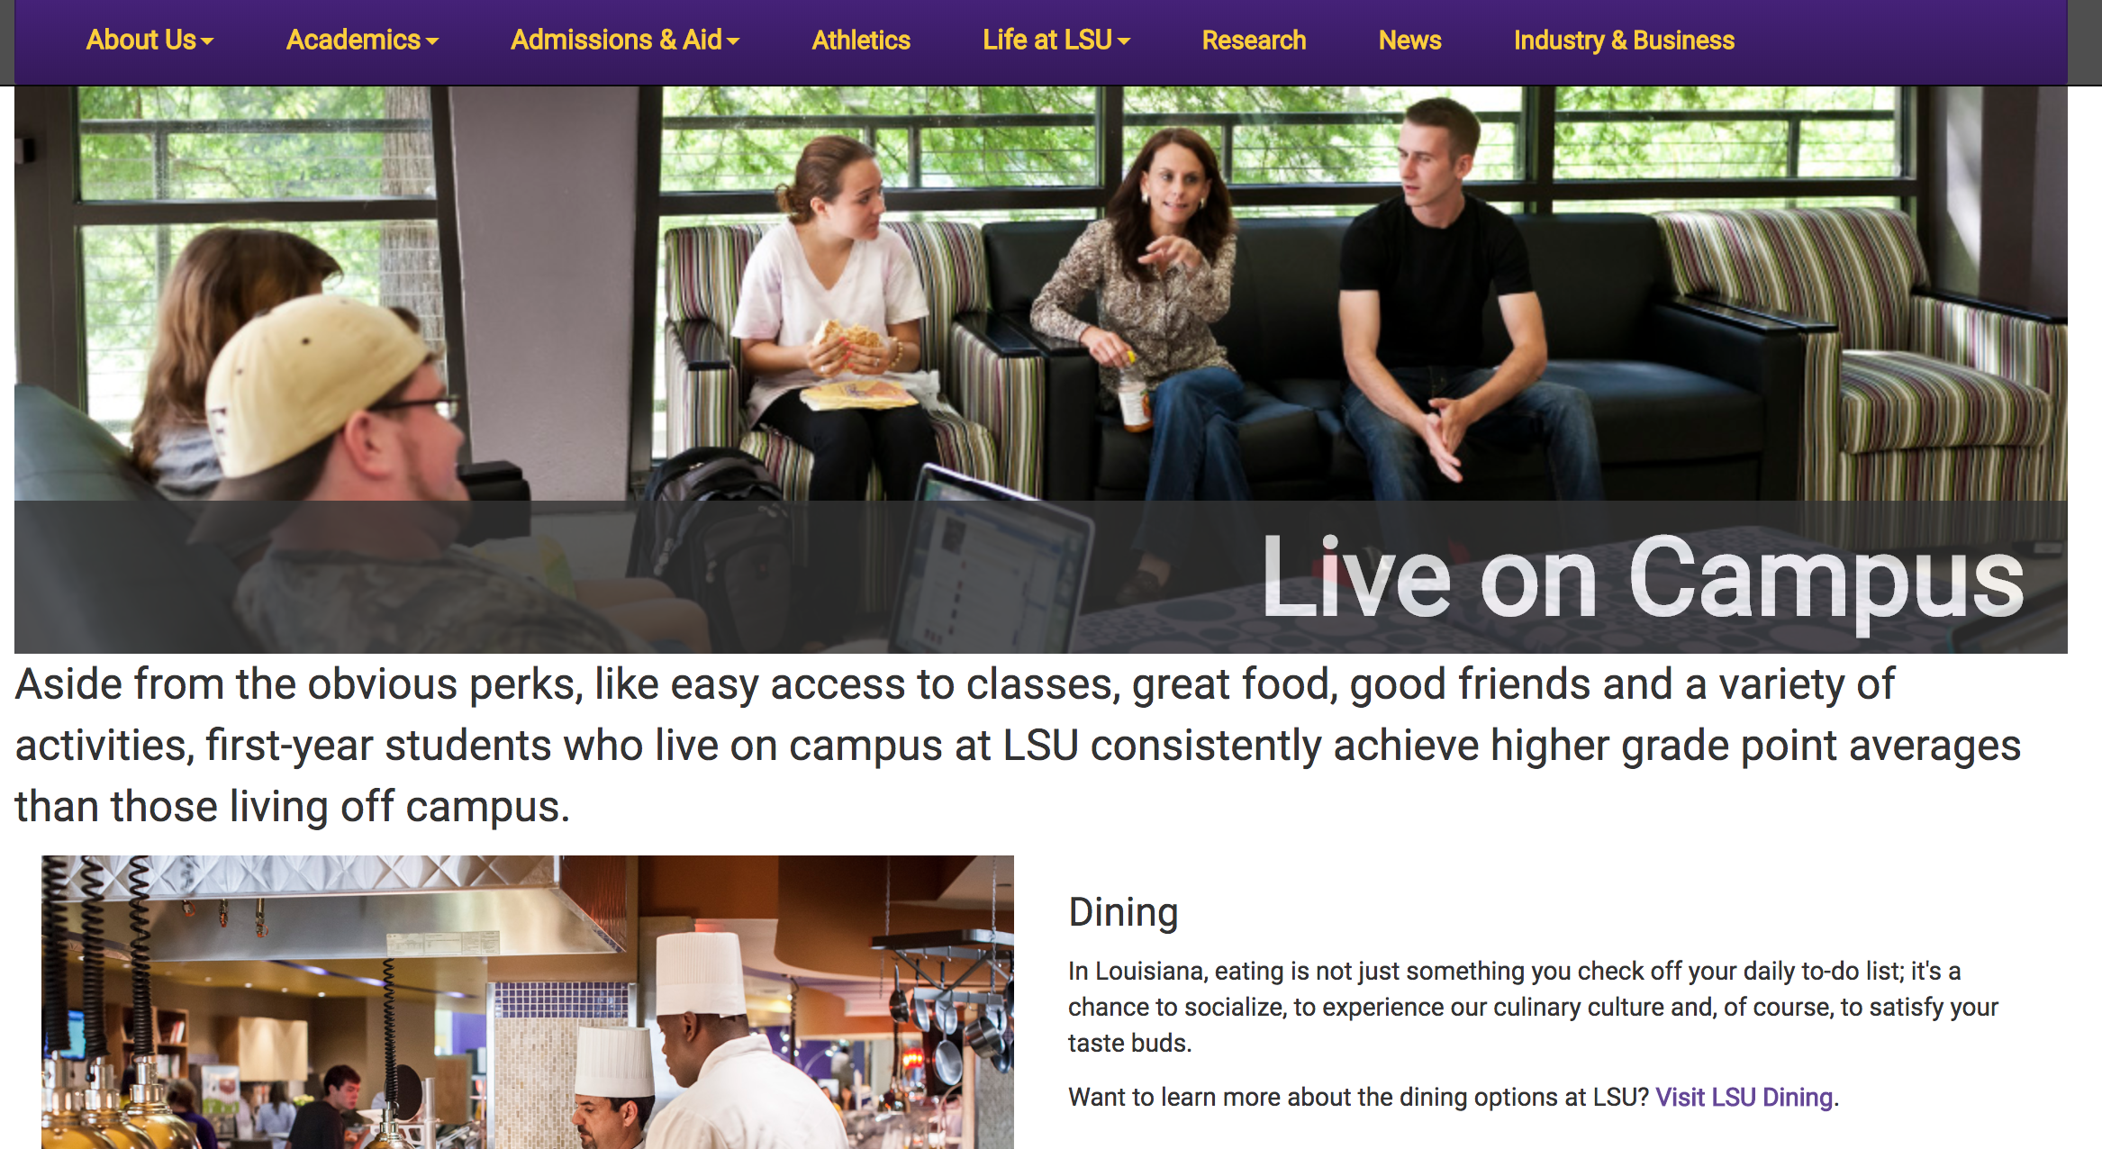
Text Formatting
Large Intro Text Example

Slide 22
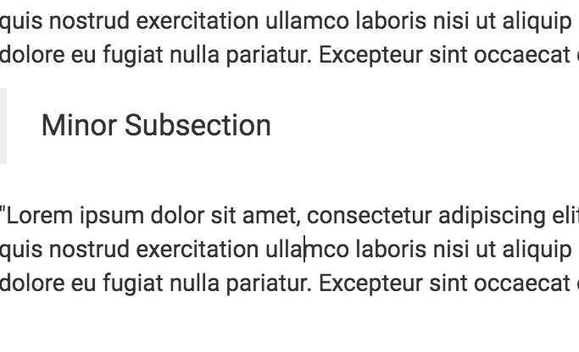
Text Formatting
Compliant
Non Compliant

Slide 23
Lists
Unordered, Ordered

Slide 24
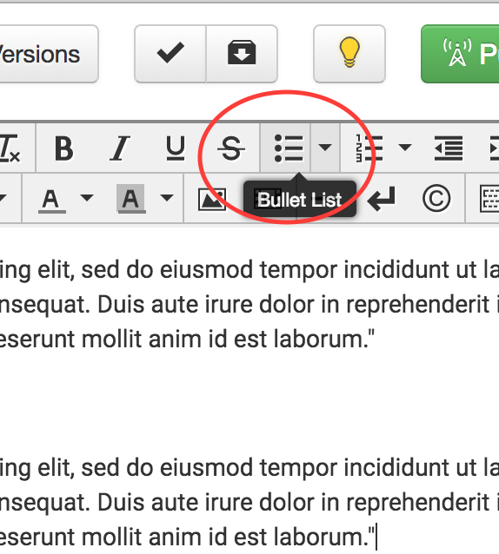
Lists
Unordered Lists
Used when the order of the items is not relevant
Used bulleted list from toolbar
Example:
Corn
Tomatoes
Bean
Onion
Garlic

Slide 25
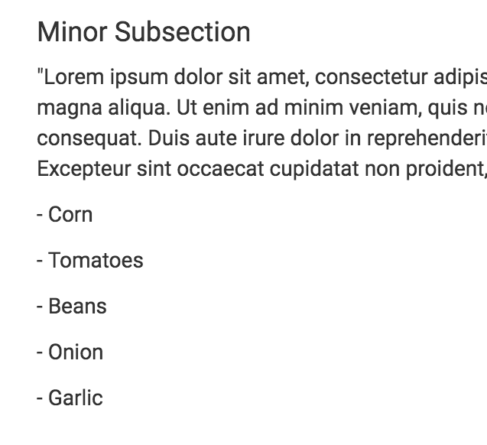
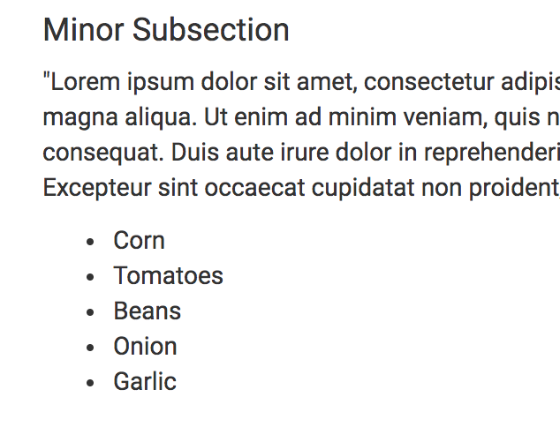
Lists
Compliant
Non compliant

Slide 26
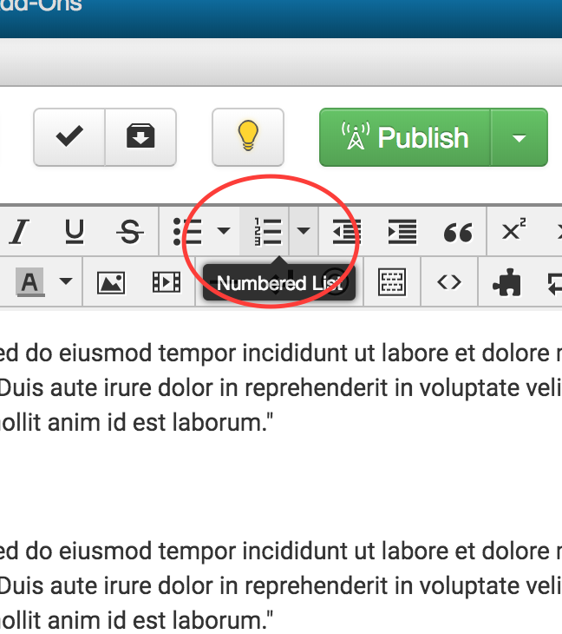
Lists
Ordered Lists
Used when the order of the items is relevant, sequential
Used numbered list from toolbar
Example:
Cook beans for 45 minutes.
Cut vegetables in small cubes.
Sauté onions and garlic.
Deglaze using the tomatoes.
Add corn and beans.

Slide 27
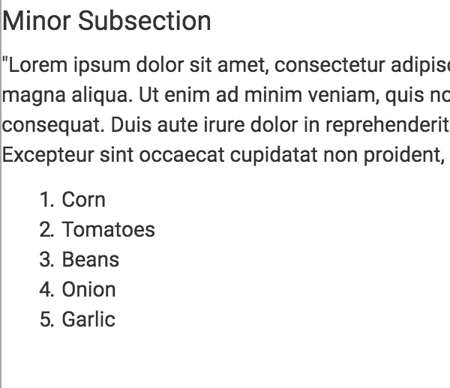
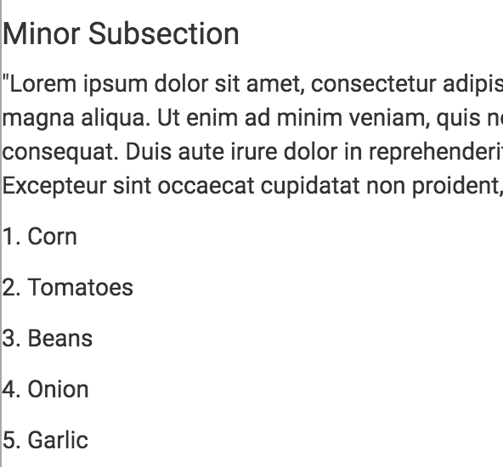
Lists
Compliant
Non Compliant

Slide 28
Links
Link Text, Link Title, Link Target

Slide 29
Links
Link Text
Link text should make sense when read by itself; using generic labels like "click here" and " learn more" is inaccessible
“Click here to register for campus tours.” can instead be “Register for campus tours.”
Redundant links, such as linking both the image and text, should be avoided in most cases

Slide 30
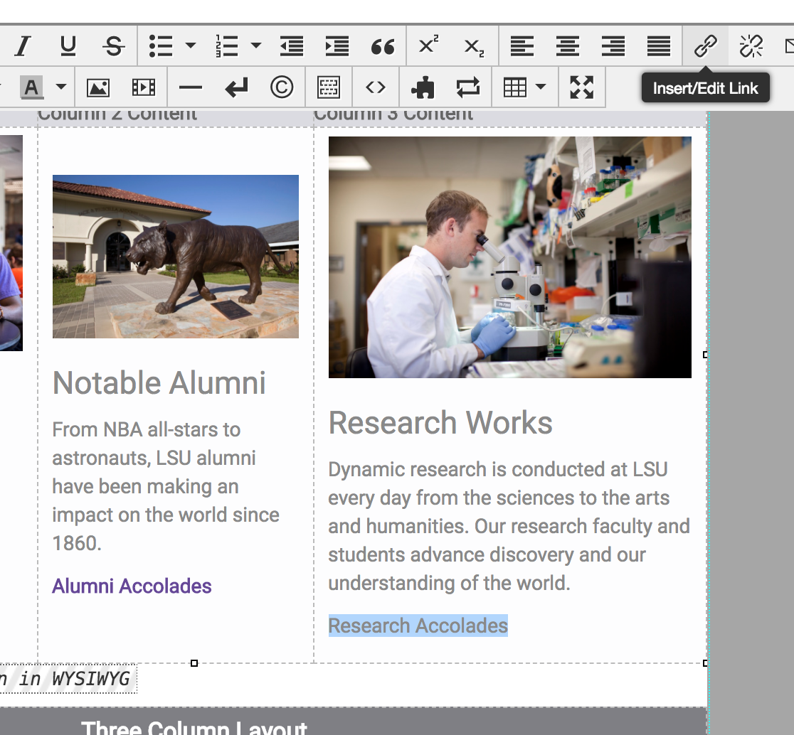
Links

Slide 31
Links
Link Title
When linking to an external site, the link title should indicate that the user is “leaving lsu.edu.”
When linking to documents, videos, larger versions of thumbnail images, the link title should identify the type of file being link to, for example “Download PDF,” “View larger image,” or “Watch YouTube video.”
Avoid redundancy. Link title should include unique information
Leave blank if no additional, unique information needs to be provided

Slide 32
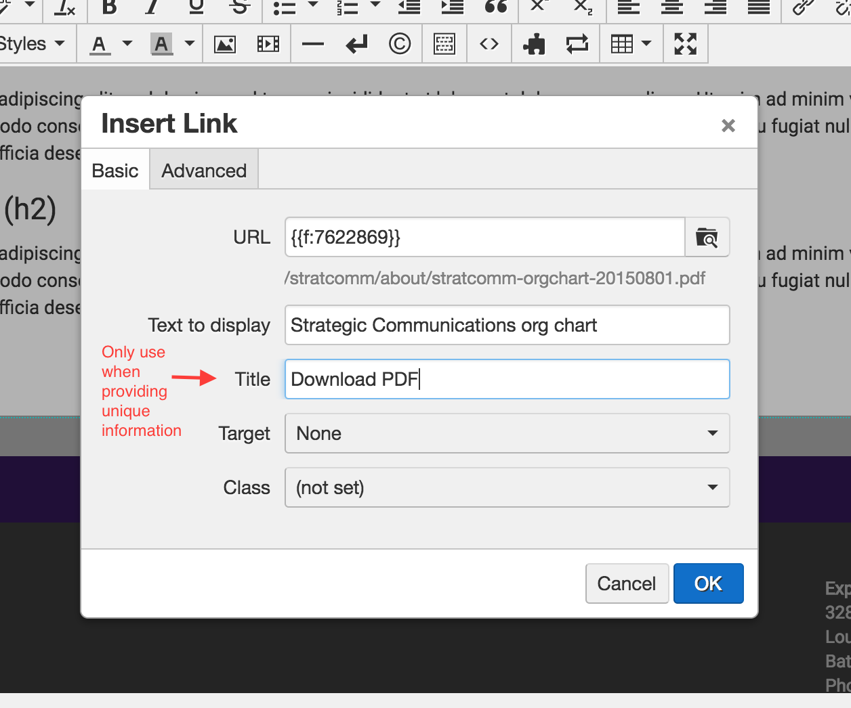
Links

Slide 33
Links
Link Target
When linking to other pages within lsu.edu, do not force links to open a new browser window or tab.
In some cases, it may be appropriate to open a link to an external site in a new browser window/tab.
Empty Links
Do not add empty links to manipulate text style
Use remove link from toolbar instead of backspace
Make sure only the link text is hyperlinked, no extra spaces
Notes:
Open in a new window - leaving lsu.edu, documents, pdfs
Empty links - extra coding in navigation, not actually a link, but an action

Slide 34
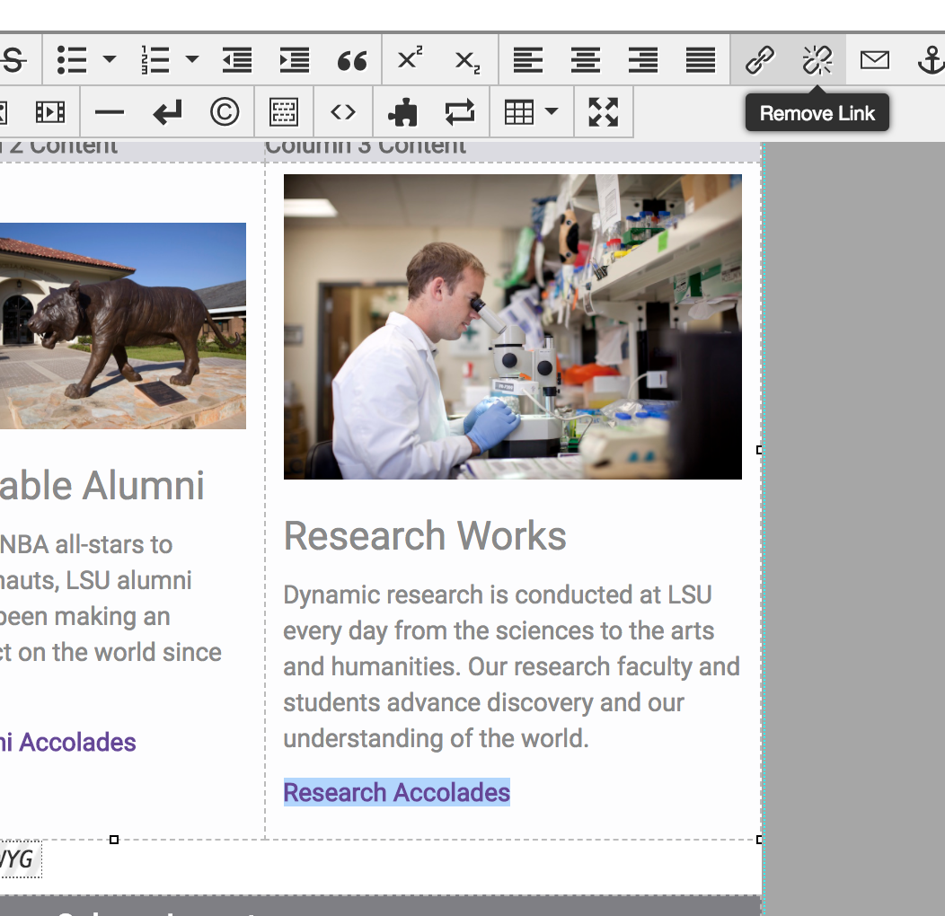
Links

Slide 35
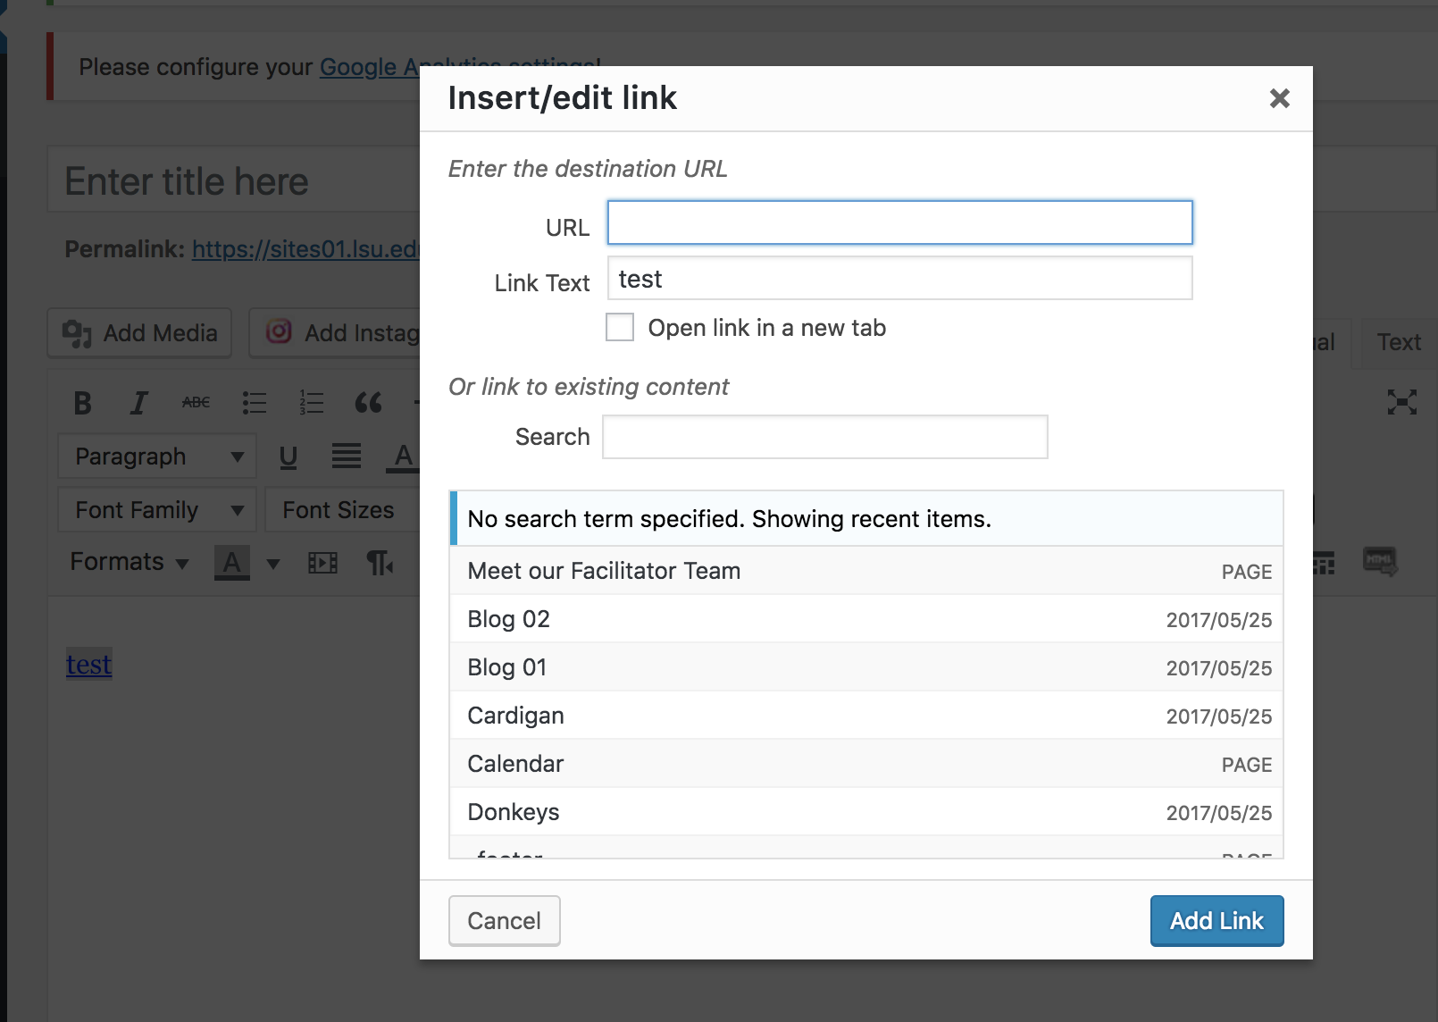
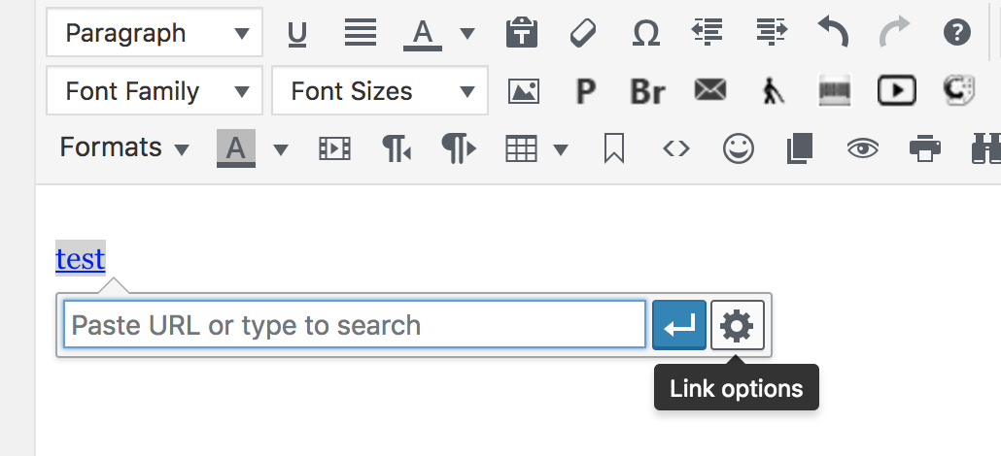
Links
Wordpress

Slide 36
Images
Alt Text, Omni Sliders

Slide 37
Images
Images are inherently inaccessible to people who are unable to see them
Use images containing text sparingly
Alternative text
Alternative text provides screen reader software users with access to all of the non-text information.
Short description of the content of the image
Browsers also display alt text visibly if an image fails to load
“Description” in Omni
Improves SEO
Notes:
Text in images
can’t trap large amounts of text in images
copy needs to be in body copy

Slide 38
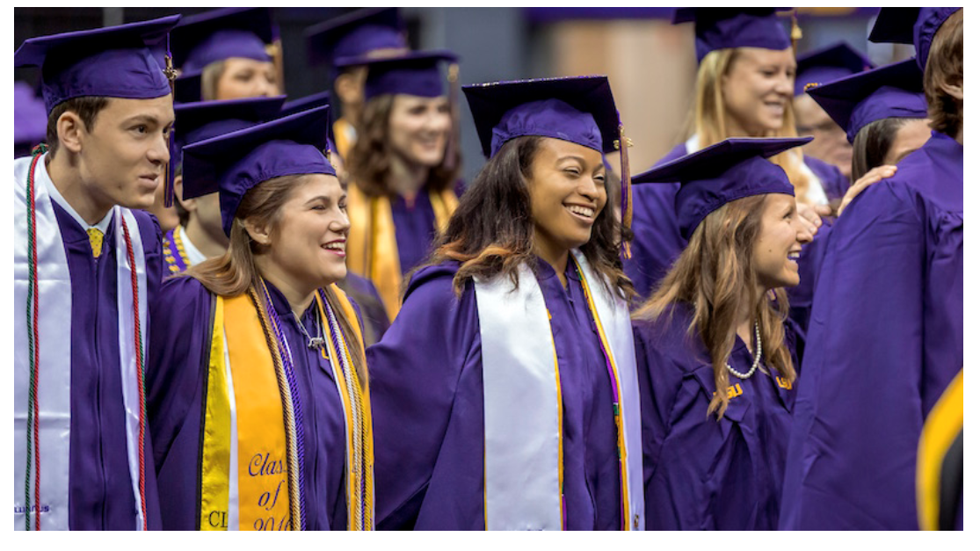
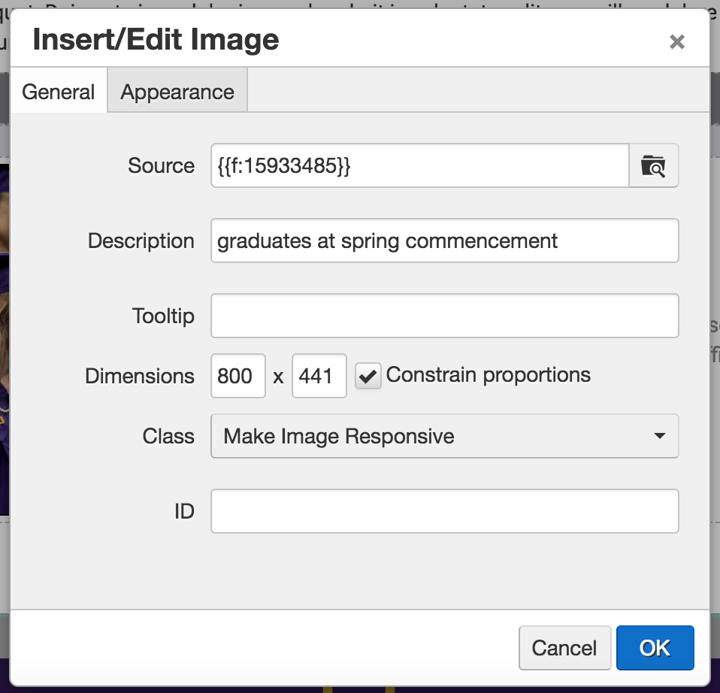
Images

Slide 39
Images
Non compliant

Slide 40
Images
add example (event artwork)
Notes:
Text in images
can’t trap large amounts of text in images
copy needs to be in body copy

Slide 41
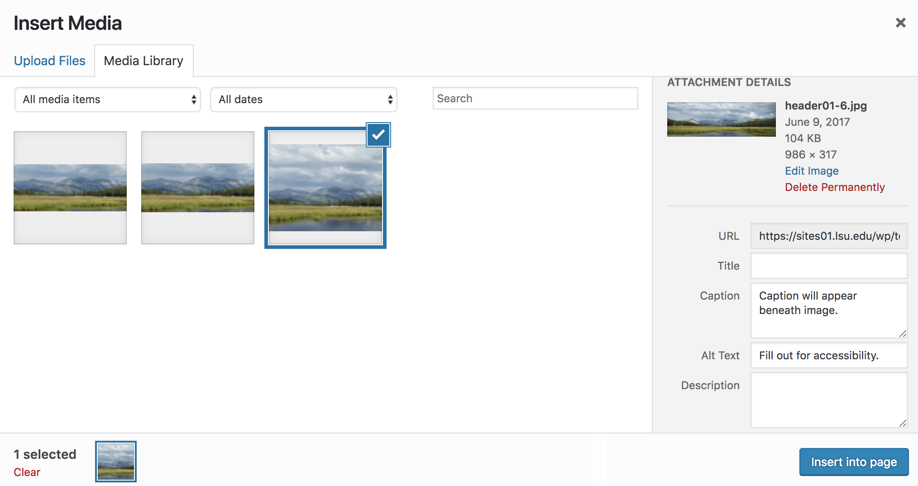
Images
Notes:
Ignore Title & Description fields
Only use caption if you want text to appear beneath image
Always fill out Alt Text.

Slide 42
Images
Omni Sliders
Title - Text in purple box
Description - Text in white box
Caption - brief description of the image, does not display
Link
All required
Slider images should be photographs or simple artwork
Notes:
Description = alt text
Photos and images in Omni sliders should not contain any text. All necessary text should be in the Title & Caption

Slide 43
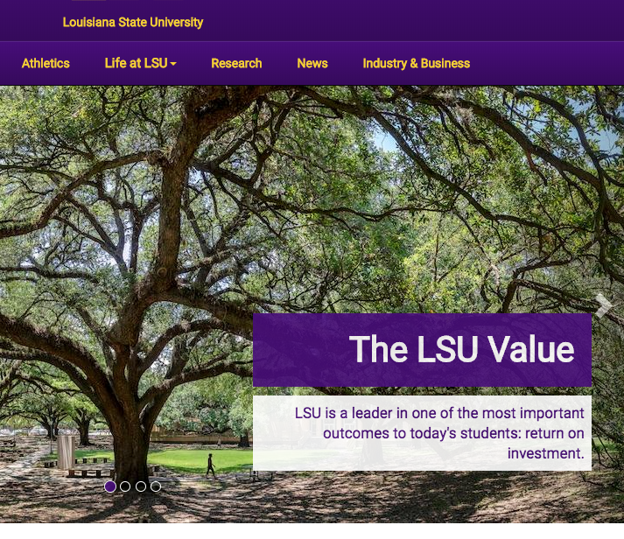
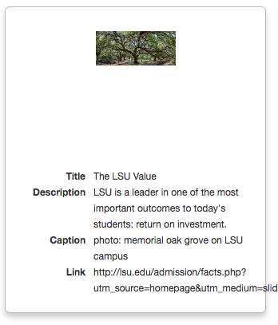
Images

Slide 44
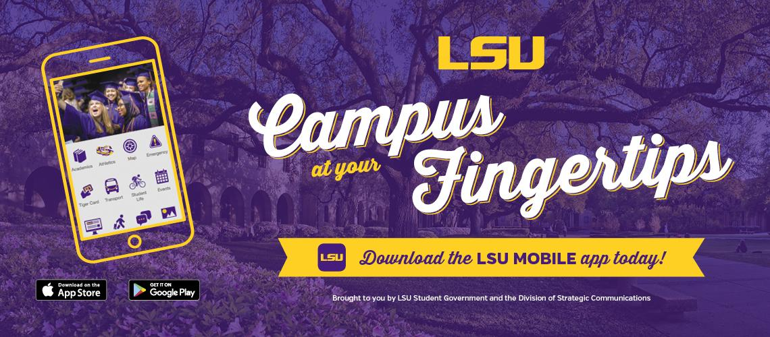
Images
Non compliant

Slide 45
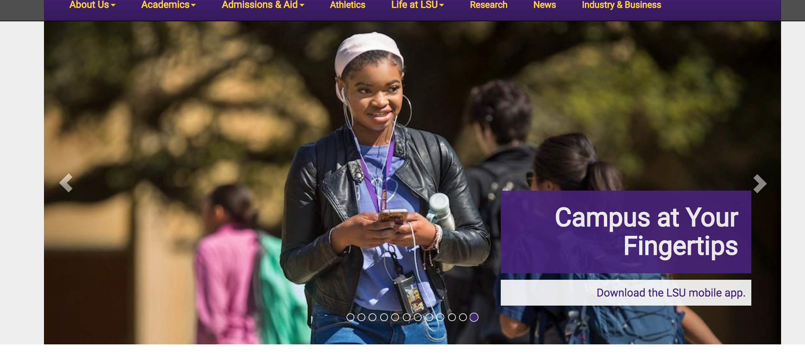
Images
Compliant

Slide 46
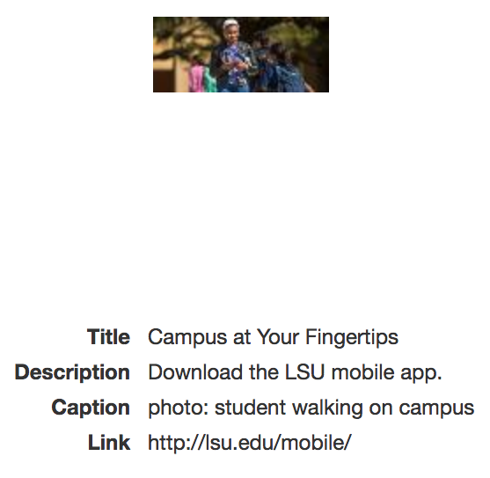
Images
Compliant

Slide 47
Tables
Data Tables, Layout Tables

Slide 48
Tables
Data tables
Must have headings
Should not be used to layout tables
Do not nest tables
Do not use tables straight from toolbar
Data tables in Omni
Simple Table with Borders
Simple Table without Borders
Styled Table Columns with Gray Header
Styled Table Columns with Purple Header
Styled Table Rows with Gray Header
Styled Table Rows with Purple Header

Slide 49
Tables

Slide 50
Tables
Layout tables
Use to adjust page layout
Do not add rows or columns to layout tables
Layout tables in Omni
Two Column Layout
Three Column Layout
Four Column Layout
Spoiler Content - Default Collapsed
Spoiler Content - Default Open
If you need additional layout options, contact Strat Comm. Do not use a data table.

Slide 51
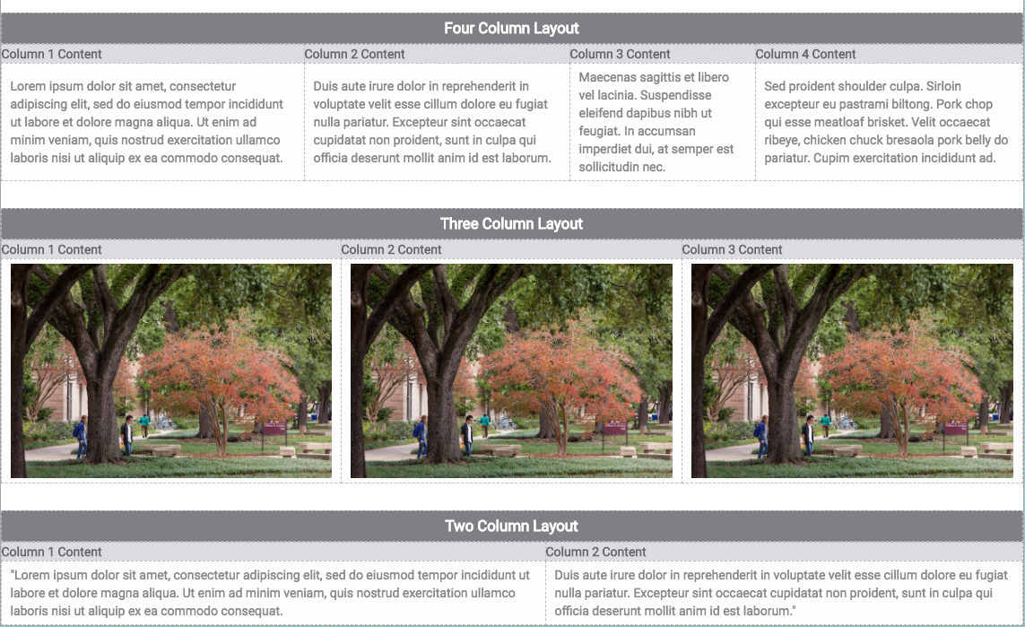
Tables

Slide 52
Publishing
Spell Check, Link Check, Accessibility Check, Free Tools

Slide 53
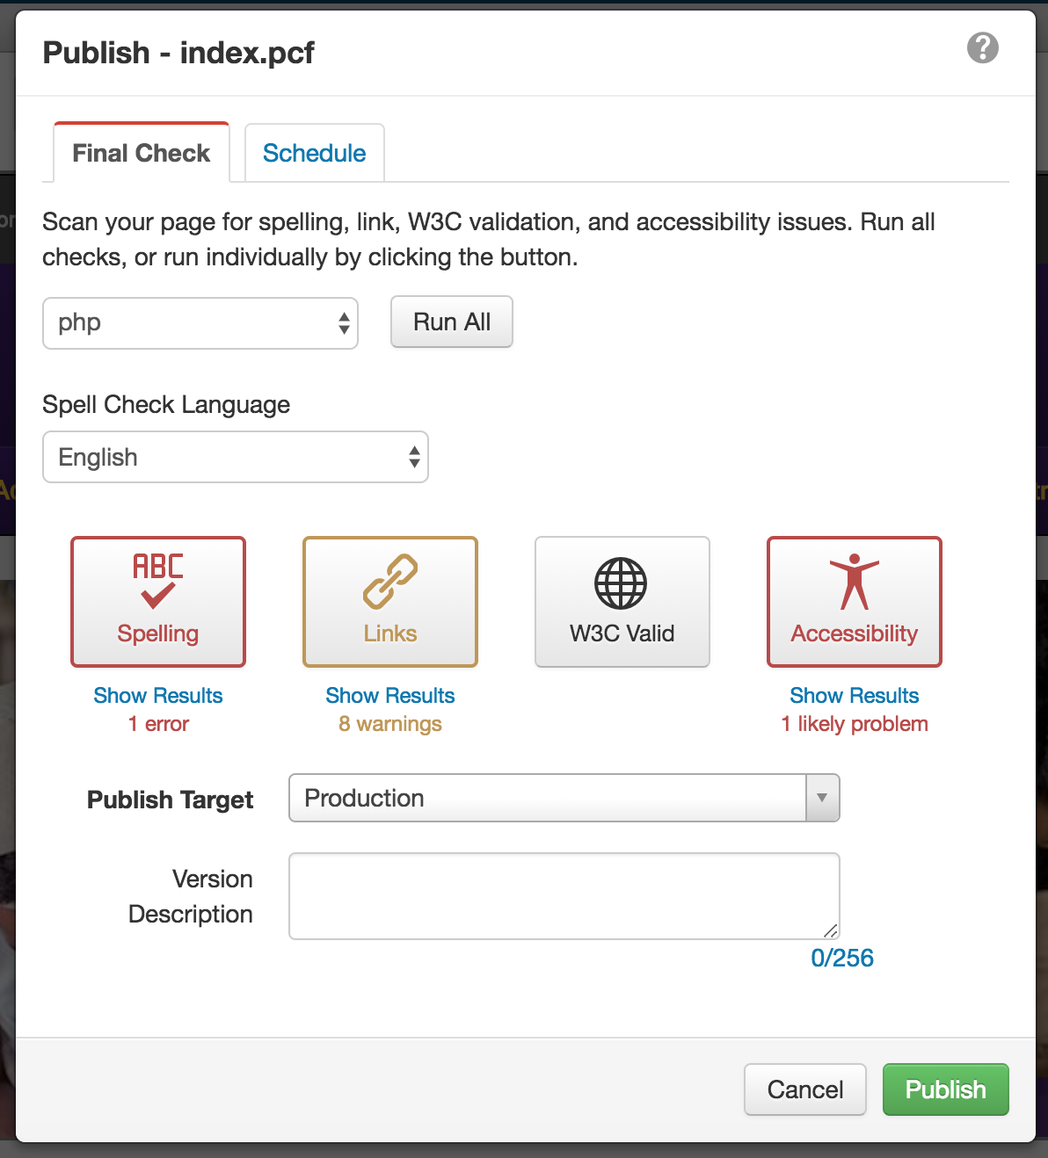
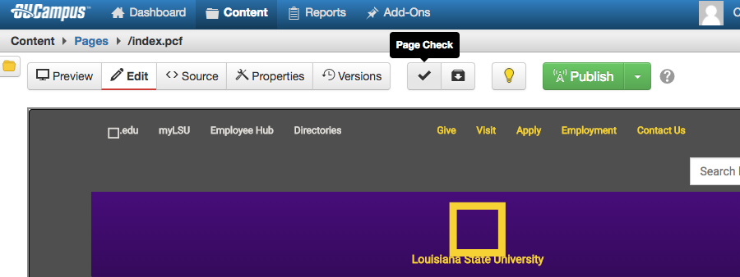
Publishing
Before submitting to publish in Omni, run spell check, link check and accessibility check

Slide 54
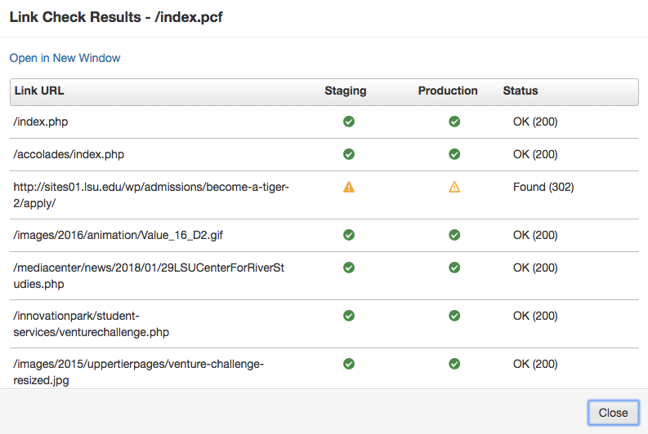
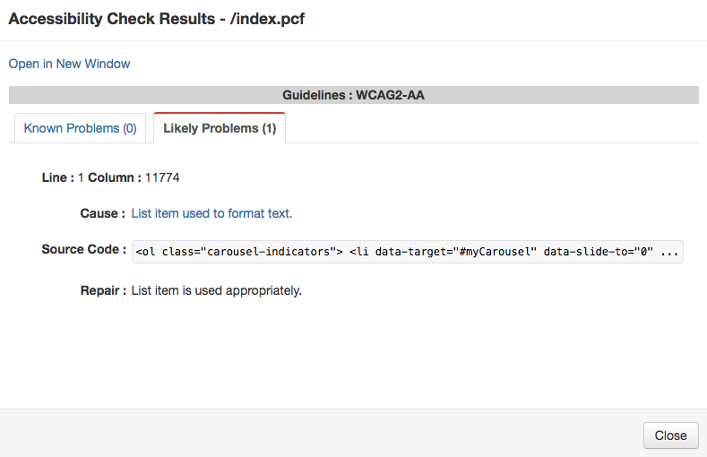
Publishing

Slide 55
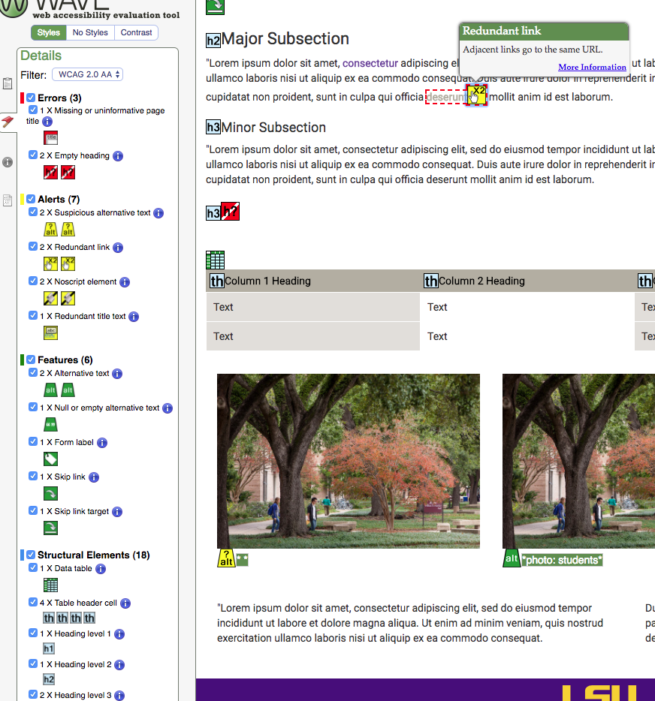
Publishing
WAVE Evaluation Tool

Slide 56
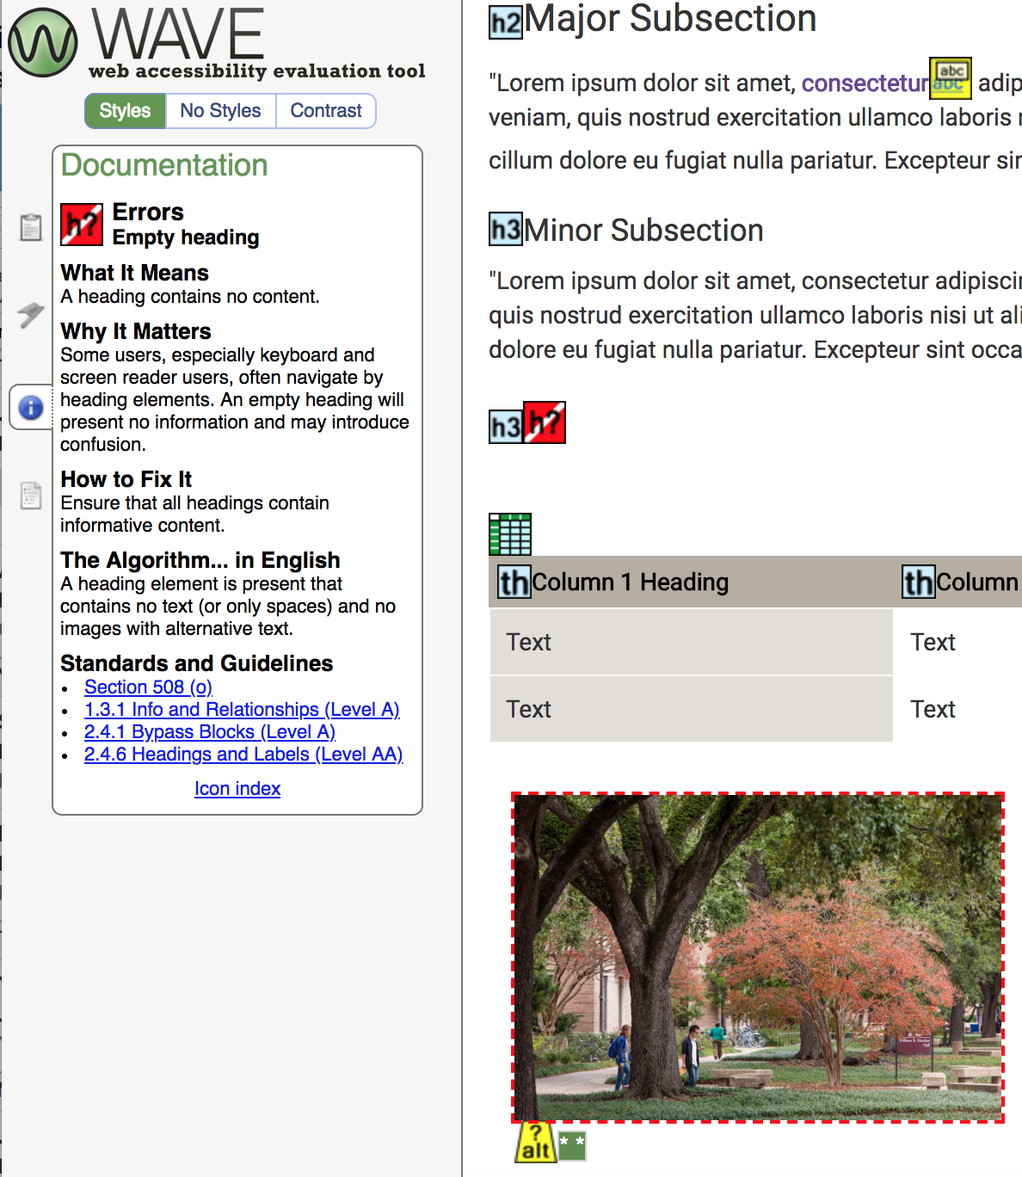
Publishing
WAVE Evaluation Tool

Slide 57
Publishing
Total Validator
HTML validator, accessibility validator, spell checker, broken link checker
Free download but requires purchase to check multiple pages

Slide 58
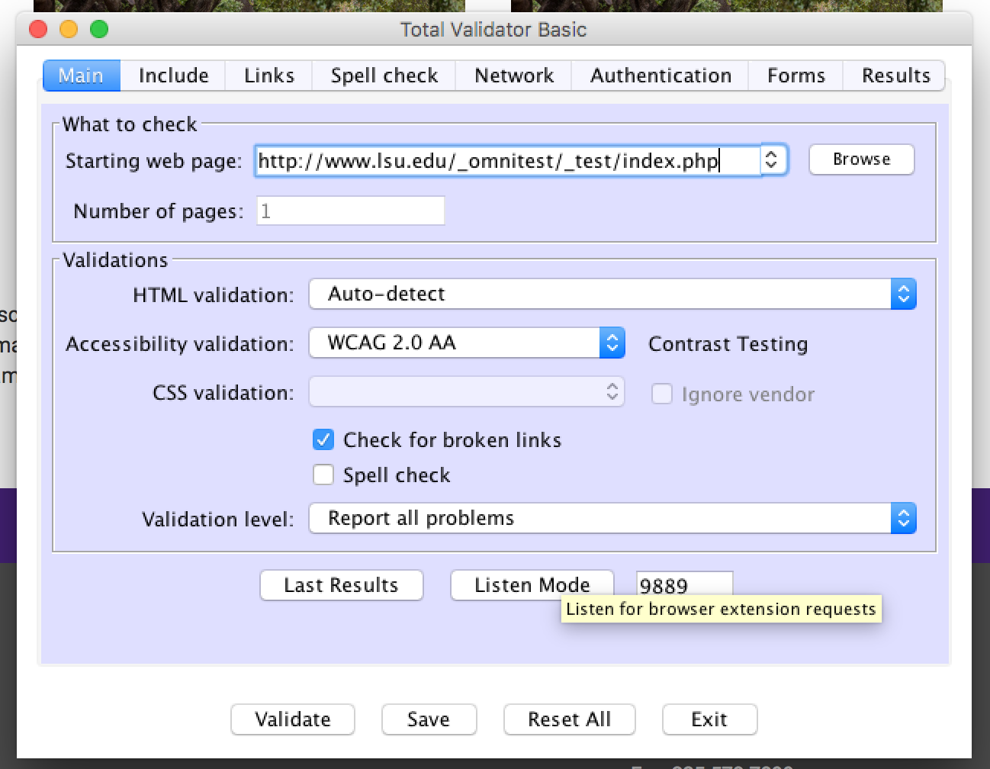
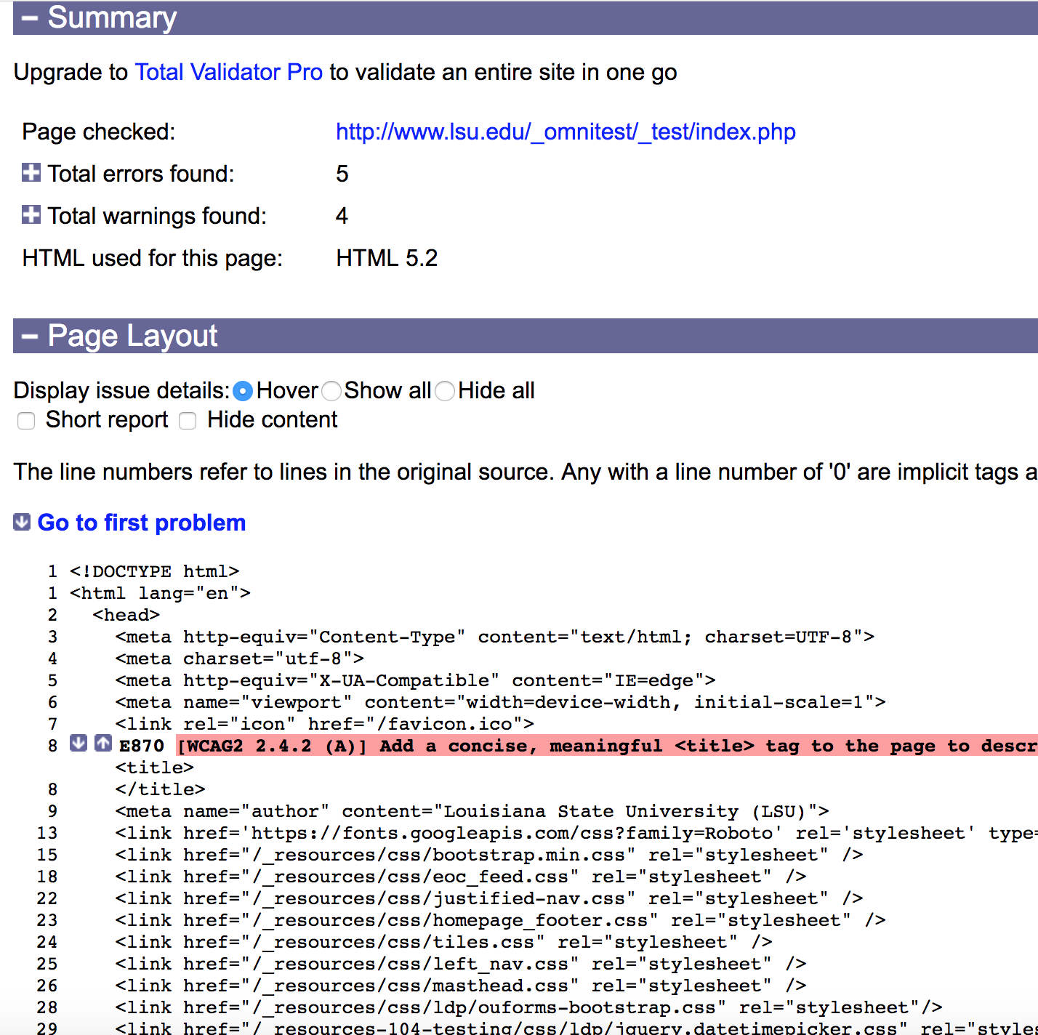
Publishing

Slide 59
Making Documents Accessible
PDFS, OCR

Slide 60
Making Documents Accessible
The core steps needed for accessibility are the same regardless of whether your document is in HTML, Microsoft Word, Adobe PDF, or another document format
Add document title
Identify document language
Use headings
Use lists
Add alternate text to images

Slide 61
Making Documents Accessible
MS Word guidelines: https://support.office.com/en-us/article/make-your-word-documents-accessible-d9bf3683-87ac-47ea-b91a-78dcacb3c66d
Adobe guidelines: https://www.adobe.com/accessibility/products/indesign.html
PDFs are only as accessible as the document from which they are created

Slide 62
Media Accessibility
Videos, Social Media, Broadcast & Marketing Emails

Slide 63
Media Accessibility
Videos
All videos must come through Strategic Communications for approval
All videos must have closed captioning or a transcript
If faculty members want to publish recordings of lectures online, they must contact the Online Accessibility Working Group to make videos or audio compliant or offer an equally effective alternate access

Slide 64
Media Accessibility
Social Media
Images must have captions
Videos must have captions or a transcript
Guidelines posted at http://lsu.edu/accessibility/

Slide 65
Media Accessibility
Broadcast & Marketing Email
Descriptive subject lines
Use headers
Use color carefully
Avoid center aligned paragraph
Text, links and images
Include plain text version when available
Guidelines posted at http://lsu.edu/accessibility/
Notes:
color
contrast
don’t use color alone to relay info

Slide 66
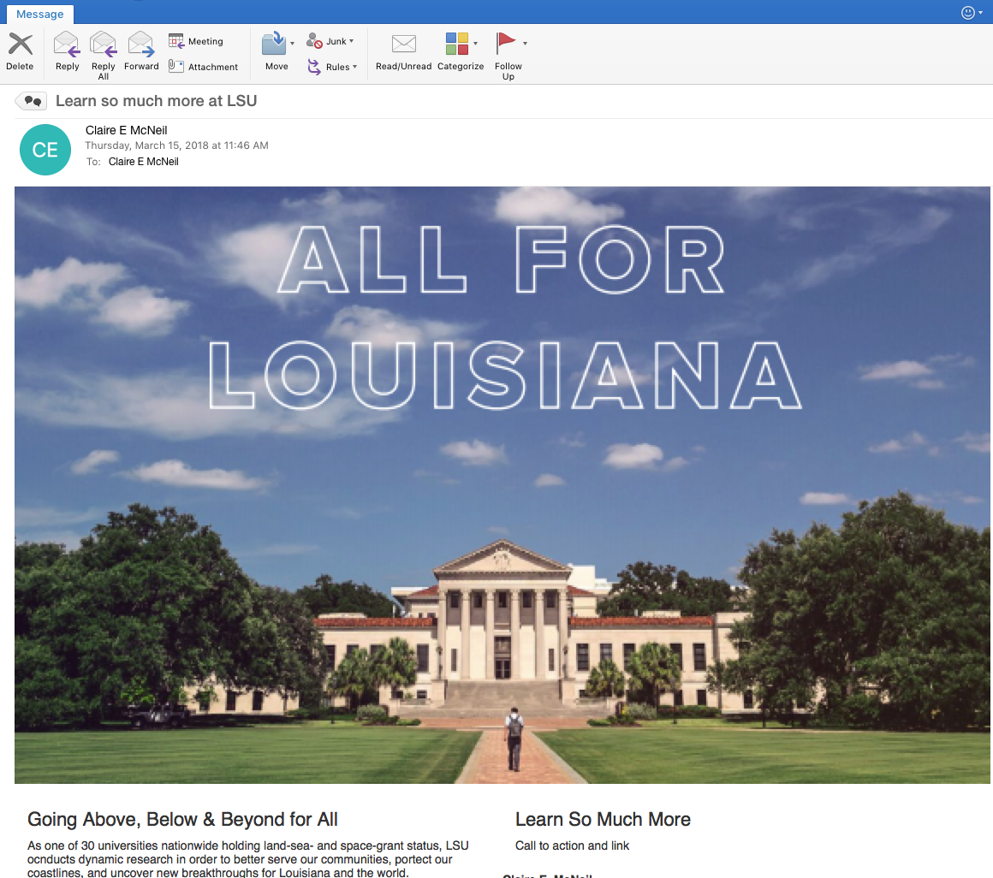
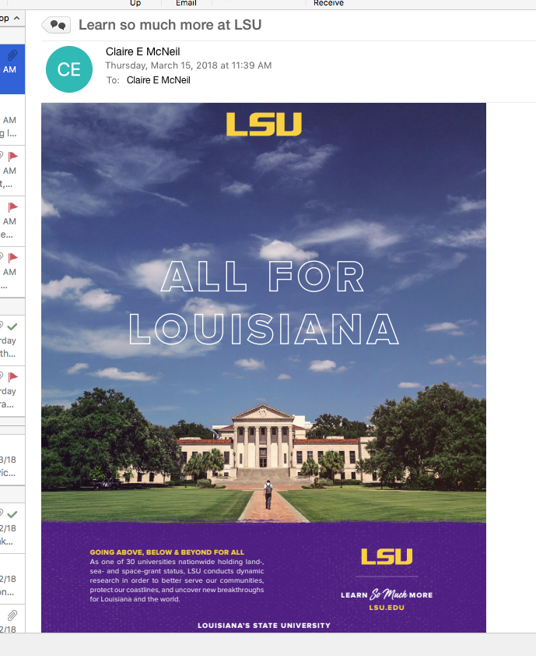
Media Accessibility

Slide 67
Next Steps
Prevent Introducing Errors, Feedback
Notes:
Prevent introduction of errors
Request for feedback
Audit is coming
Plan for New Content Approval

