Slide 1
LSU CENTER FOR
ACADEMIC SUCCESS

Slide 2
WORKING WITH CAS
Get Content Support
Optimize Learning Strategies
Want/need additional content help
Like to study in groups
Enjoy learning from peers
Want to learn “how to study”
Feel like performance doesn’t match potential
Want to improve the quality of your academic experience

Slide 3
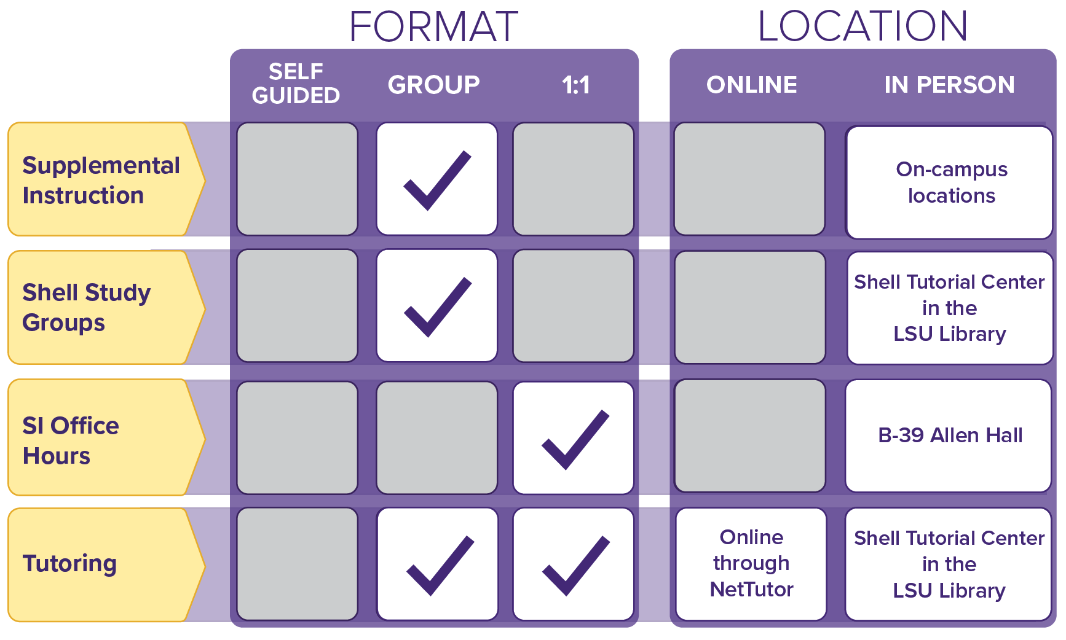
Get Content Support

Slide 4
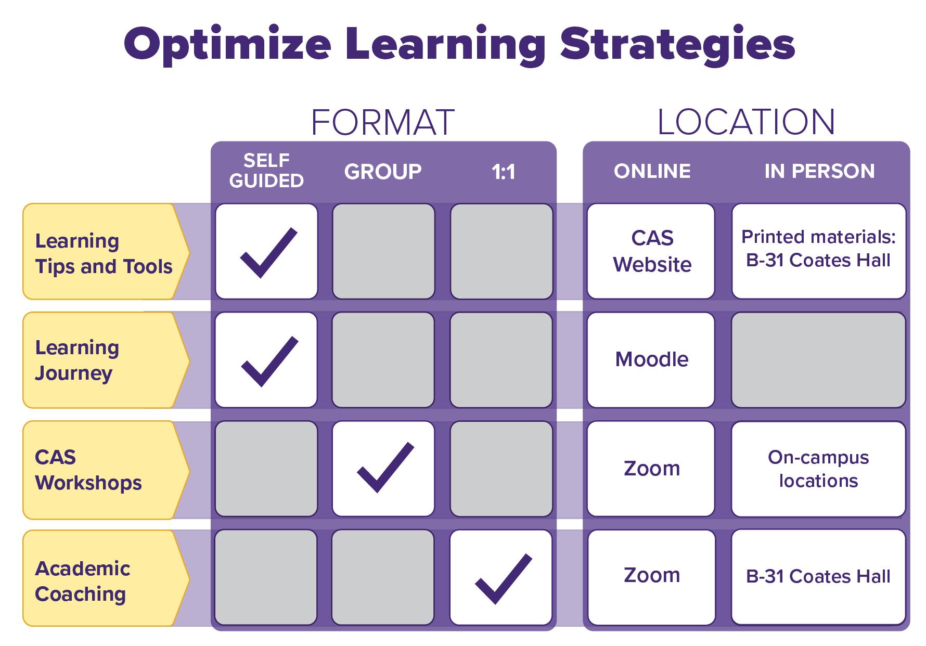

Slide 5
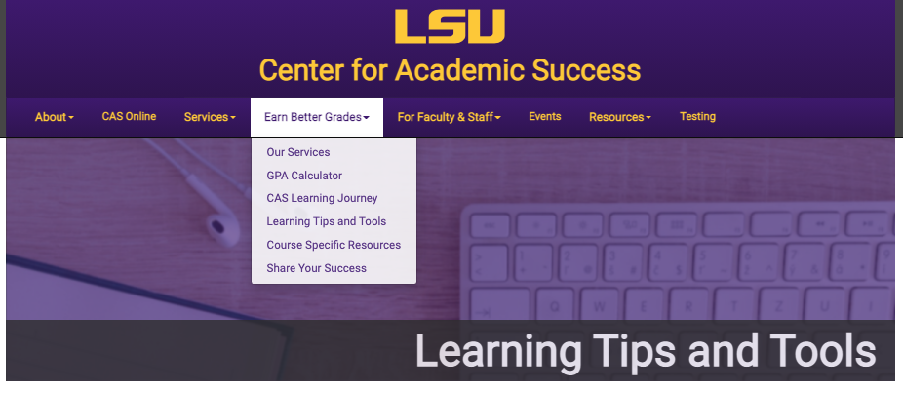

Slide 6
SIGNATURE SERIES
Learning Strategies

Slide 7
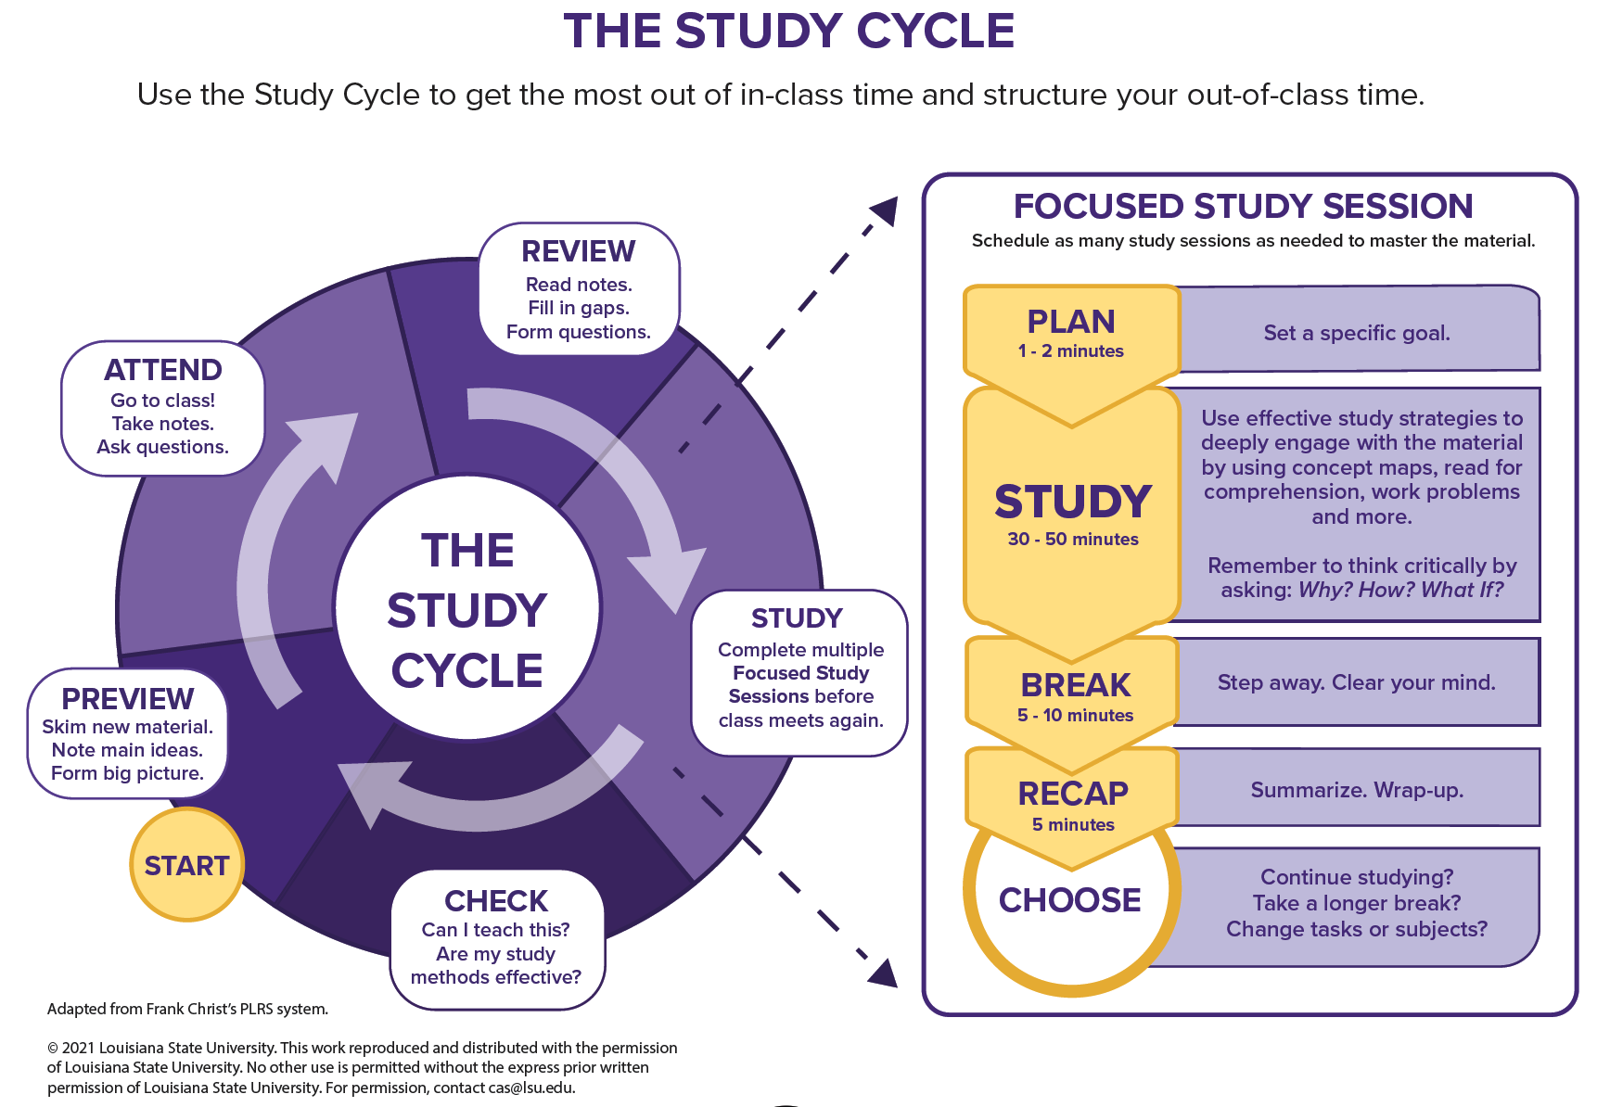

Slide 8
www.lsu.edu/cas
Service Descriptions
Appointment Scheduling
Tips and Resources

