Slide 1


LSU Center for Academic Success
Empowering Students. Inspiring Success.

Slide 2

CAS Services Video
Notes:
CAS Services Video (long version)
https://www.youtube.com/watch?v=iIyspE9-OIQ

Slide 3
CAS Services www.lsu.edu/cas
Content Support
Learning Strategies
Supplemental Instruction
Peer Tutoring*
NetTutor
Academic Coaching*
Signature Strategies Workshops*
Learning Tips and Tools
Learning Journey
All services are FREE
*by appointment

Slide 4

Signature Strategies Workshops

Slide 5


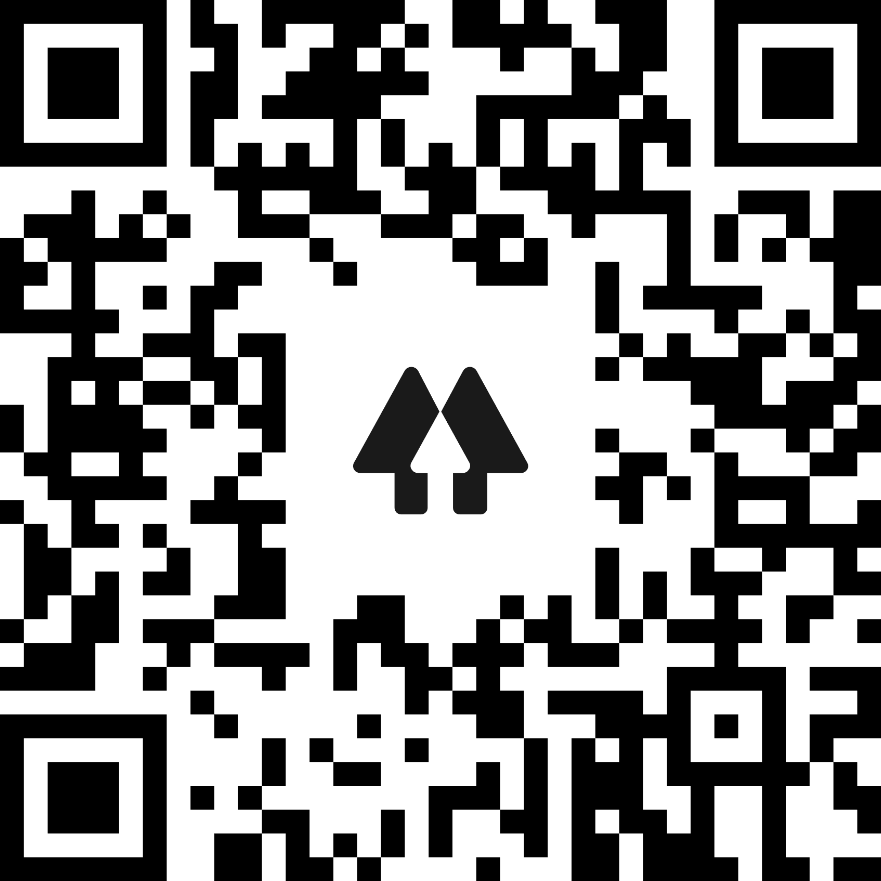

LSU CAS
Learn more about CAS services and follow us on social media
Scan the QR Code
2X NCLCA National
Center of Excellence
www.lsu.edu/cas

