Slide 1
Engaged Citizens Program

Slide 2
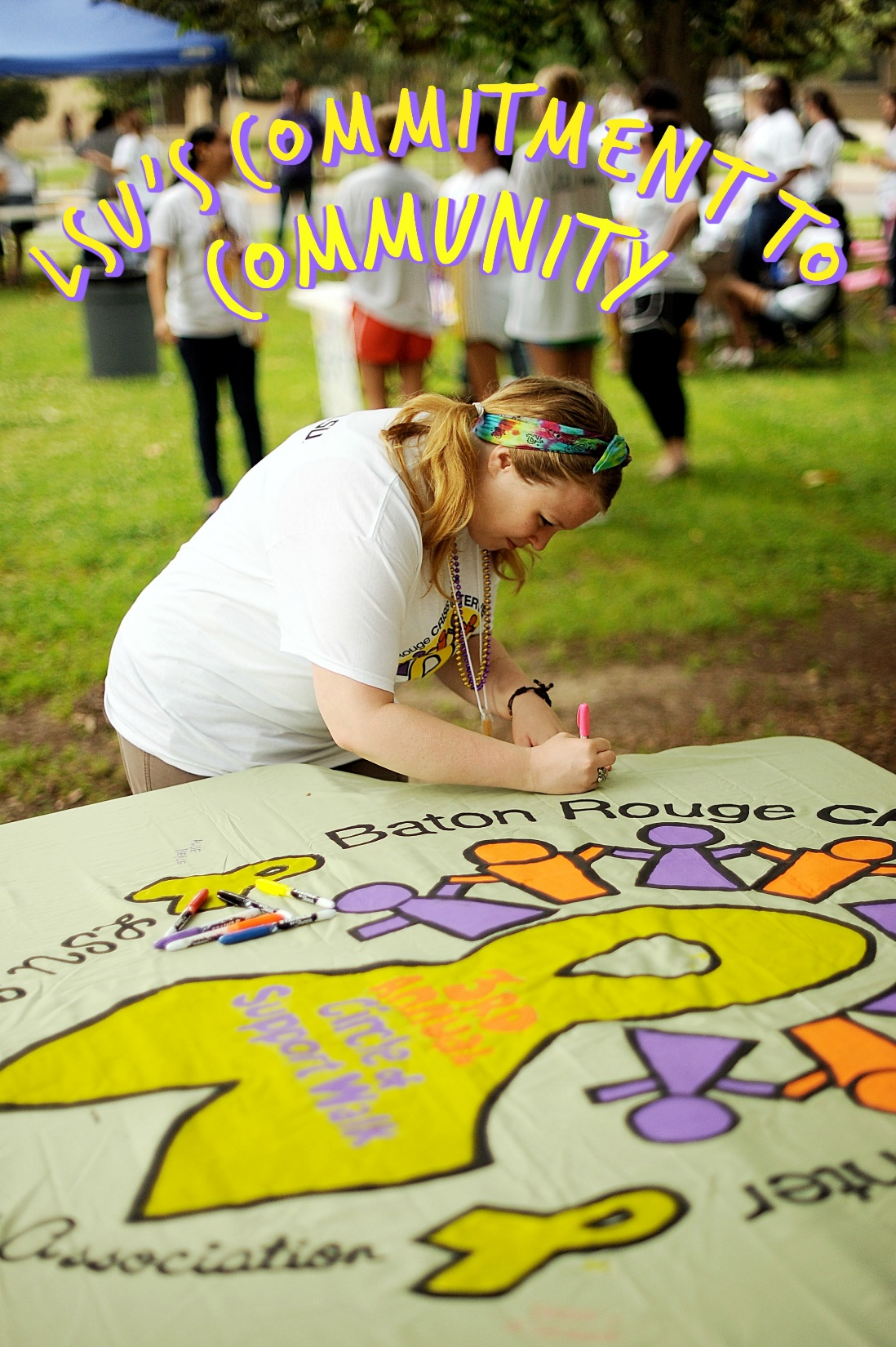
Louisiana State University is an interactive community in which students, faculty, and staff together strive to pursue truth, advance learning, and uphold the highest standards of performance in an academic and social environment.
It is a community that fosters individual development and the creation of bonds that transcend the time spent within its gates.
To demonstrate my pride in LSU, as a member of its community, I will:
accept responsibility for my actions;
hold myself and others to the highest standards of academic, personal and social integrity;
practice justice, equality, and compassion in human relations;
respect the dignity of all persons and accept individual differences;
respect the environment and the rights and properties of others and the university;
contribute positively to the life of the campus and surrounding community; and
use my LSU experience to be an active citizen in an international and interdependent world.
The continued success of LSU depends on the faithful commitment by each community member to these, our basic principles.

Slide 3
Requirements?
7 Credit Hours of Service-Learning Courses
100 Hours of Community Service
1 Reflection Paper
___________________________________________
Engaged Citizens Distinction!

Slide 4
3 service-learning courses
Service-Learning course are designated as “SVC” in the schedule request description
Students can option a course not already designated as service-learning with instructor and CCELL approval

Slide 5
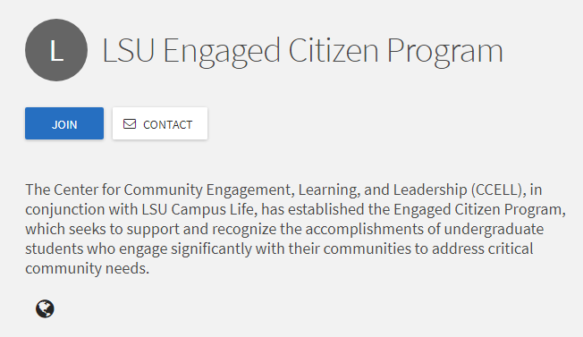
Hands-on, in person activities
Log hours in TigerLink
Join ECP on TigerLink
Input hours as you accumulate them
Include description of service, organization/community partner service was conducted with, what impact you had

Slide 6
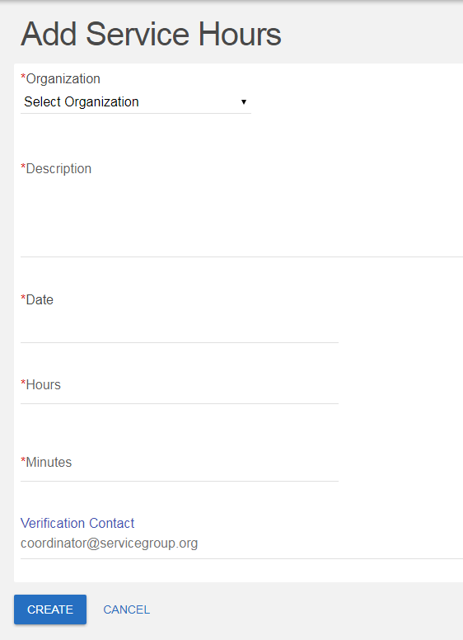
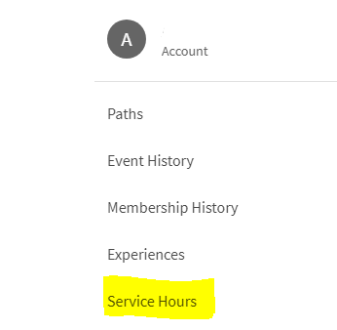
How do I log my service hours on TigerLink?
1.
M
Mike the Tiger
2.
3.

Slide 8
Ready to enroll in the program?

Slide 9
Want more information?
Visit:
lsu.collegiatelink.net (Search “LSU Engaged Citizens Program”)
Lsu.edu/engagedcitizens
Lsu.edu/ccell
Lsu.edu/campuslife
Contact:
Kristin Menson: kmenson@lsu.edu
Josh Dean: jdean@lsu.edu

